Slide 1
Applications of Neutron Scattering in Materials Science & Engineering
Andrew Payzant
Oak Ridge National Laboratory

Slide 2
What is this talk about?
In this presentation I will give an overview of how we use neutrons to solve what I will categorize as “engineering problems”, though you will see that many of these could be described as complex materials science problems

Slide 3
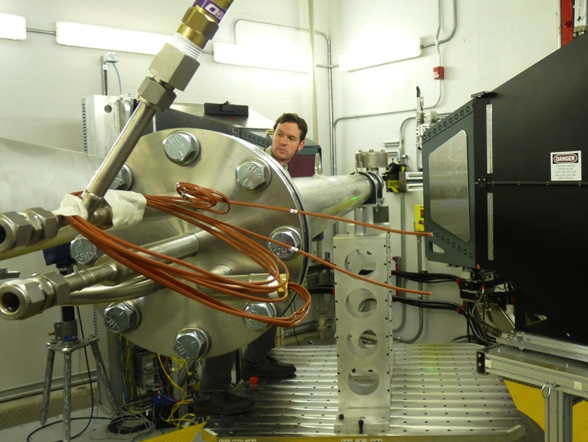
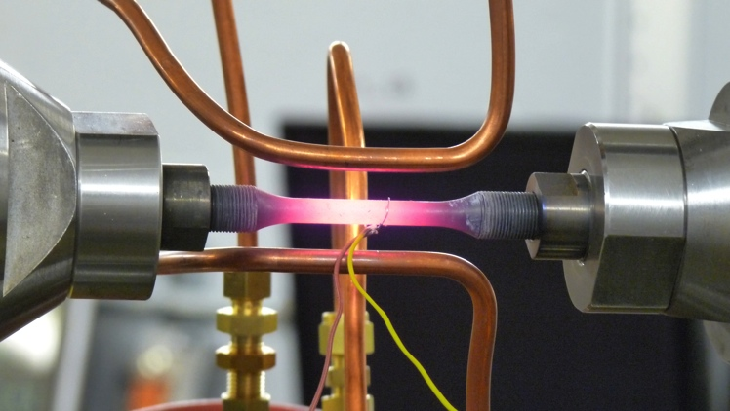
These are the sort of experiments I will cover
Residual stress / phase mapping
In-situ diffraction under thermomechanical loading.
In-operando measurement.
Residual stress determination of large engineering components. Picture shows mapping an ITER cable in a cryogenic chamber.
The temporal evolution of lattice strain during in-situ thermomechanical testing provides insights into the micromechanism at the local levels.
Neutron diffraction probes the degradation of large format batteries.

Slide 4
My background…
I came to ORNL in 1995 as a postdoc, having completed my graduate education in Canada with degrees in physics (BSc), engineering physics (BEng), and engineering science (PhD)
My postdoc was mainly developing a dedicated residual stress mapping instrument, using time on a TAS (HB-2) at HFIR
The prototype instrument (NRSF) became a dedicated instrument NRSF2 (HB-2B) following the HFIR Be reflector replacement in 2001-2003
I have had various roles at ORNL since becoming staff in 1997, in MSTD, CNMS, and returning to neutron scattering in 2012
Now lead Materials Engineering Group in Neutron Scattering

Slide 5
Credits (credit where credit is due)
As always, the work presented here represents the contributions of many staff and Users. I will try to credit them as I go along.
In particular, I should acknowledge Ke An, Ducu Stoica, Yan Chen, Dong Ma, Dunji Yu, Jeff Bunn, and Chris Fancher
Also Harley Skorpenske, Matt Frost, and Paris Cornwell
And many others…

Slide 6
Important problems in Materials Science/Engineering
Our modern world is enabled by technologies which depend on a sophisticated understanding of advanced materials and processes to manufacture “stuff” to enable:
  Transportation (automobiles, aircraft, ships, spacecraft, etc.)
  Buildings
  Infrastructure (power grid, pipelines, roads, tunnels, bridges, etc.)
  Energy production (fossil, nuclear, hydro, wind, tide, solar, etc.)
  Energy storage
  etc.
At ORNL we apply neutron scattering techniques to help understand materials better and so make better “stuff”!

Slide 7
What more specifically am I talking about?
An understanding of the(Micro)Structure – Property relationship is essential. This allows you to modify the material to achieve the desired properties
  A good example is the aluminum beverage can. This consumer product that we use and throw away/recycle is the end product of an incredibly complex process to create an aluminum alloy sheet that can be drawn into a thin-walled can without cracking
In this talk most of my examples will be metal alloys, but you should be able to see how these concepts and methods could extend to ceramics, glasses, polymers, etc.

Slide 8
So what are some important structural parameters?
Phase(s) - crystal structure(s)
  In the case of multiphase materials, the phase fraction is important
  Solid-solution / alloy chemistry (what atoms are where)
Grain size and shape
Preferred orientation / texture
Residual stress
etc.

Slide 9
And finally, why use neutrons?
You all should be able to answer this, so I will ask you now!

Slide 10
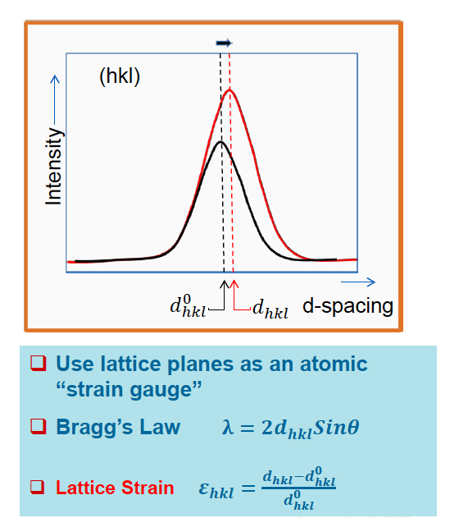


Shift in Bragg peak position = strain
Stress Free Sample
Incident
Neutrons
Diffracted
Neutrons
Applied Tension
$$σ$$
$$σ$$

Slide 11


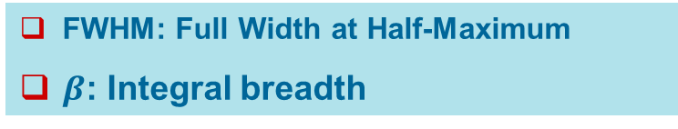
Peak width/shape = size, microstrain, dislocations…
Stress Free Sample
(hkl)
Incident
Neutrons
Intensity
Diffracted
Neutrons
d-spacing
Applied Tension
FWHM: Full Width at Half-Maximum
$β$: Integral breadth
$$σ$$
$$σ$$

Slide 12
Peak intensity = texture and/or phase changes
Powder sample
(hkl)
Incident
Neutrons
Intensity
Diffracted
Neutrons
d-spacing
Applied Tension
Change in integrated peak intensity due to grain rotation, leading to texture development.
Use inverse Pole Figure to represent texture.
$$σ$$
$$σ$$

Slide 13

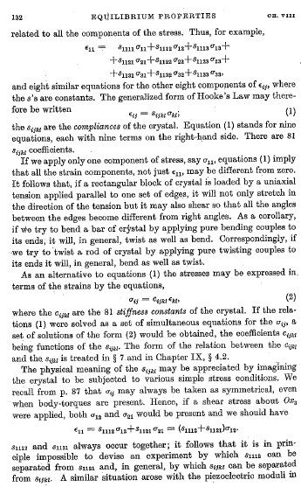
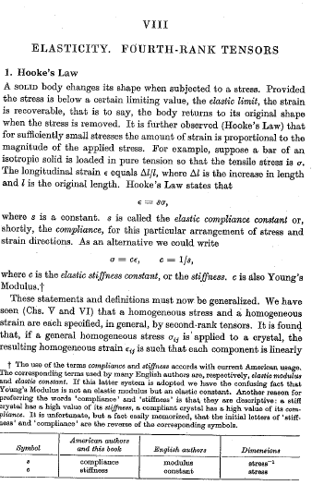
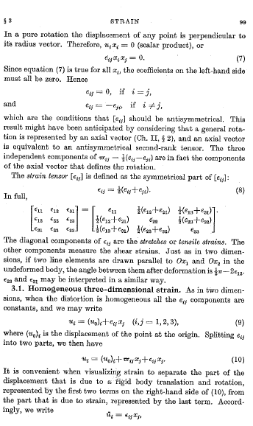
Note that Stress and Strain are tensors!

Slide 14
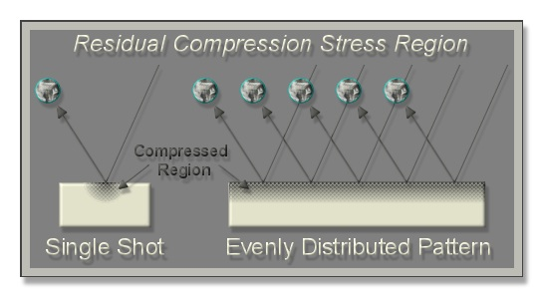
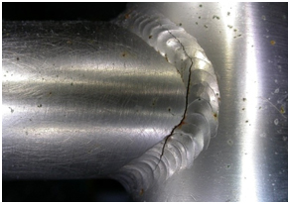
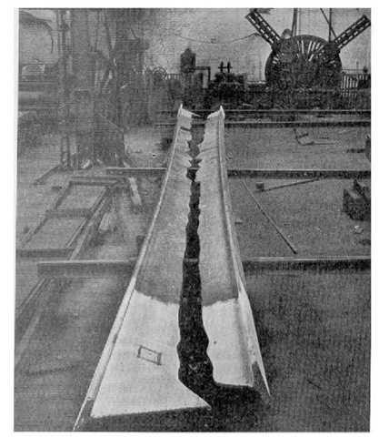
Residual stresss can be desirable, or not…
Bad: Sometimes, processing materials (e.g. welding) introduces stresses that induce cracking and failure
Good: Shot-peening is a method of introducing wanted compressive stress at the surface of materials.
Ugly: relaxation of residual stress can also cause failure. This is a giant I-beam that split from this effect

Slide 15
How do we measure stress with neutrons?
We don’t, at least not directly
We measure the shift of Bragg peaks
Strain is determined from the relative change in lattice spacing from that of a “stress-free” reference
The direction of the strain is given by the instrument and sample geometry
A map of strains in three orthogonal directions can give the stresses, if you know the elastic constants for the material

Slide 16
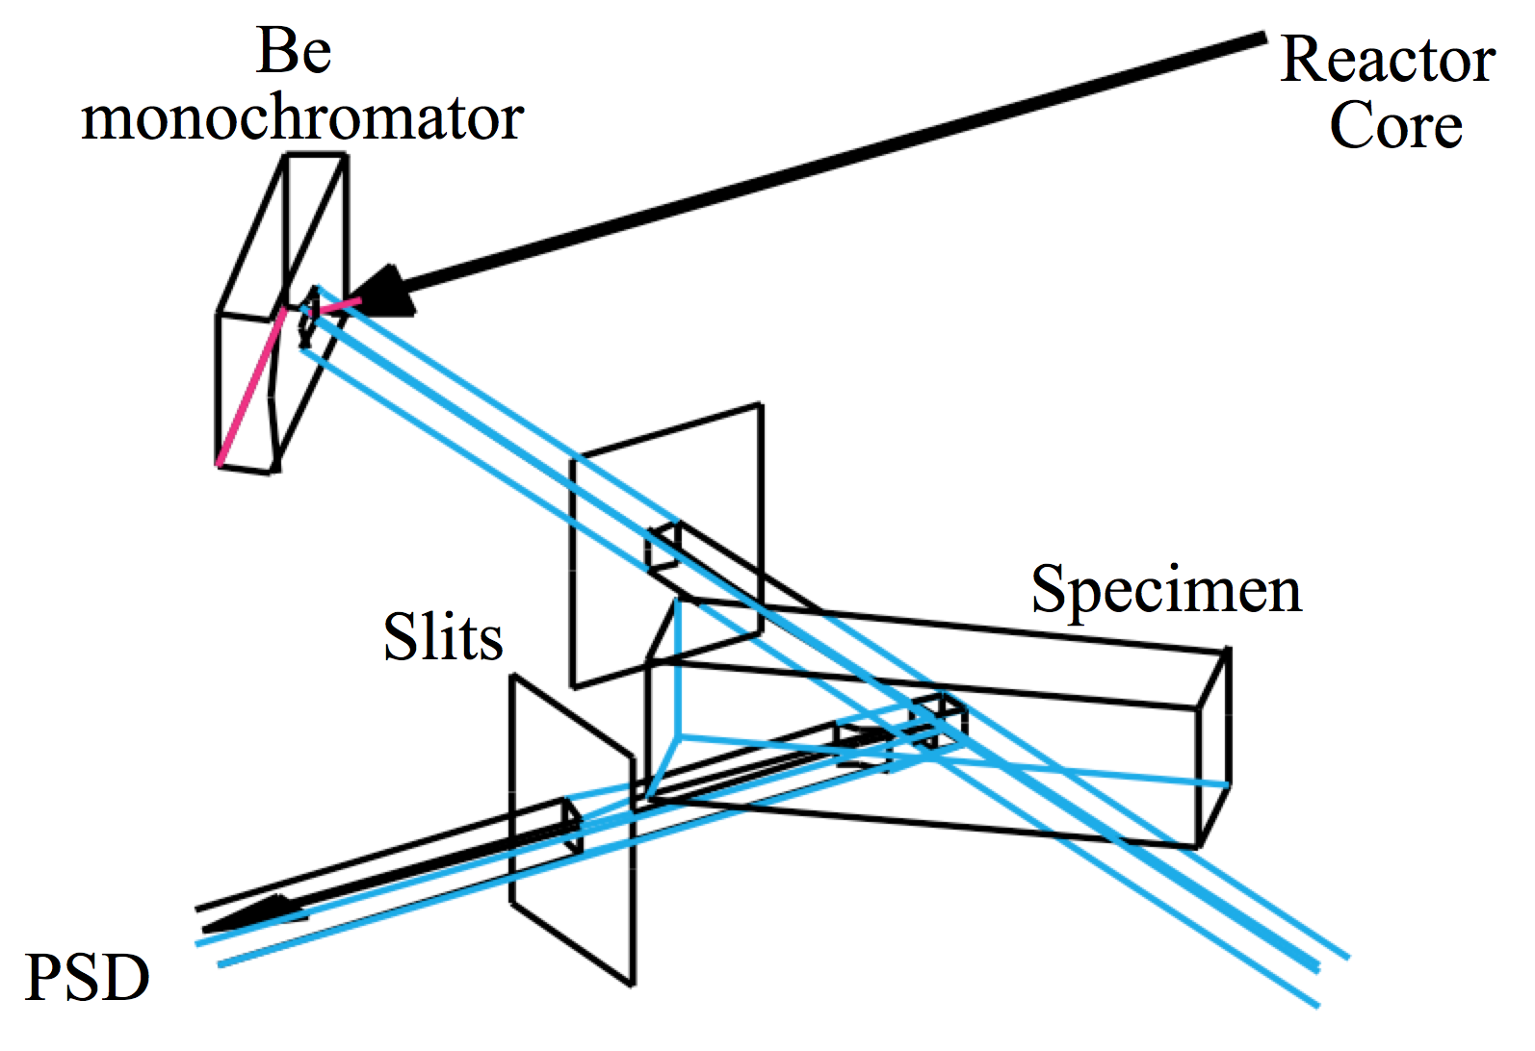
How do we “map” strains?
We use fine slits to define/collimate the incident and diffracted neutron beams to just a few mm².
This defines a local “gauge volume” from which the diffraction occurs (and the direction)

Slide 17
ORNL residual stress mapping early history
In 1991/92, three ORNL researchers, Cam Hubbard, Steve Spooner, and Stan David collaborated on a LDRD proposal to build a “proof of concept” neutron residual stress mapping instrument at HFIR using the HB-3 triple axis spectrometer, with advice and assistance from John Root (AECL)
Following the success of the demonstration experiments, a dedicated neutron stress mapping instrument NRSF was built

Slide 18
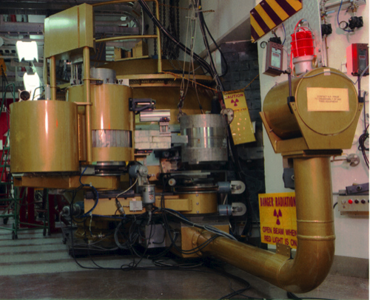
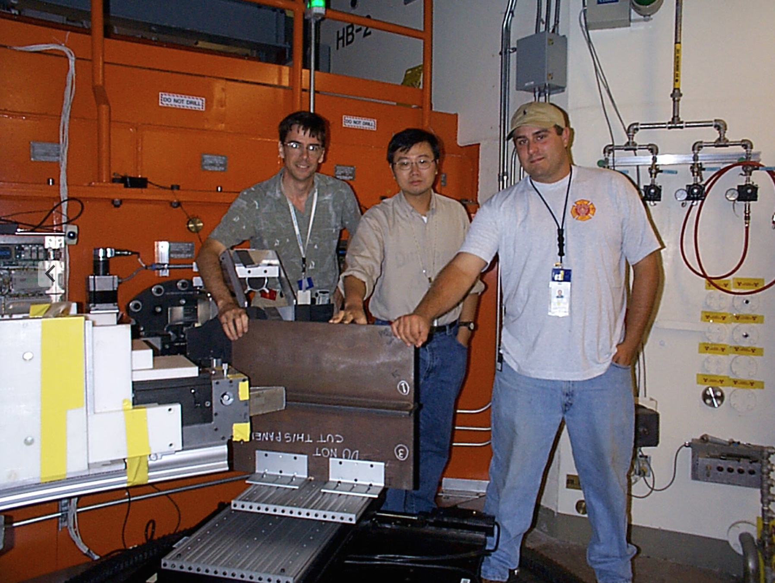
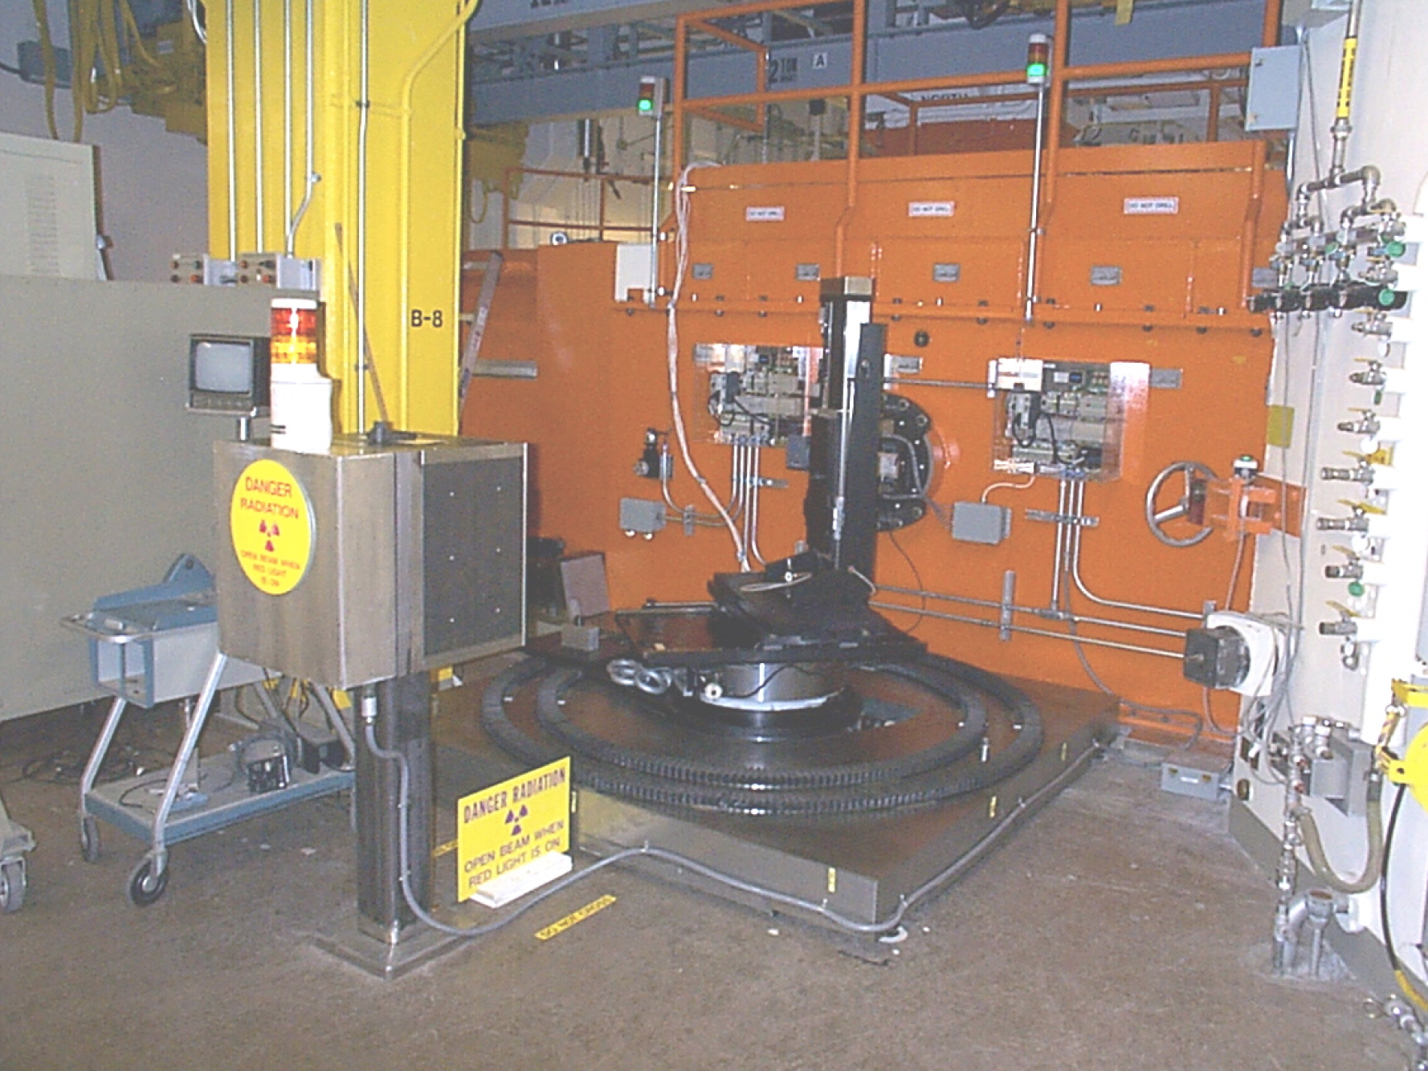
Evolution of NRSF to NRSF2

Slide 19
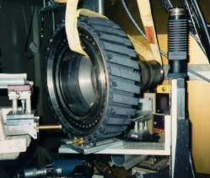
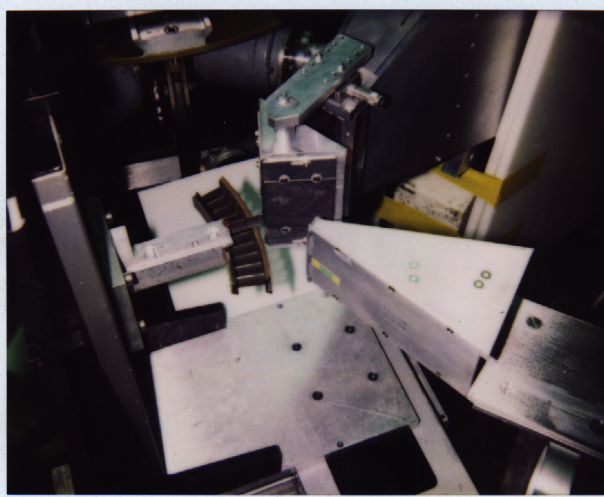
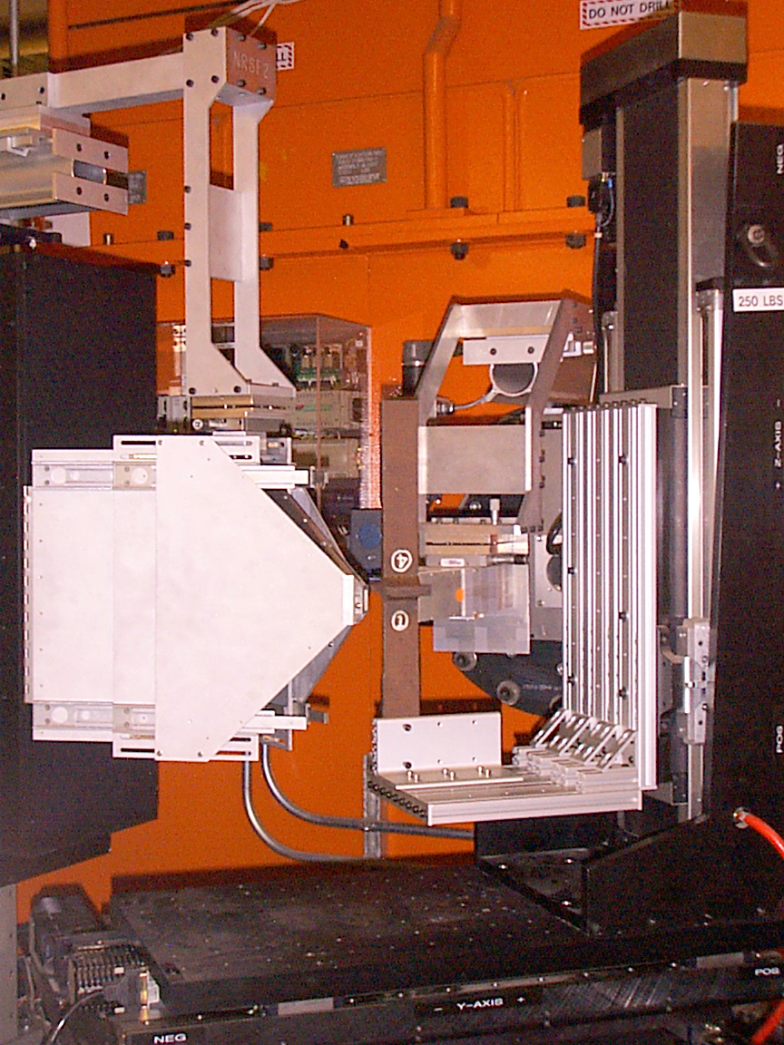
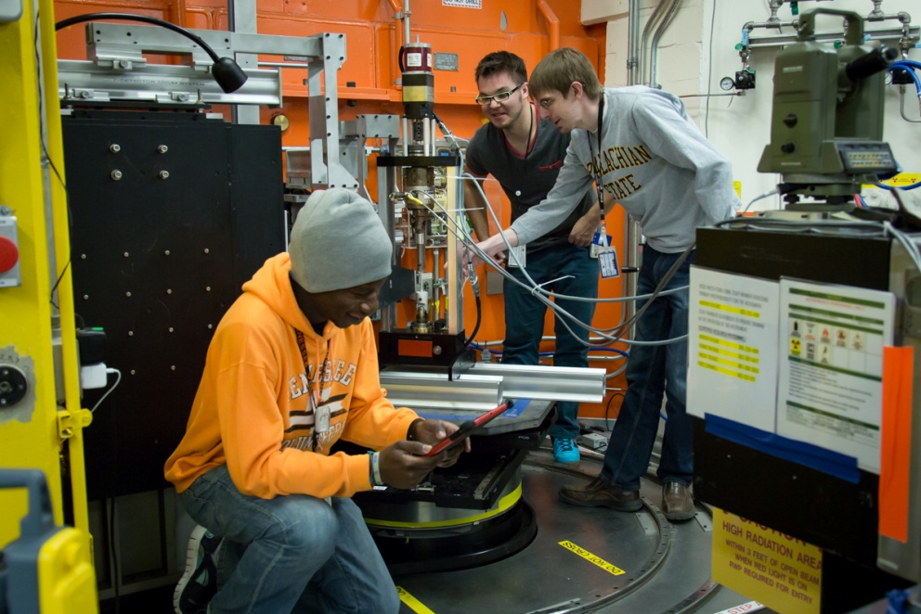
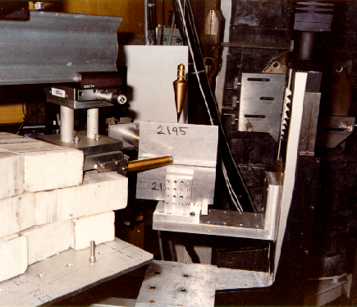
NRSF2 covers a wide array of engineering problems
400 lb Ti-6Al-4V jet engine fan blade hub
F414A jet engine nickel superalloy stator vane segment
Shape memory alloys under applied multiaxial loading
Welded 2195 aerospace aluminum-lithium alloy
Welded steel cruciform samples

Slide 20
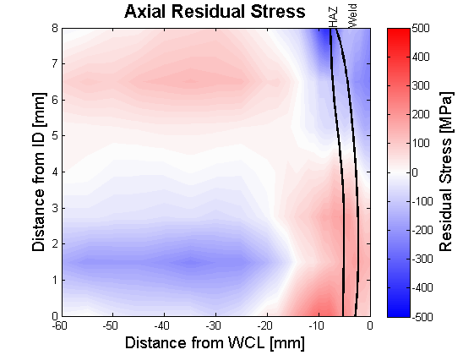
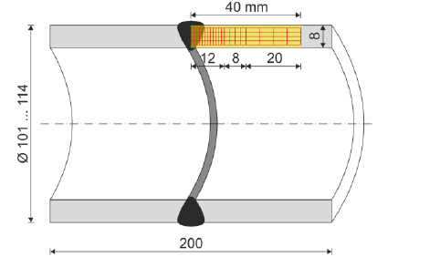
Neutrons provide a nondestructive bulk probe of strain
Surface Stresses Mapped with XRD
Interior stresses mapped with ND
N. Hempel, TU Braunschweig, Unpublished Data
Surface stresses are better studied by XRD, bulk by ND

Slide 21
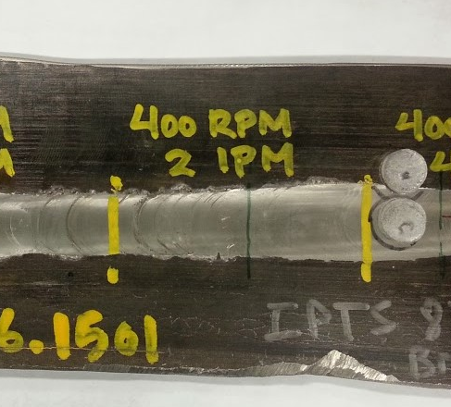
Strain mapping example – FSW ODS alloy
2D Mapping
Powerful mapping capability to find stress/strain concentrations, or more commonly to validate FEM results

Slide 22
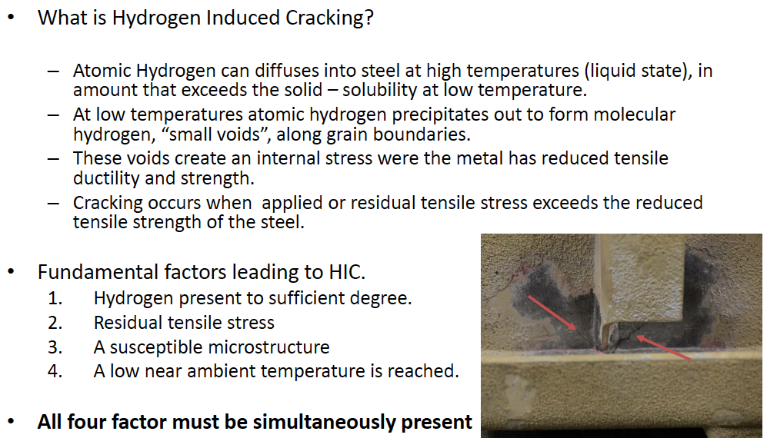
Understanding and controlling welding stresses are of very high importance

Slide 23
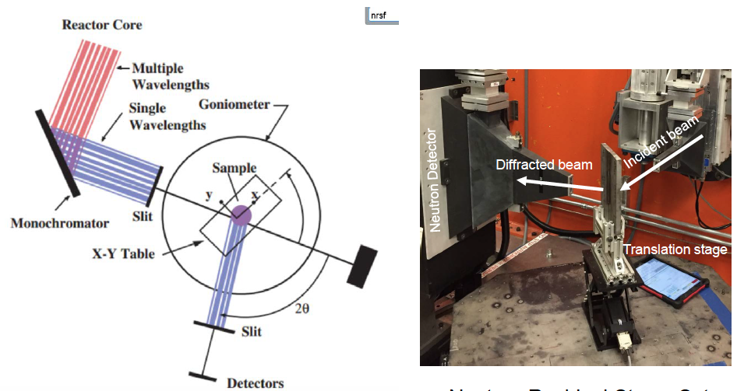
NRSF2 mapped the strain distribution

Slide 24
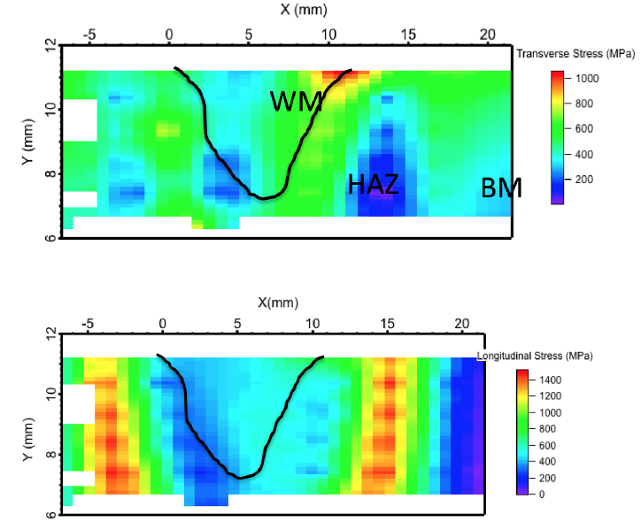
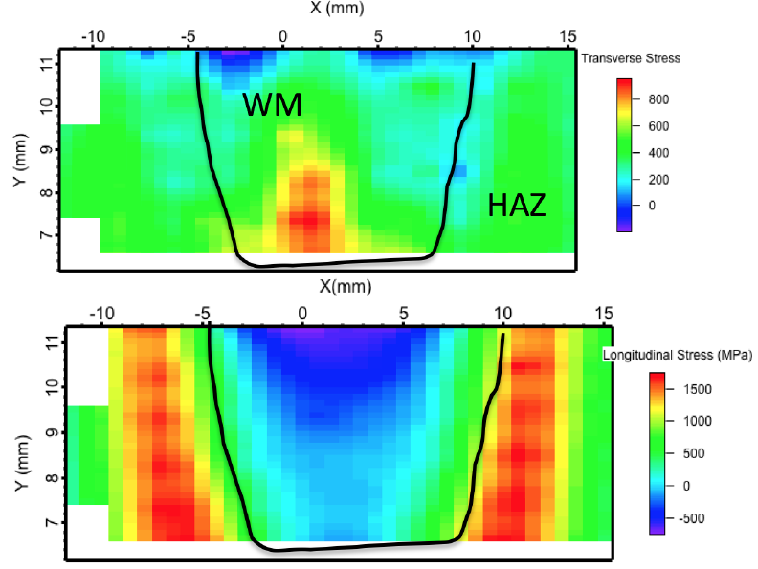
Changing weld wire composition made big impact
Note lower magnitude of stresses with experimental filler wire (right) compared to conventional wire (left)

Slide 25
ORNL engineering beamline at SNS
Based on experience at NRSF, and having seen new TOF neutron instruments commissioned at ISIS, Lujan, etc., it was clear that there was need for a new “engineering beamline” at the SNS.
The new instrument, named “VULCAN” after the Roman god of metalworking, was built with important funding contributions from the Canadian government and also DOE-EERE.
VULCAN was designed to do much more than strain mapping, and to handle more complex sample environments.

Slide 26
VULCAN beam layout
High Resolution:
High Intensity:
Chopper speed: 60, 30, 20 Hz
Curved guide reduces background
Long path (60m) provides needed resolution

Slide 27
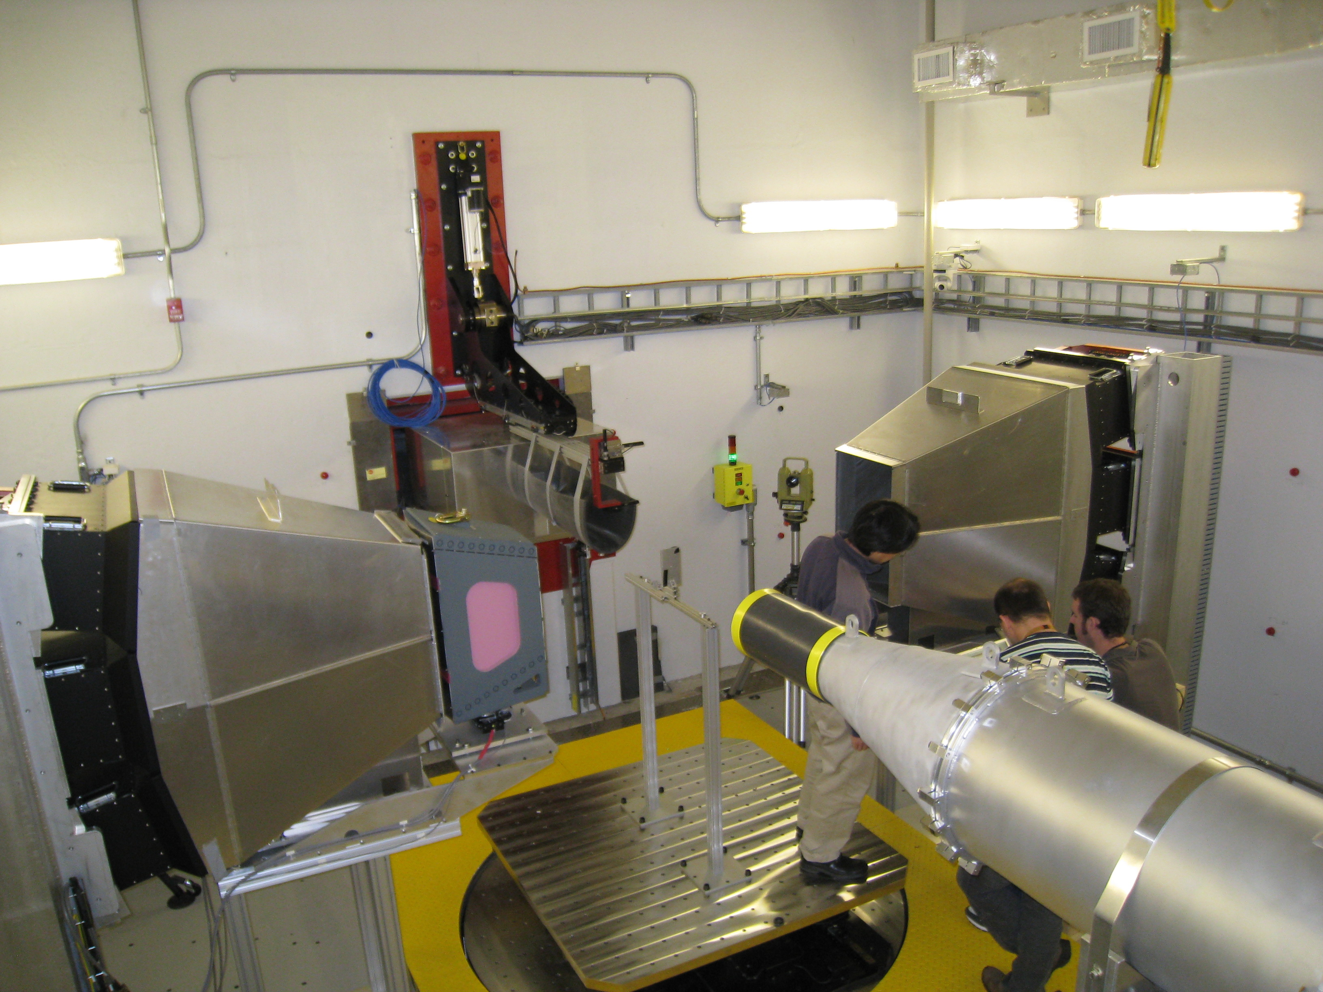
VULCAN instrument cave
Able to handle large samples and sophisticated sample environments
Detector banks at ±90 deg allow collection of two orthogonal directions simultaneously
Detector
Bank2
Sample
Detector
Bank1
Collimator
Get-lost tube
Sample Table

Slide 28
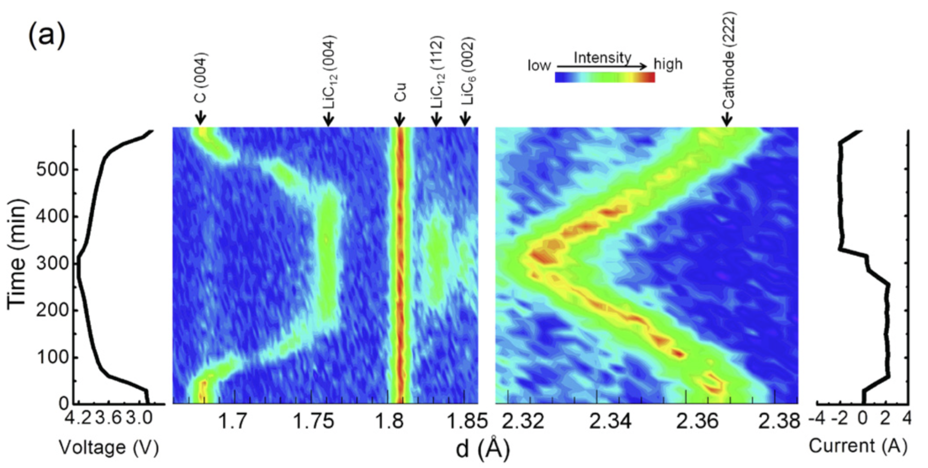
VULCAN does more than ”just stress”
Lu Cai et al., J. Power Sources 236, 163 (2013)

Slide 29
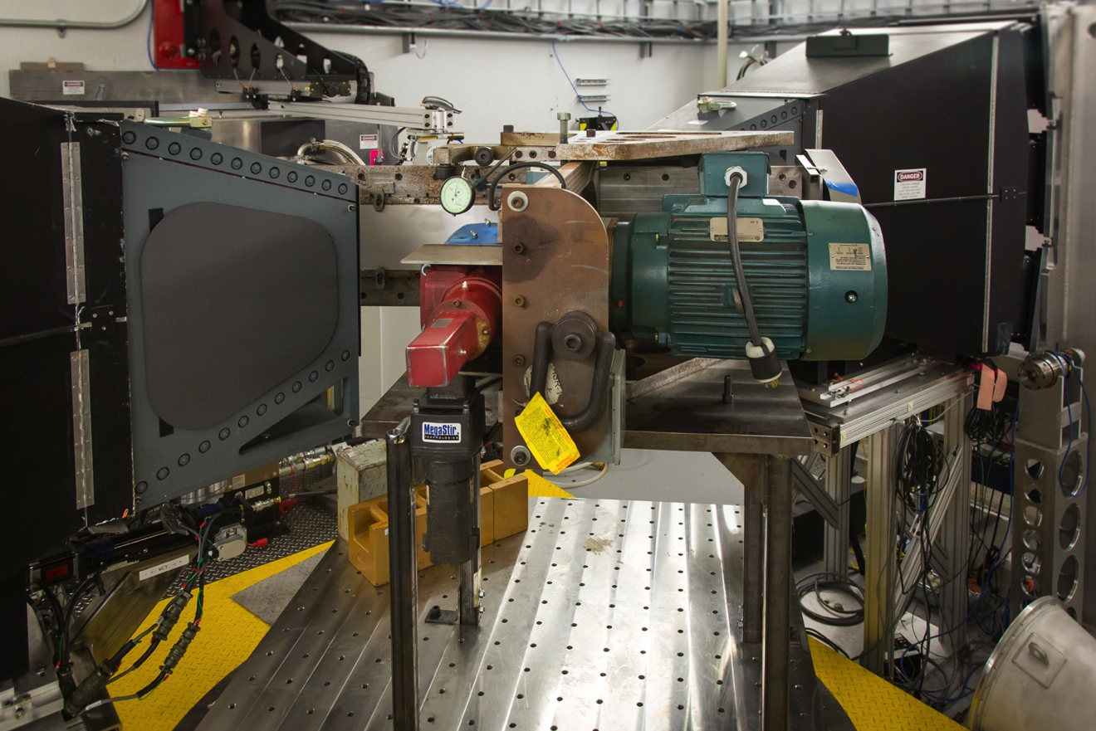
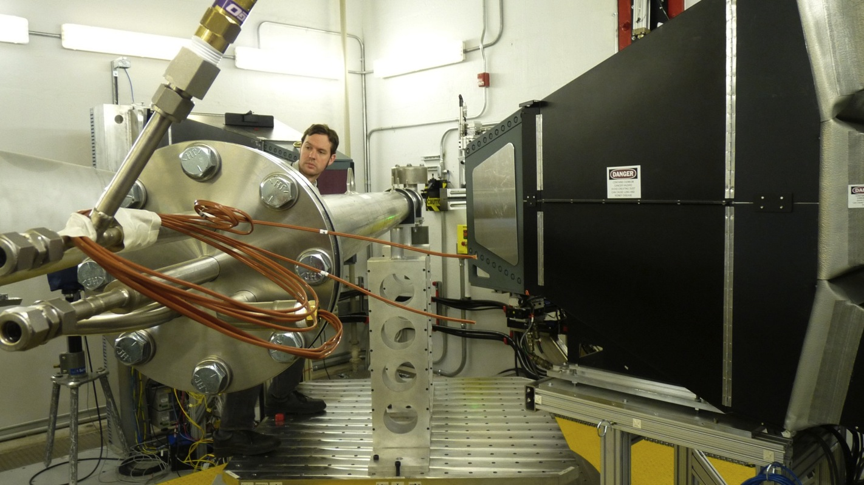
Large sample space enables flexible/unique sample environments
Friction Stir Welding
  Specially-built friction stir welder designed by ORNL MS&T Welding Group to run on VULCAN enabled in-situ studies of the FSW process.
ITER superconducting cables
  Specially-built cryostat designed by ORNL ITER project to test samples on VULCAN enabled in-situ studies of the superconducting cable at operating temperatures

Slide 30
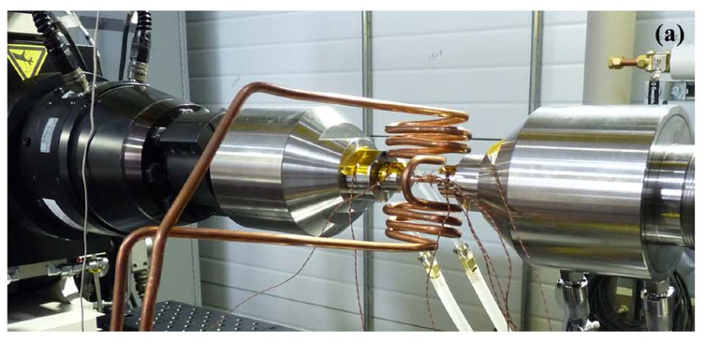
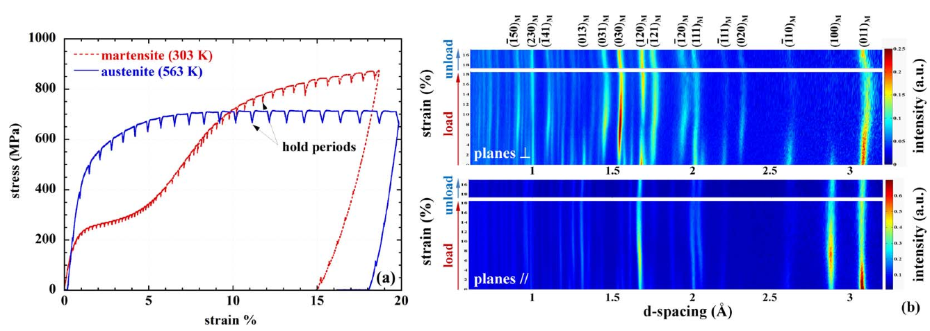
VULCAN offers multiaxial loading at high temperature!
Multimodal capabilities enable studies of materials response under processing and/or operating conditions
  Effect of temperature and multiaxial (torsion + tension) loading on NiTi shape memory alloy
Benafan et al. Rev Sci Instrum 85 103901 (2014)

Slide 31
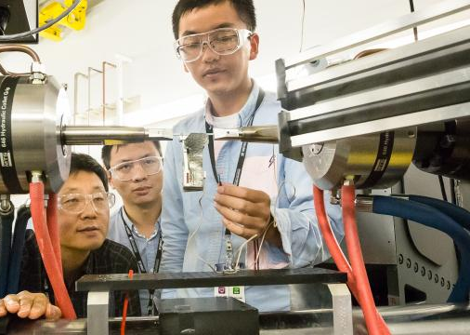
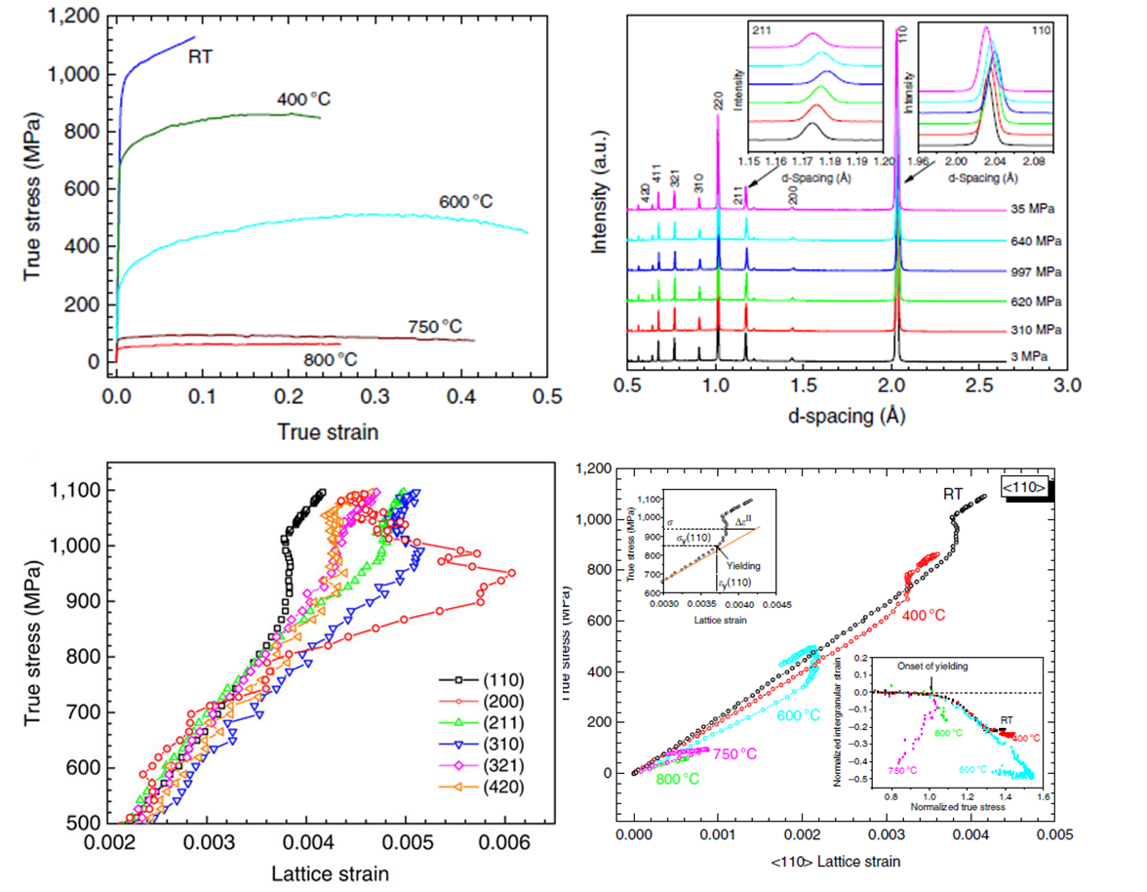
VULCAN opens new areas of neutron-based materials science and engineering research
Macro response
Multi-peak analysis
Vulcan Strengths:
Large sample environment
In-situ studies
Thermo-mechanical studies
Multiphase material studies
Stoica, G.M., et al. "Temperature-dependent elastic anisotropy and mesoscale deformation in a nanostructured ferritic alloy." Nature Communications 5 (2014).
Isothermal mechanical
Thermo-mechanical

Slide 32
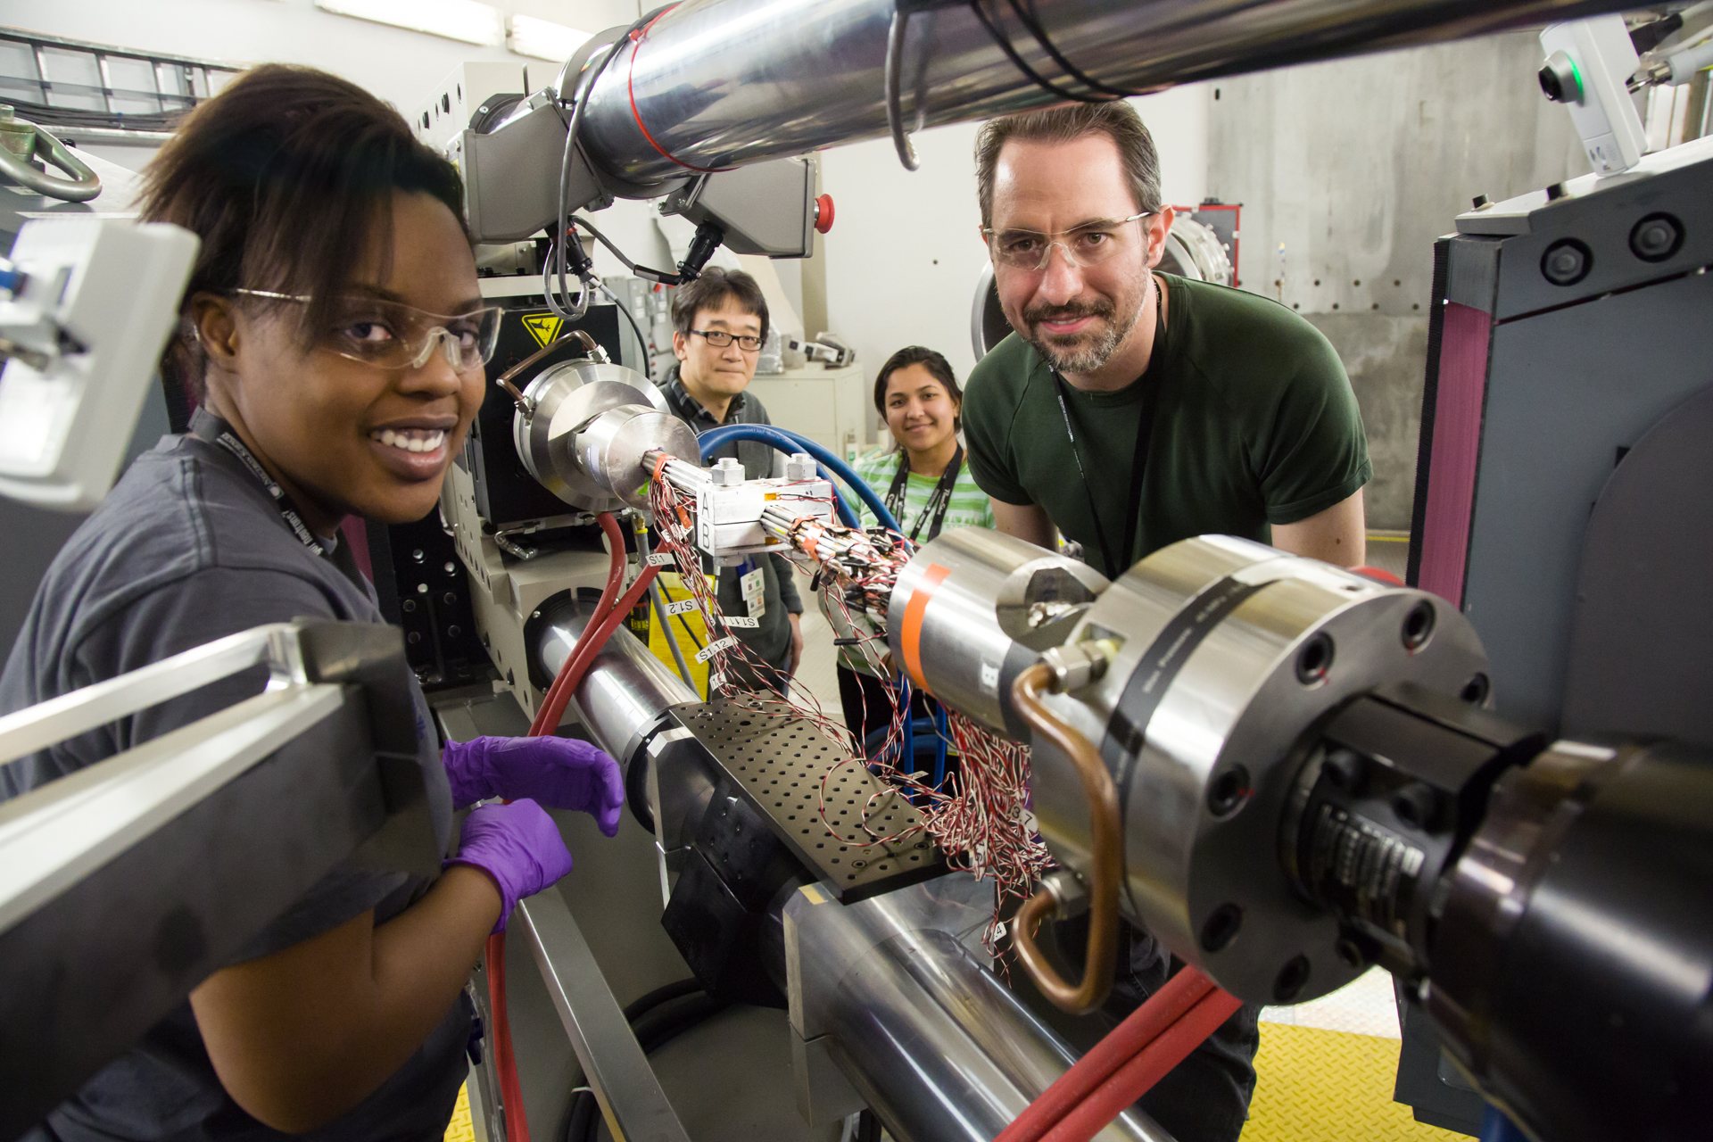
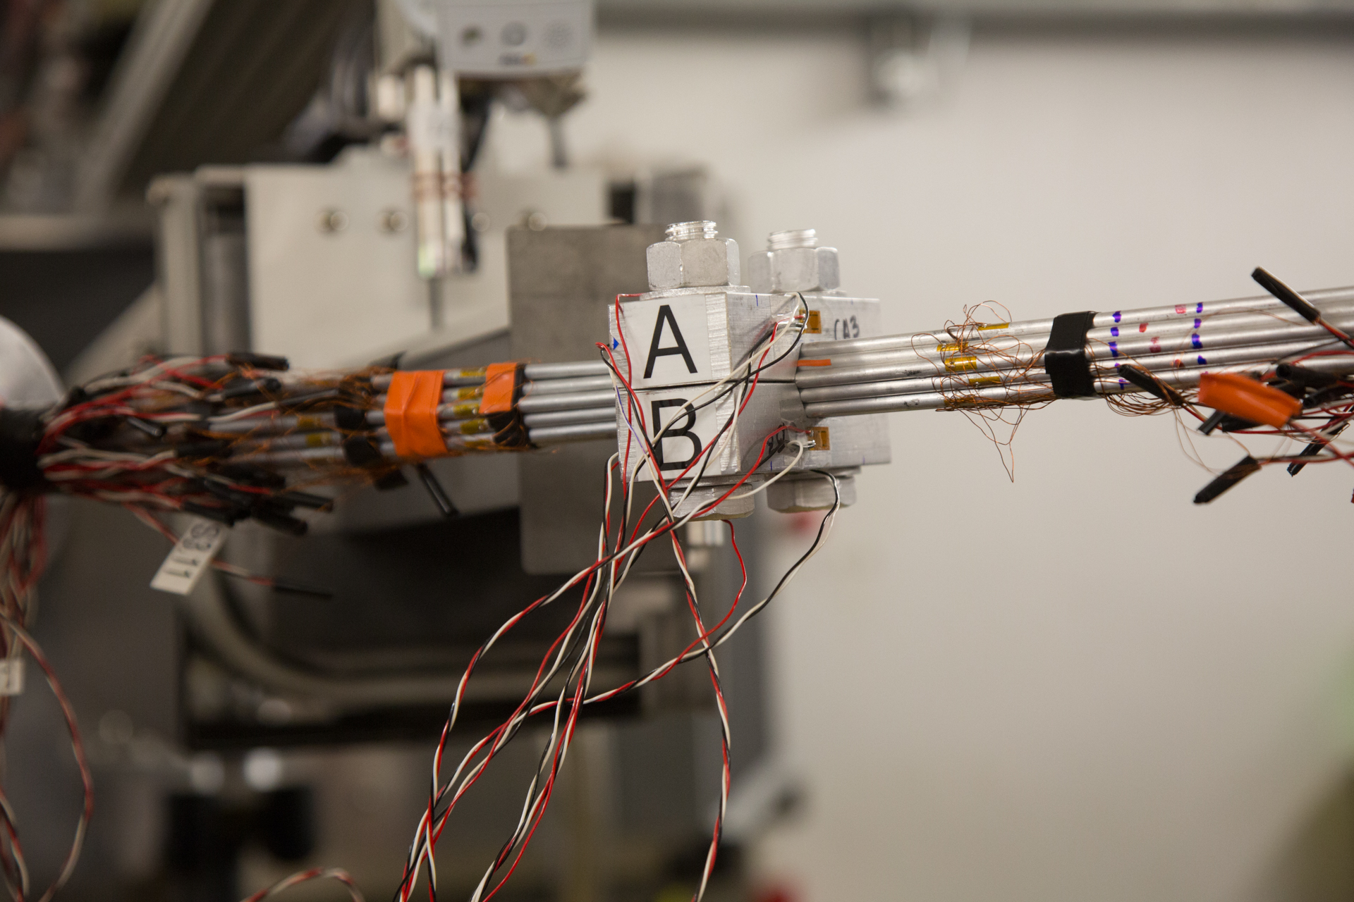
Neutron data helps us understand the mechanics of engineering structures
Adrian Brugger (Columbia University) uses VULCAN to study the load redistribution in suspension bridge cable wire bundles.

Slide 33
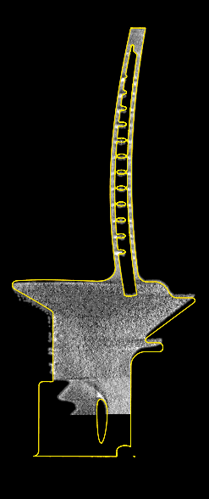

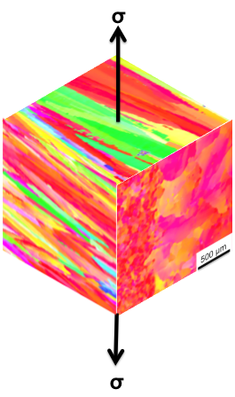
Combining data from multiple techniques
Input microstructure
Product Certification
σ
ε
Model Response
Neutron Computed Tomography and Bragg Edge Imaging
Residual stress measurements

Slide 34
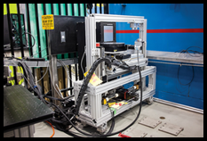
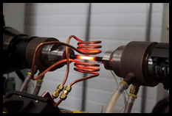
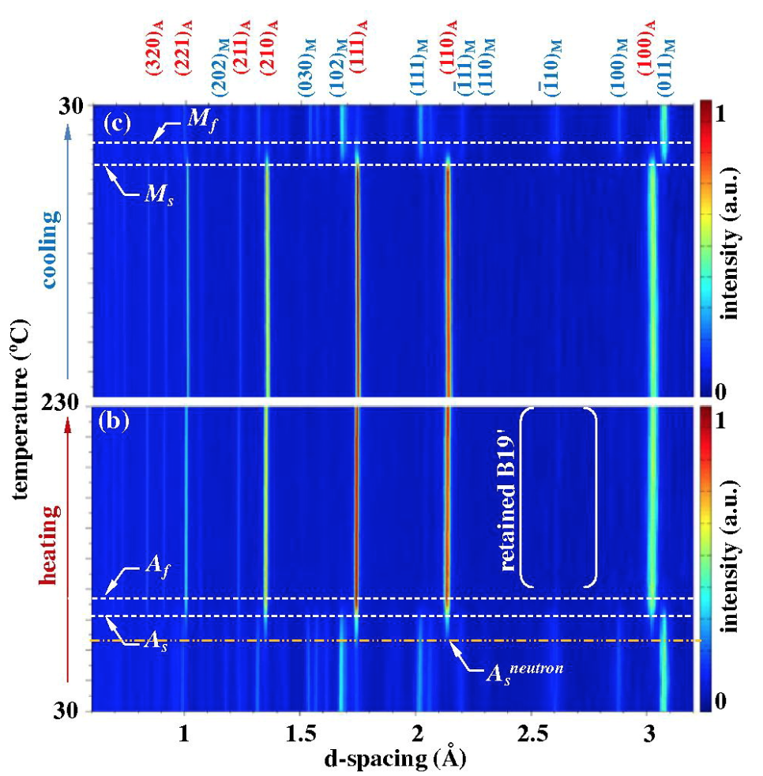
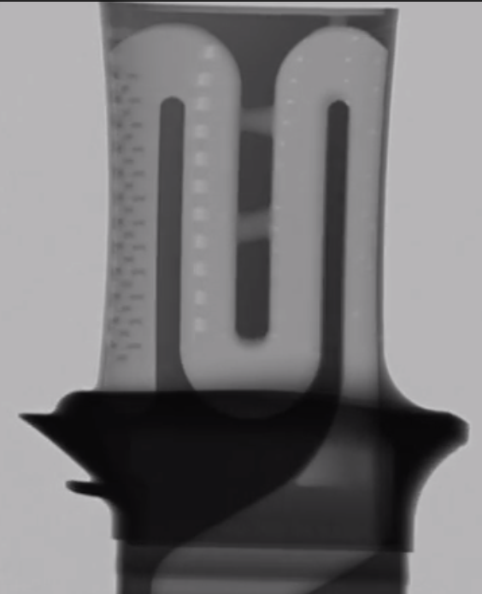
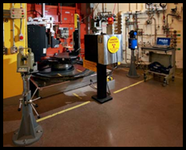
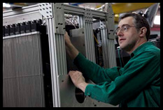
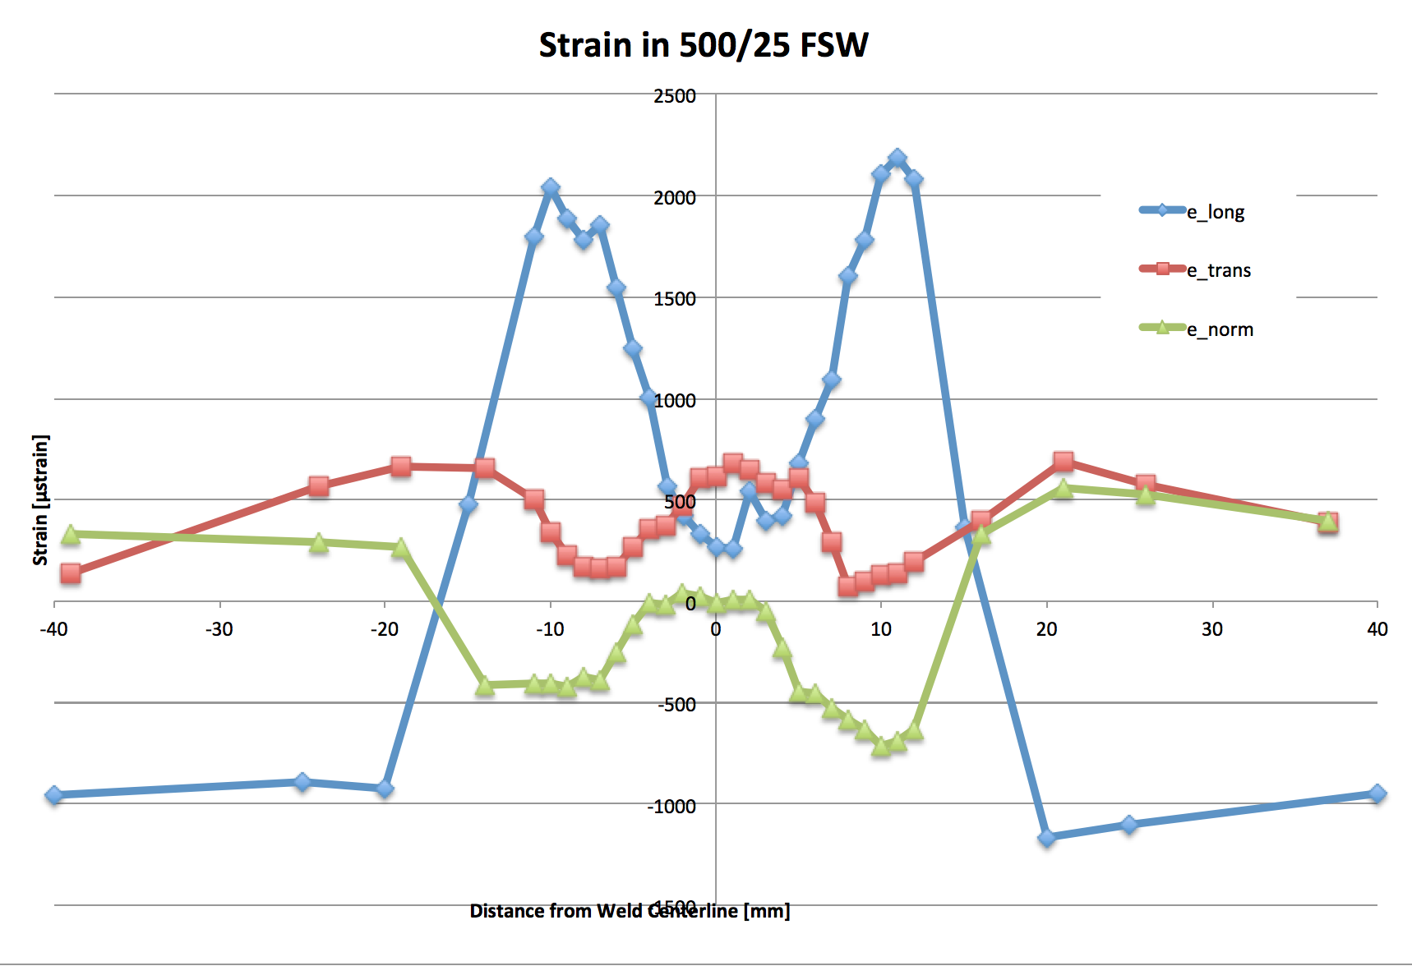
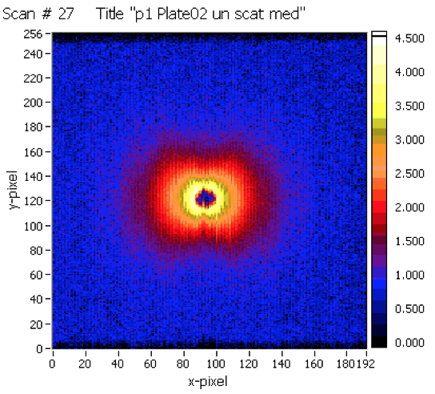
Neutron diffraction, imaging, and SANS all contribute to answering materials science and engineering questions
VULCAN (SNS):
Collimated neutron beams with detector banks at ±90° to the incident beam enable mapping studies of residual stresses and composition, and detailed study of the response of engineering materials to multiaxial mechanical loading, temperature, and applied fields. Data can be collected continuously and “time-sliced” as needed for analysis.
Neutron Imaging (HFIR):
This former prototype instrument utilizes a “white beam” of cold neutrons and 2D area detectors and has quickly generated a growing community of imaging and tomography users, studying topics ranging from fracking of geological materials, hydrogen or lithium distributions in energy storage materials, real-time imaging of fuel injectors, nondestructive tomographic imaging of additive manufactured components, etc.
Residual Stress (HFIR):
Neutron wavelengths can be selected from seven possible values. Scattering volumes may be selected using fine slits to <1mm dimensions, enabling detailed maps of applied or residual strains in polycrystalline materials. This instrument is primarily used for studies of mechanics of materials and features integrated load frames and high precision axis controls.
GP-SANS (HFIR):
The high flux of cold neutrons available at GP-SANS enables size and shape characterization from 0.5 – 200 nm. In addition to soft matter, the instrument is used to quantify size and shape of precipitates, porosity, etc., in hard matter systems, such as minerals, aerospace alloys, and reactor pressure vessel steels. Magnets, load frames, pressure cells, crystats and furnaces are available.

