Slide 1


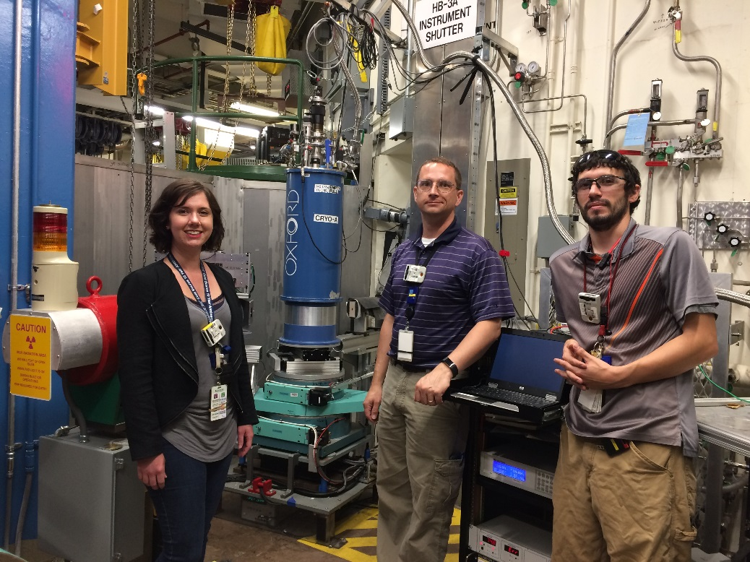
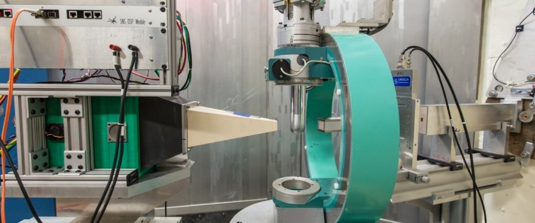
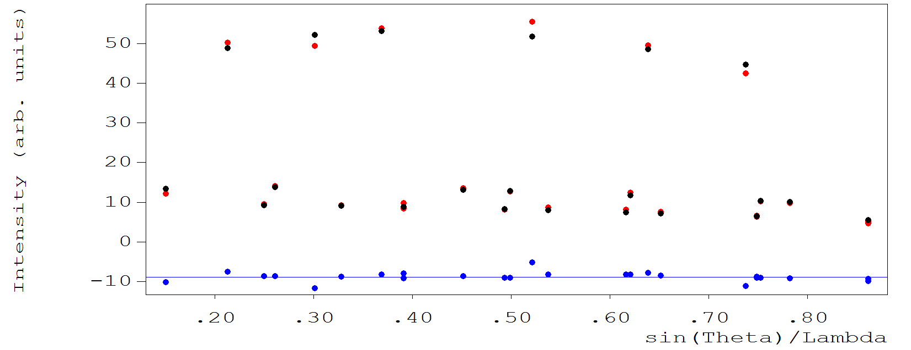
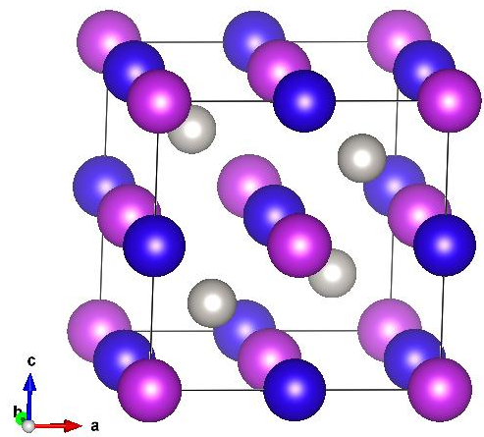
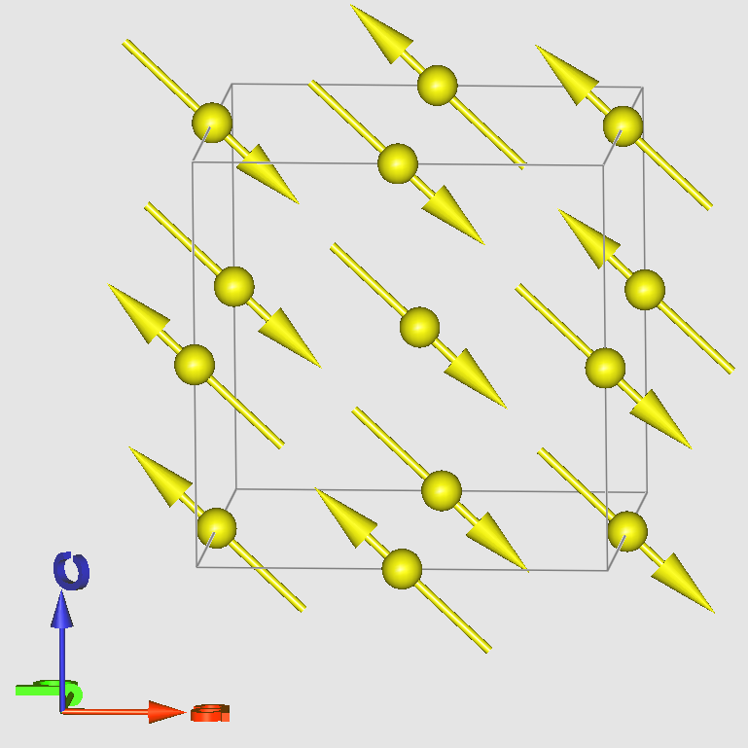
Cryostat at HB3A Four-Circle Diffractometer
Katie Andrews
Cory Fletcher
Tyler White
Achievement
Structure refinement: red and black dots are observed and calculated squared structure factors respectively. The blue dots show difference. RF -factor : 2.258; Chi2(Intens): 1.330
The cryostat has been tested at HB3A FCD and the data collected by the current 5x5cm Anger camera at 1.5 K were well fitted and consistent with the structure measured at 4 K with the regular CCR. The background is about 50% higher because the detector mask is off. The successful commissioning helps to estimate the background level for the large area detector upgrade and proved the capability of diffraction at ultra-low temperature, one of the benefits of the large area detector upgrade.
A successfully single crystal neutron diffraction was done at 1.5 K and magnetic order occurs at 3.4 K. Both magnetic and nuclear structures are well refined.
(½ ½ ½ )
Nuclear structure Magnetic structure Magnetic Ordering parameter
Katie Andrews, Cory Fletcher, Tyler White, Eric Stringfellow, Mike Hittman, Jon Smith, Gary Taufer
Huibo Cao, Yan Wu, and Bryan Chakoumakos

