Slide 1
The High Flux Isotope Reactor
A Brief History
James B. Roberto
Associate Laboratory Director,
Science and Technology Partnerships
Oak Ridge, Tennessee
April 13, 2015

Slide 2
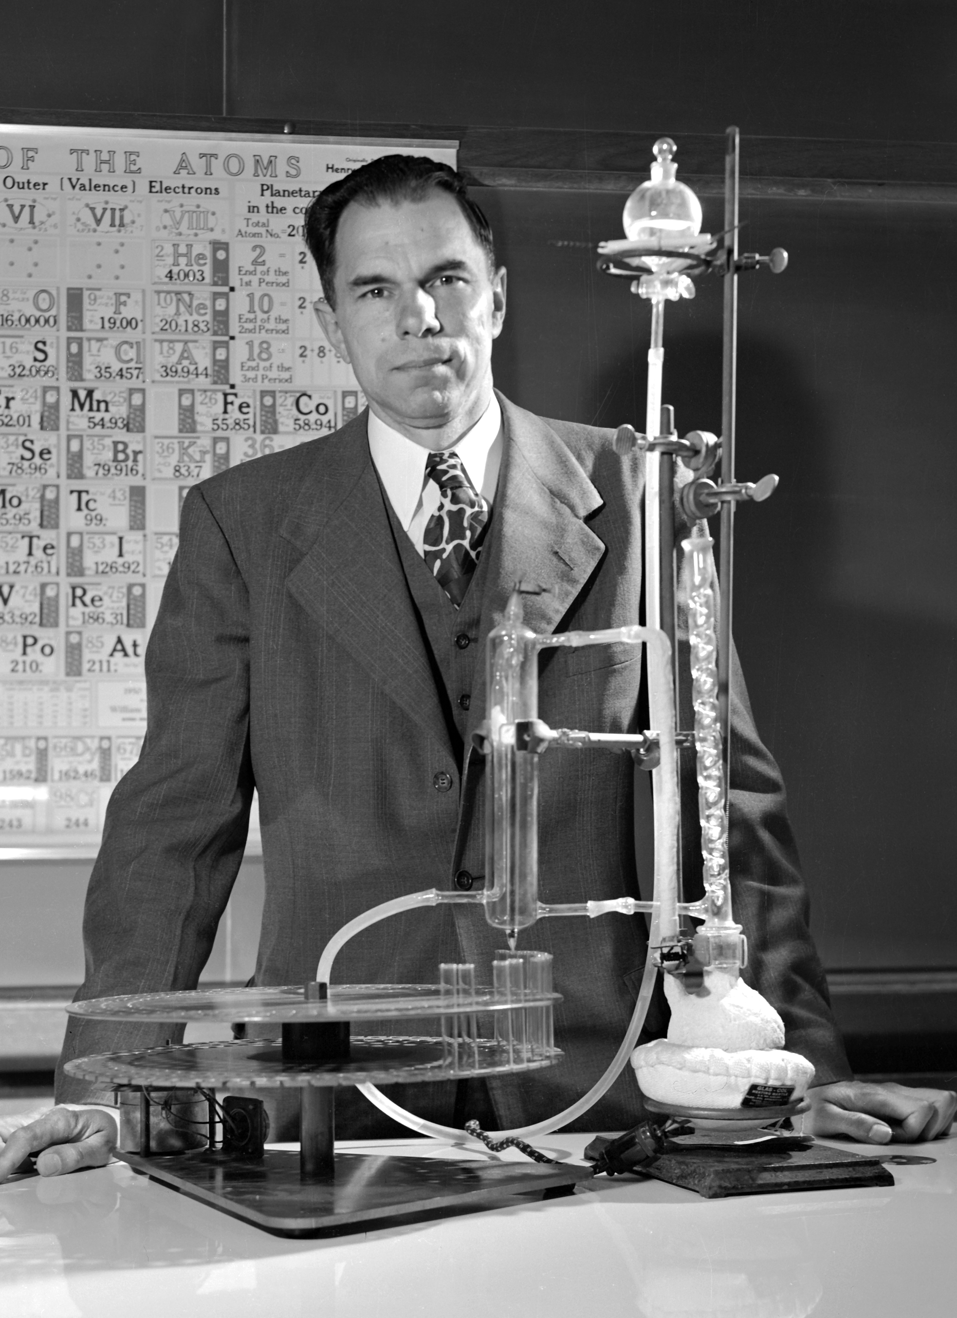
Seaborg’s vision: A “very high flux reactor” for heavy element production
Letter to AEC Chairman Lewis Strauss, October 24, 1957
Future progress in “the field of new transuranium elements” requires production of “substantial weighable quantities
(say milligrams) of berkelium, californium,
and einsteinium”
A unified national effort is needed for:
  Irradiation of substantial quantities of Pu²³⁹
  as reactor fuel elements, and the reirradiation of the products . . . to form hundred gram amounts of Cm²⁴⁴ and higher curium isotopes
  Irradiation of the curium in “the suggested
  ‘very high flux reactor’ ” to produce
  Bk, Cf, and Es

Slide 3
The AEC had already recognized a need for more powerful research reactors
1956: AEC’s Division of Reactor Development solicited proposals for a new research reactor
3 labs quickly developed proposals tailored to meet
the needs of different groups and priorities
Brookhaven
Oak Ridge
Argonne
  Solid-state physics and neutron diffraction
  High Flux
  Beam Reactor, $12.5M
  Chemistry and isotope production
  High-Flux
  Isotope Reactor, $12M
  Physics, chemistry, and metallurgy
  Mighty Mouse Research Reactor, $65M

Slide 4
These proposals were reviewed at a meeting in November 1958
. . . increased interest in the properties of the heavy elements indicated that an even more accelerated [transplutonium] production schedule might be advisable
. . . any accelerated schedule would require a new isotope production reactor providing thermal neutron fluxes up to 5 × 10¹⁵
A meeting was held in Washington, D.C., on November 24, 1958,
to review plans for the construction of such a reactor
and other high-flux research reactors
The unanimous recommendation was that a high flux isotope reactor be designed and constructed at the Oak Ridge National Laboratory with construction to start in fiscal year 1961
– J. A. Lane et al., High Flux Isotope Reactor Preliminary Design Study,
ORNL CF-59-2-65, March 1959

Slide 5
The AEC gave 4 reasons for its decision to build HFIR at ORNL
Availability
of fuel reprocessing facilities
Availability
of facilities
for processing and distributing
the products
of the irradiation
Recognition that ORNL
is a national center
for isotope research and development
Interest
in the Laboratory
in constructing the reactor
This reactor would serve as the first AEC-wide
high-flux facility and be operated in conjunction
with the national heavy element production program
Letter from J. H. Williams to A.M. Weinberg, December 12, 1958,
summarizing results of High Flux Research Reactor Meeting

Slide 6
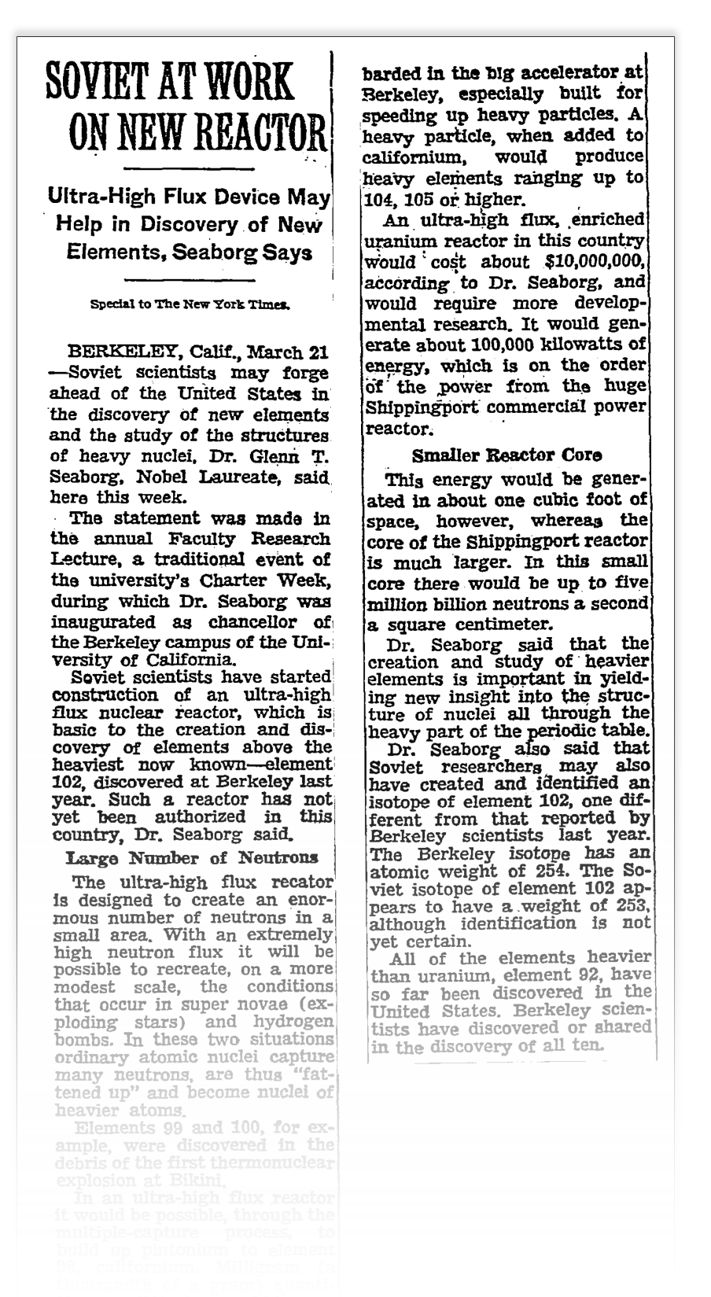

March 1959:
Seaborg discusses Soviet plans
Soviet scientists have started construction of an ultra-high flux nuclear reactor
Such a reactor has not yet been authorized in this country
An ultra-high flux, enriched uranium reactor in this country would cost about $10,000,000
The creation and study of heavier elements is important in yielding insight into the structure of nuclei
Published: March 22, 1959
Copyright © The New York Times

Slide 7
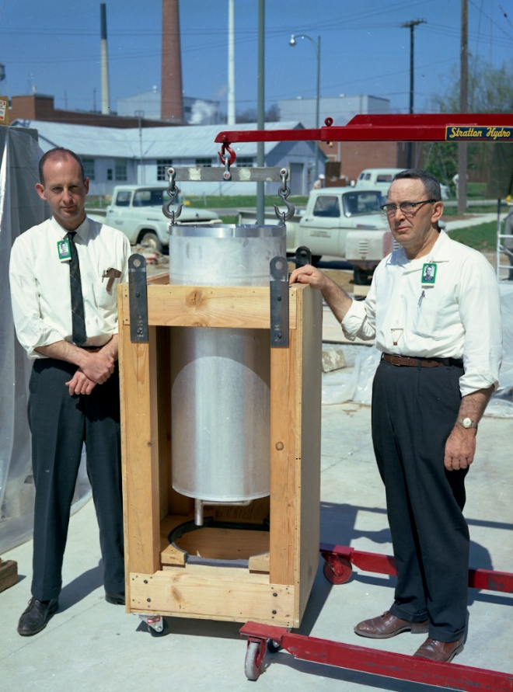
Dick Cheverton’s ORSORT design problem addressed Seaborg’s concern
Oak Ridge School of Reactor Technology, 1956: Dick Cheverton led a small group that designed
a high-performance flux-trap reactor
As Cheverton remembers it:
  Alvin Weinberg initially dismissed
  the design as “the most hare-brained idea I have ever heard”
  When the Soviet reactor was announced,
  “we told Seaborg we knew exactly
  what to do, we had the plans
  for a better one”
Dick Cheverton
and Jess Irwin

Slide 8

HFIR: Designed for isotope production, equipped for neutron scattering
Designed and constructed to meet need
for production of transuranic isotopes
  4 horizontal beam tubes added
  at insistence of Alvin Weinberg
  Peak thermal flux: 2.6 × 10¹⁵ neutrons/cm²/s, highest in the western world
Primary mission today: Neutron scattering
  Thermal and cold neutrons
  12 instruments in user program
Additional missions
  Isotopes: Supplies 80% of world’s Cf-252;
  future source of Pu-238 to power
  NASA’s deep space missions
  Materials: Exceptional resource for irradiation
  and neutron activation analysis

Slide 9
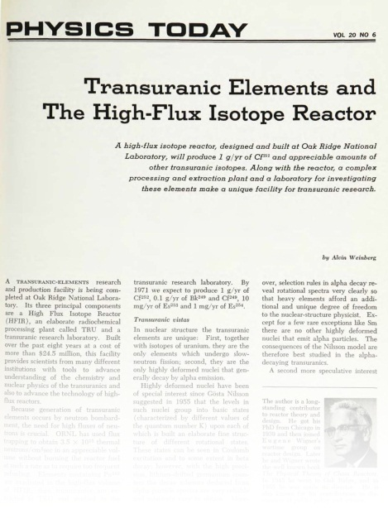
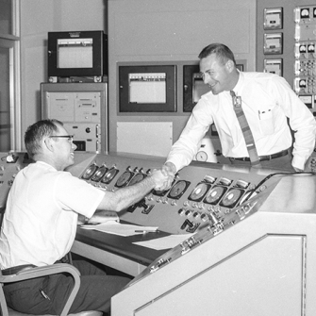
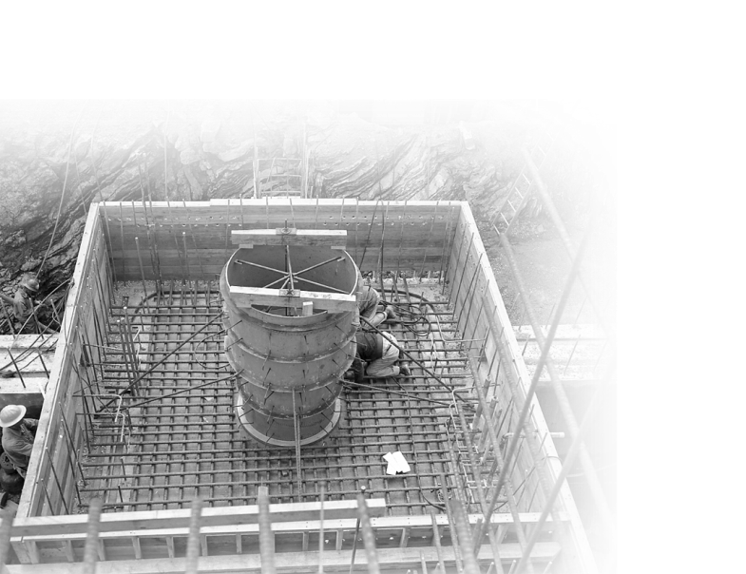
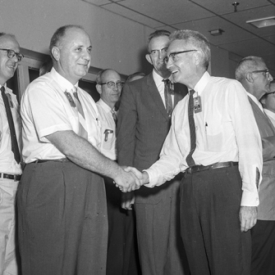
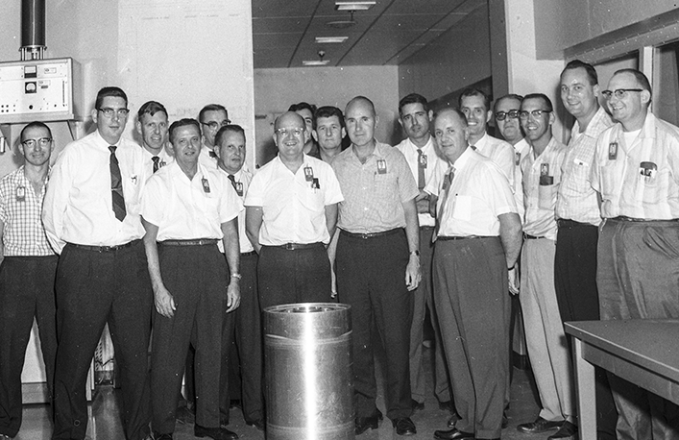
Construction was completed in less than 5 years
March 1959
July 1959
− Alvin Weinberg
June 1967
Proposal for construction submitted to the Atomic Energy Commission
June 1961
Approval
to proceed
August 1965
Construction begins
First criticality achieved

Slide 10
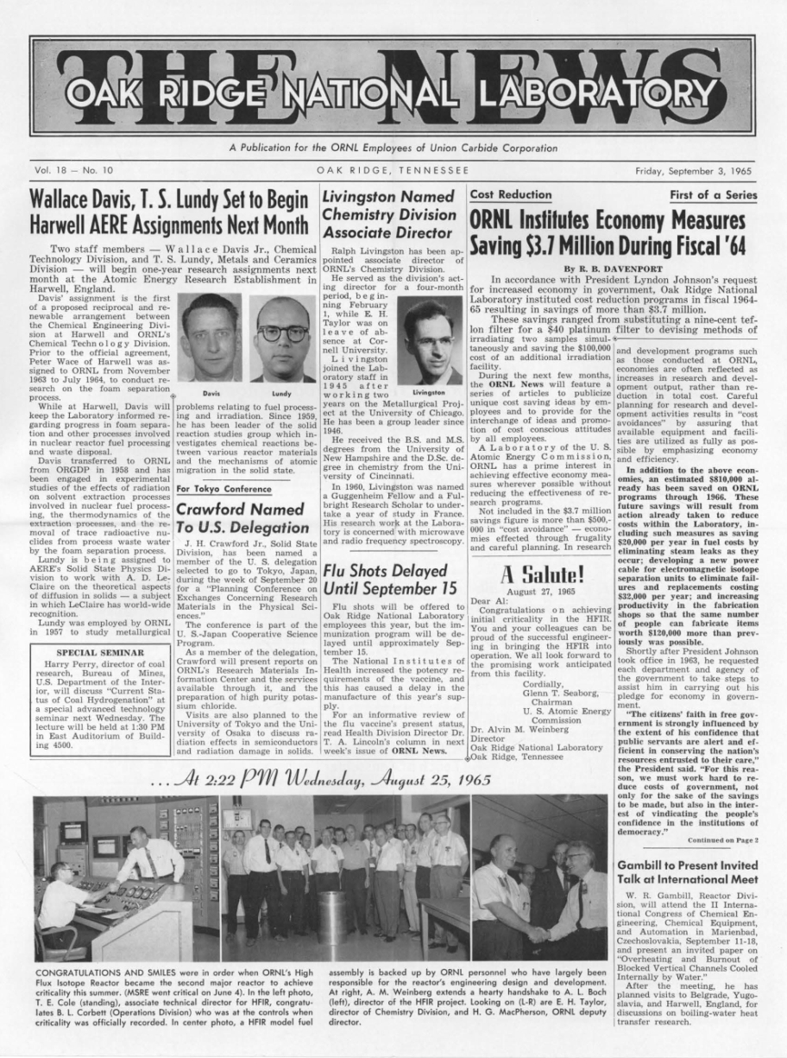
Seaborg sent congratulations
A Salute!
August 27, 1965
Dear Al,
Congratulations on achieving initial criticality in the HFIR.
You and your colleagues can be proud of the successful engineer-ing in bringing the HFIR into operation. We all look forward to the promising work anticipated from this facility.
Cordially,
Glenn T. Seaborg
Chairman
U. S. Atomic Energy
Commission

Slide 11
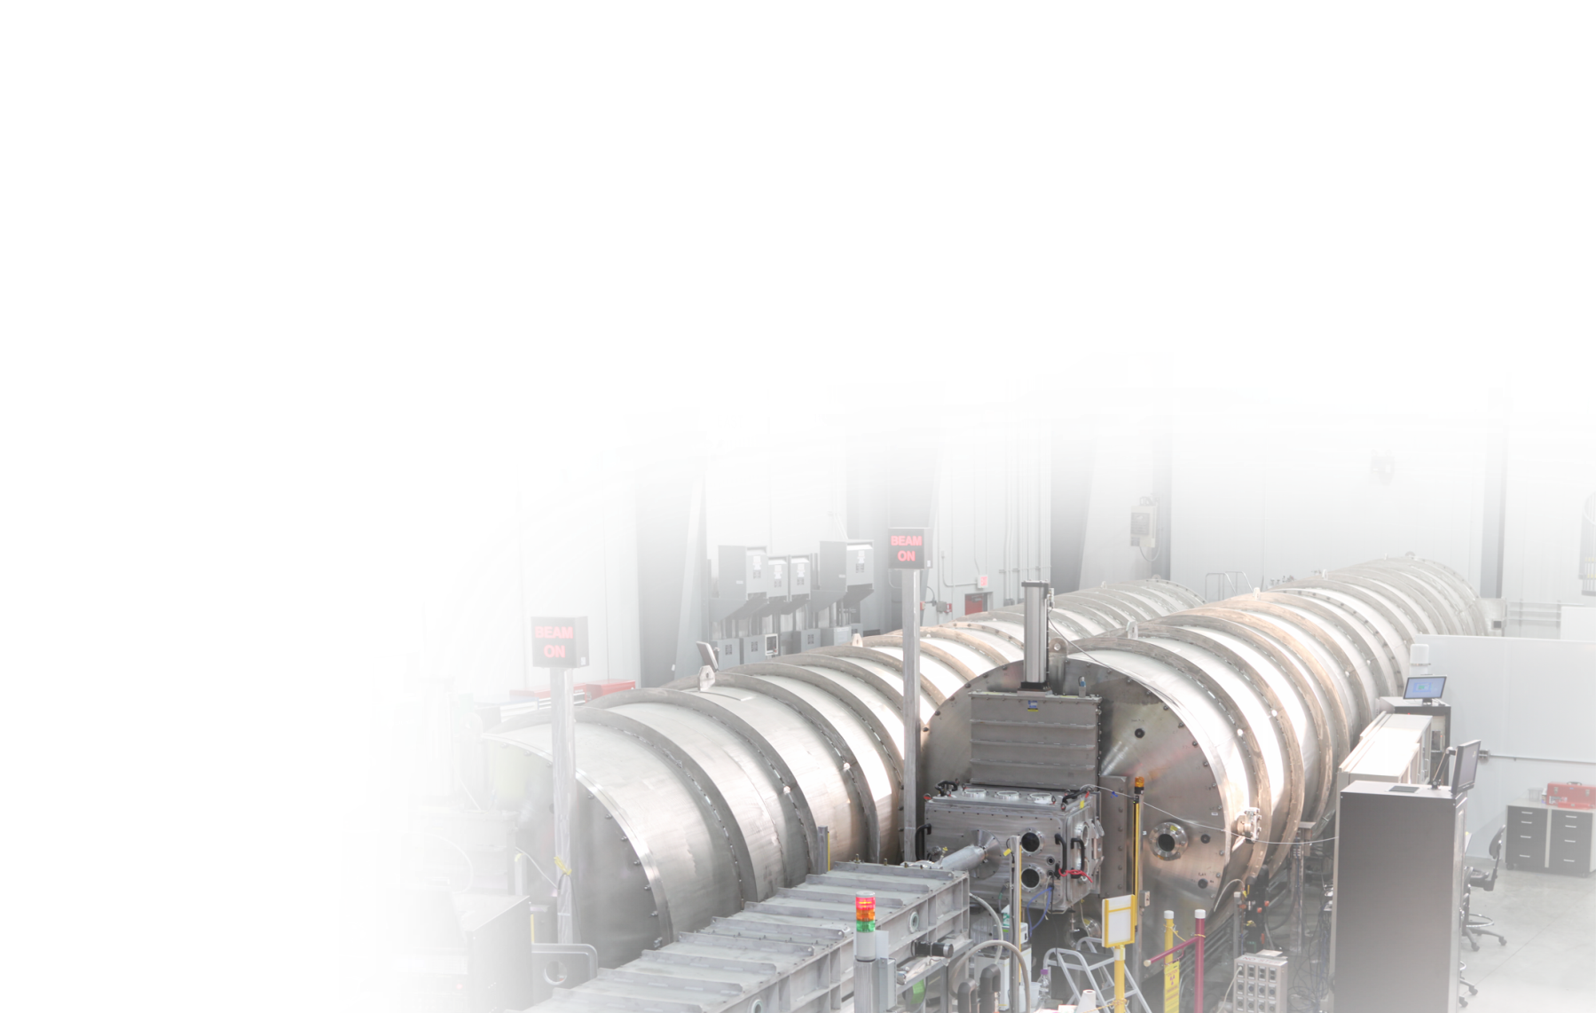
HFIR’s world-class capabilities serve a variety of national missions
Neutron scattering
Isotope production
Materials irradiation
  Cold source
    Small-angle neutron scattering (SANS)
    Cold triple-axis spectroscopy
    Neutron imaging
    Quasi-Laue diffractometer
  Thermal beams
    Triple-axis spectroscopy
    Powder diffraction
    Single-crystal diffraction
    Residual stress diffraction
  Californium-252
  for industrial, defense, medical, and energy uses (supplying 80% of world demand)
  Berkelium-249 for heavy-element research
  Plutonium-238 for powering satellites and deep space exploration
  Selenium-75, nickel-63, tungsten-188
  Fusion energy: Radiation damage testing (30+ year collaboration with Japan)
  Fission energy: Support for next-generation power reactors, including accident-tolerant fuel
  and reactor materials
  National security: Neutron activation analysis
  for nonproliferation monitoring

Slide 12
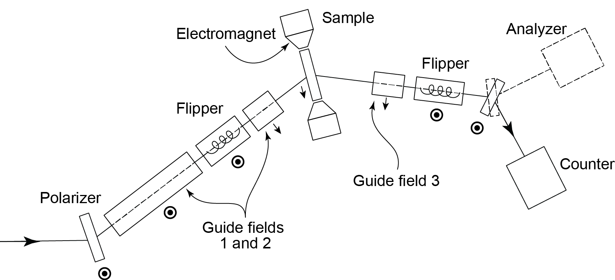
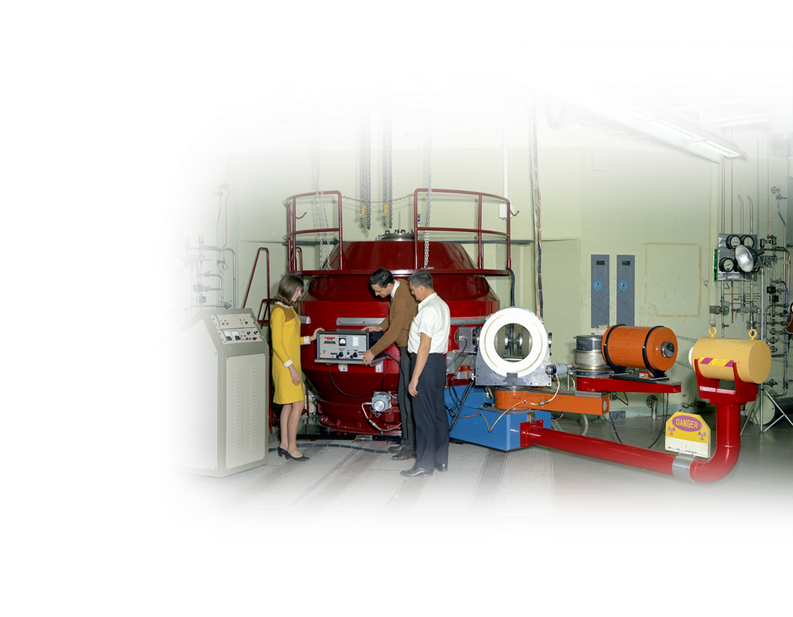
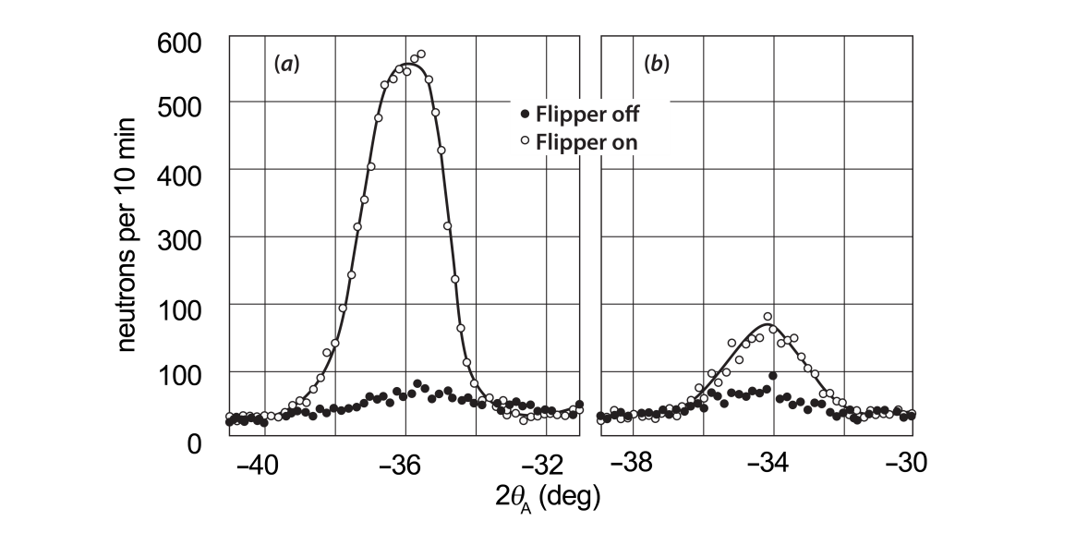
1969: Ralph Moon and colleagues invent neutron polarization analysis
Schematic
of original
apparatus
Sharron King adjusting
the RF spin reversal circuit for the polarized beam spectrometer at HB-1, with Ralph Moon and Jim Sellers
Measurements
of spin-flip scattering
in neutron excitations
R. M. Moon, T. Riste, and W. C. Koehler, Phys. Rev. 181, 920–931 (1969)

Slide 13
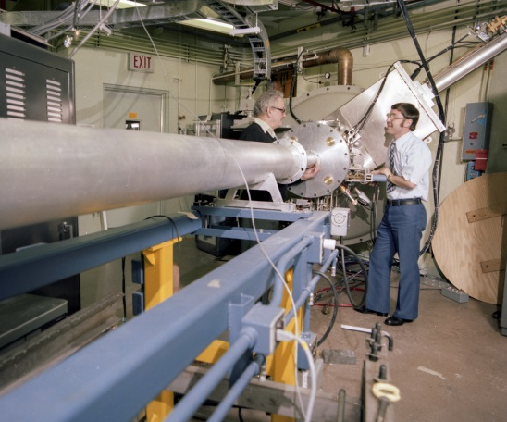
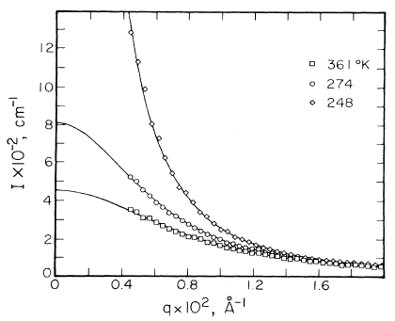
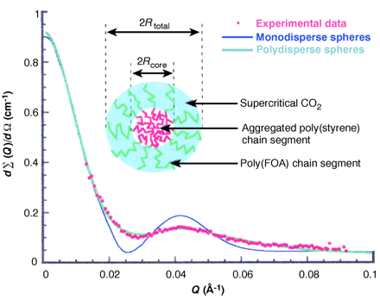
1978: Small-angle neutron scattering advances research on polymers
Early results for critical scattering
in polymer mixtures, exploiting the neutron contrast between H and D
[F. S. Bates, G. D. Wignall, and W. C. Koehler, Phys. Rev. Lett. 55, 2425 (1985)]
Scattering from micelles formed
in supercritical CO₂, which earned a “Green Chemistry” award for George Wignall and
Joe DeSimone
Wally Koehler and George Wignall
at the 30-m small-angle neutron scattering instrument, part of the
NSF-supported Center for Small
Angle Scattering Research

Slide 14
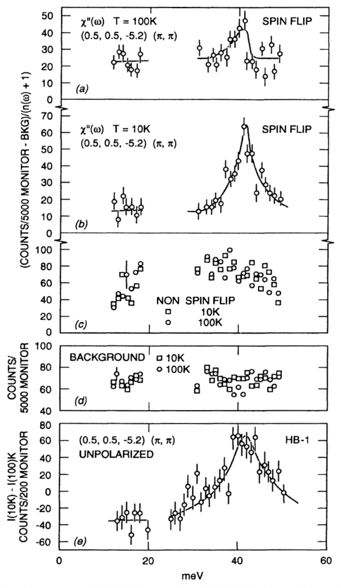
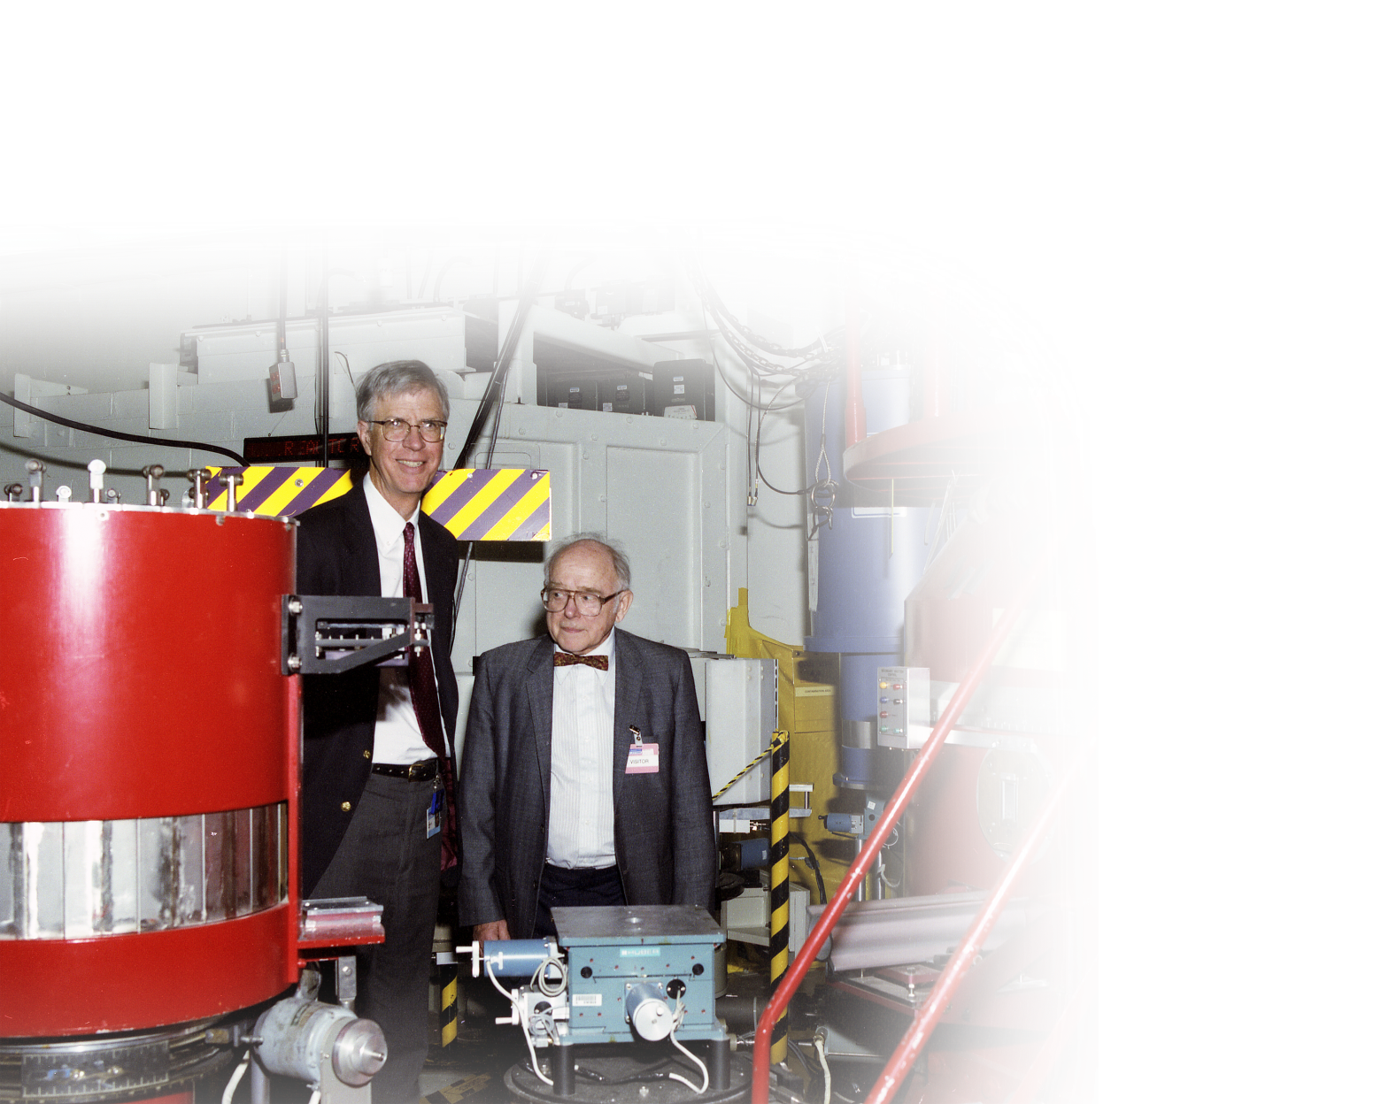
1993: Herb Mook leads explorations of high-temperature superconductors
First polarized measurement of magnetic fluctuations
in the 41 meV “resonance” in YBCO
The nature of these fluctuations remains the subject of great interest
[H. A. Mook et al., Phys. Rev. Lett. 70, 3490 (1993)]

Slide 15
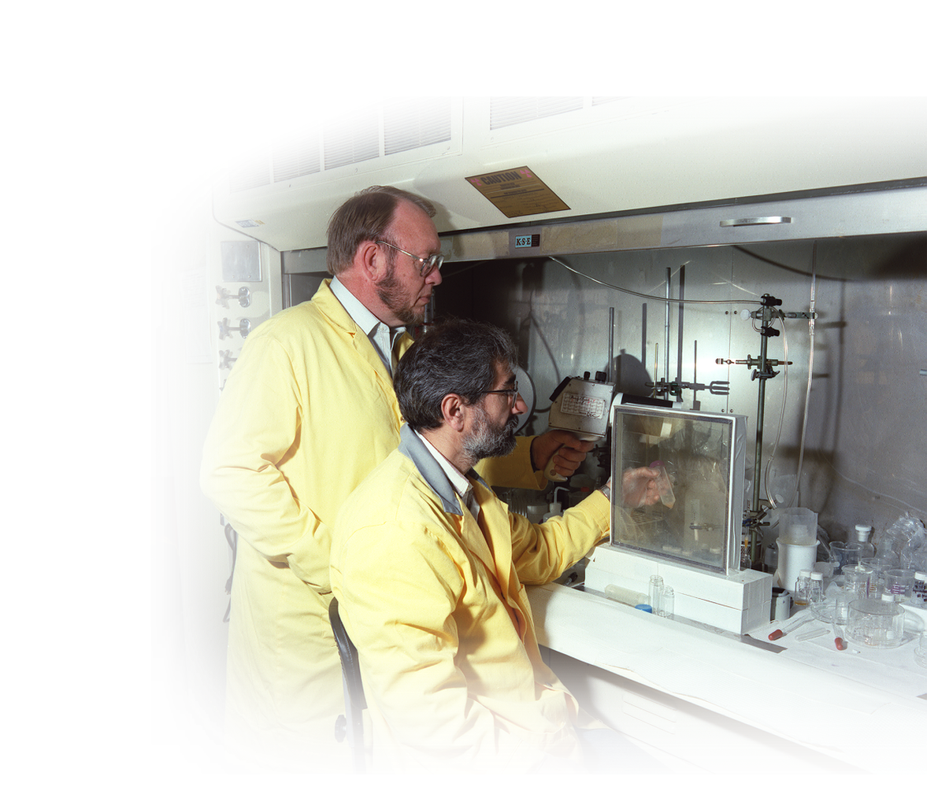
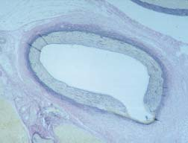
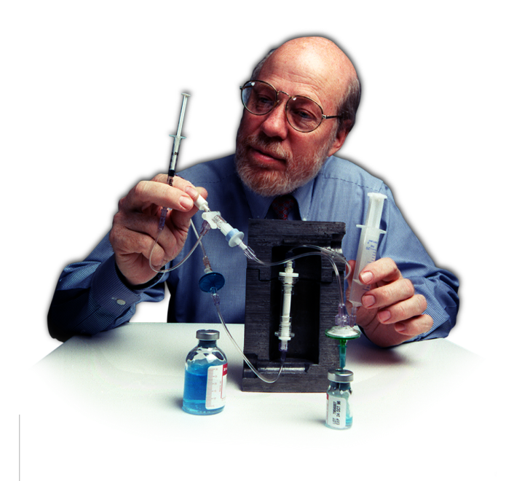
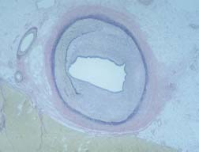
HFIR is an important resource for medical radioisotopes
Imaging agents
  Cardiac ischemia
  Pancreatic insufficiency
  Alzheimer’s disease
  Changes in gene expression
  in response to new drugs
Bone pain palliation
Cancer treatment
Prevention of arterial restenosis
after balloon angioplasty
Today: Medical isotopes developed
at HFIR are used worldwide

Slide 16
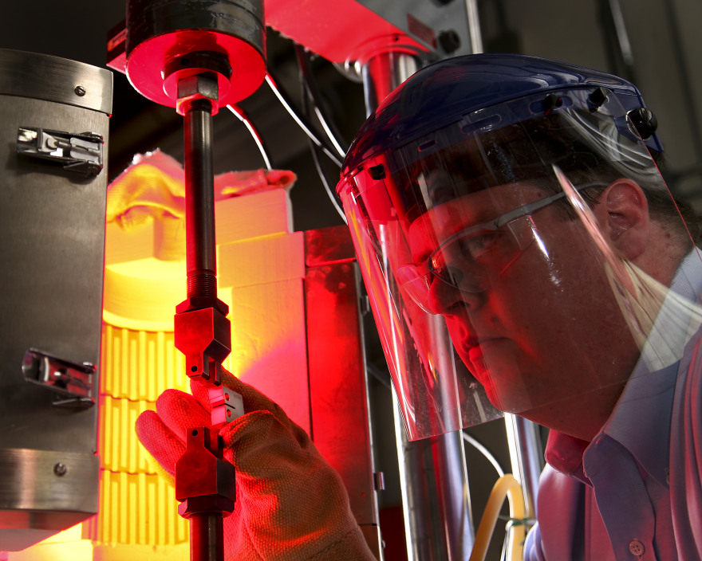
HFIR has enabled advances in fission and fusion materials research
Advanced fission and fusion reactors subject structural materials
to damaging particle irradiation
HFIR provides:
  A high flux of fast neutrons to produce displacement damage
  A high flux of thermal neutrons
  to produce helium and hydrogen
Experiments yield critically important data on radiation effects, enabling development of:
  Improved properties in existing alloys
  New alloys specifically designed
  to resist degradation
HFIR is a critical tool for testing materials for future fusion reactors, including a new cast stainless steel developed at ORNL

Slide 17
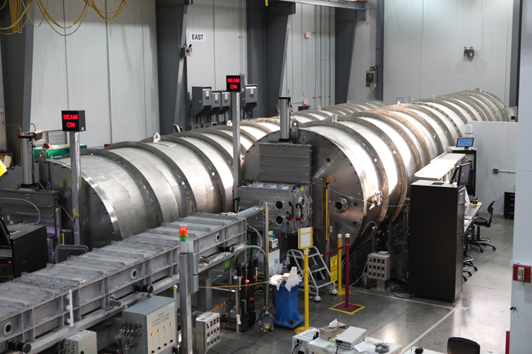
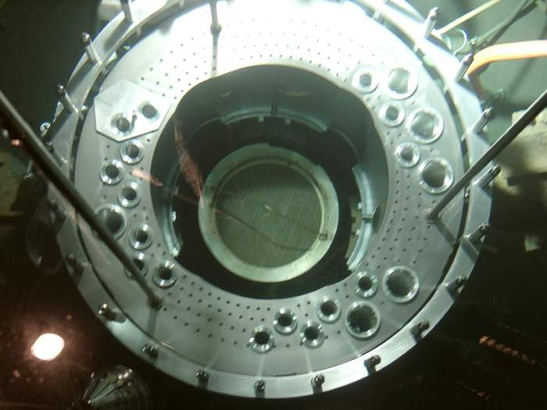
2007: A major refurbishment of HFIR is completed
Neutron scattering upgrades:
  New guide hall
  New and upgraded
  instruments
  First-of-a-kind cold
  neutron source with intensity
  comparable to the world’s best
  Thermal neutron intensities
  2–3× higher for most
  experiments
Larger beam tubes
New beryllium reflector, cage,
and shroud
New cooling tower and process waste line

Slide 18
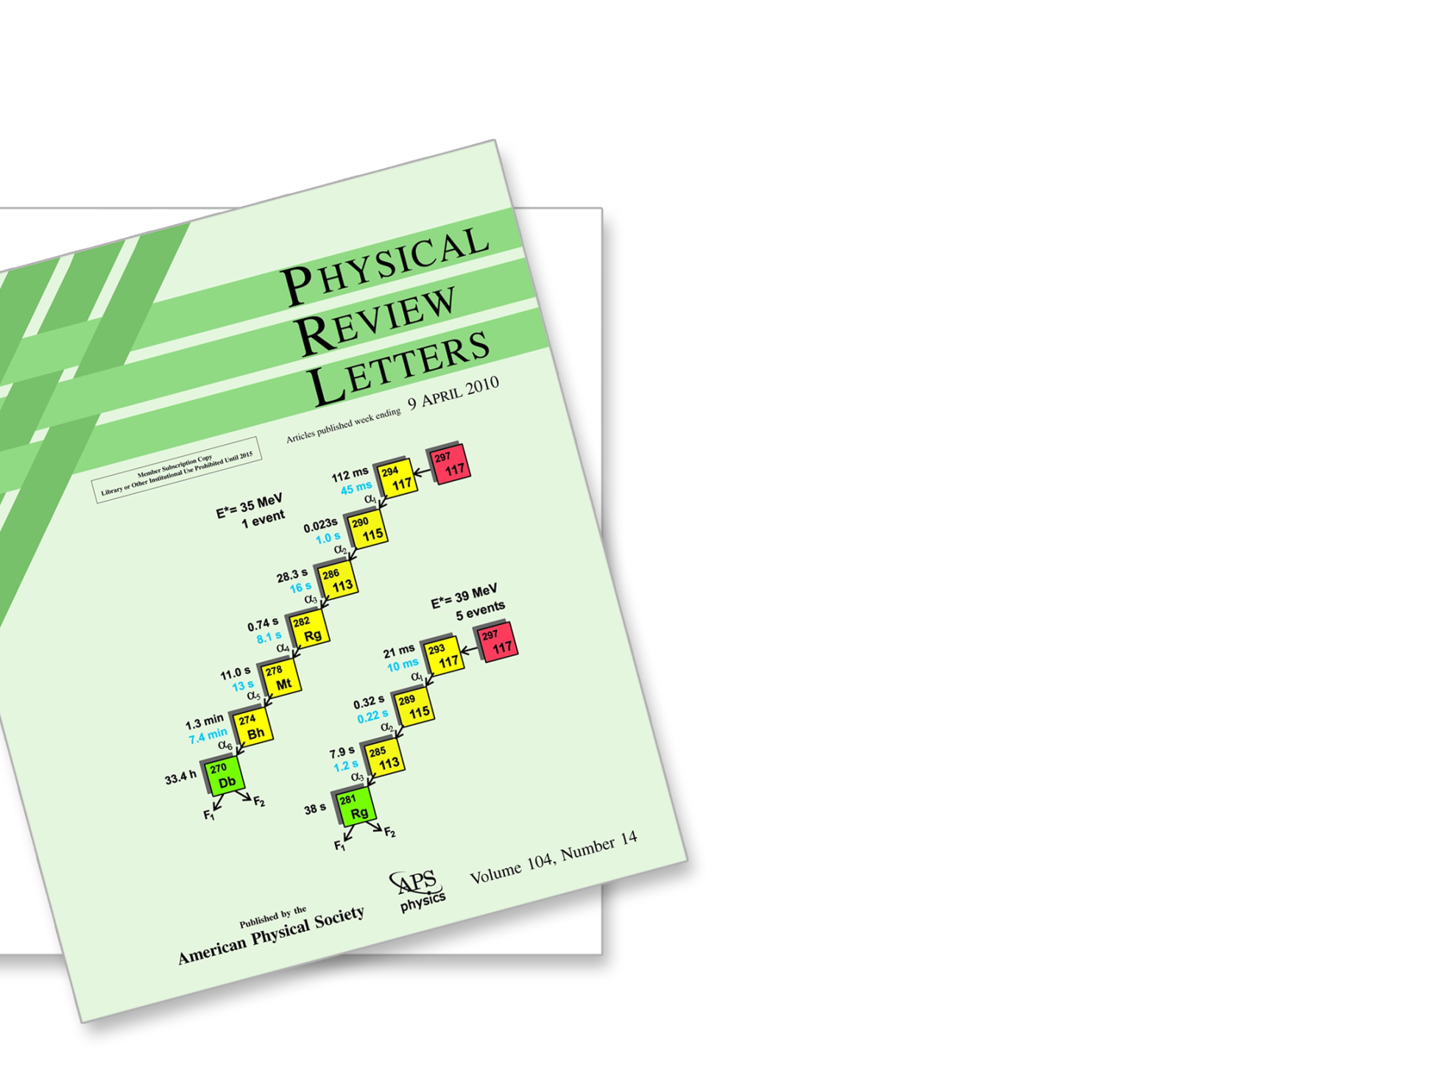
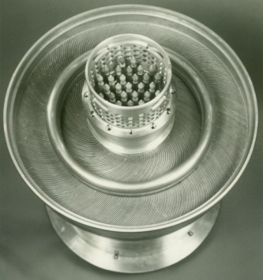
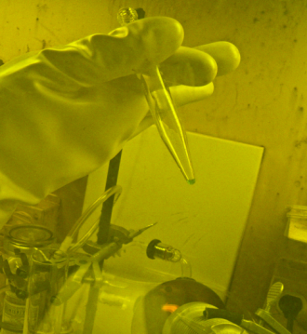
2010: HFIR played a key role in the discovery of element 117
Am/Cm targets
were irradiated
in the HFIR flux trap
Processing of targets at Radiochemical Engineering Development Center yielded
20 mg of ultrapure berkelium-249
Researchers at JINR Dubna bombarded Bk-249
with a Ca-48 beam
to produce element 117
Evidence for the existence of the “island of stability” for super-heavy elements, originally proposed by Seaborg in the 1960s

Slide 19
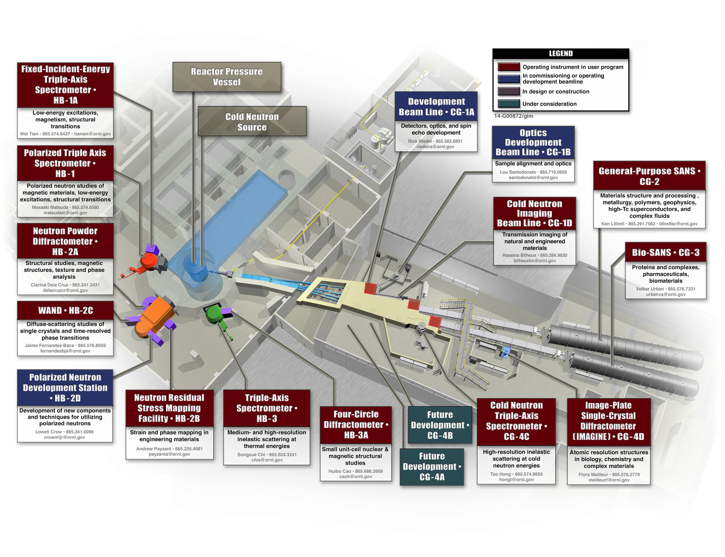
HFIR’s instruments today

Slide 20
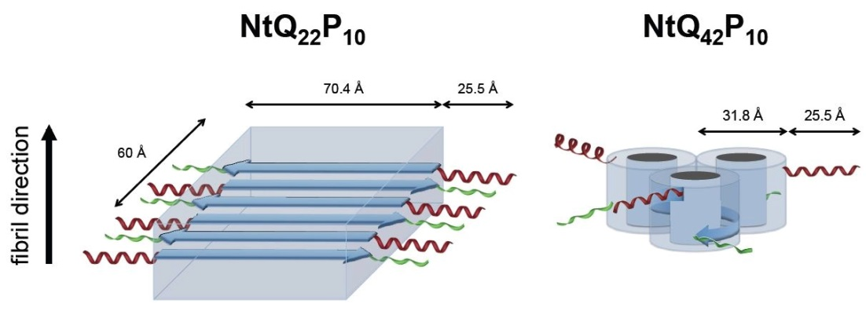
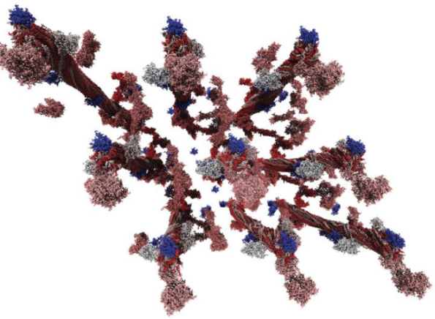
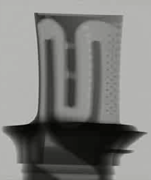
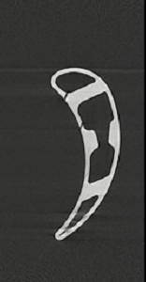
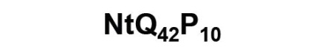
Exploring the frontiers of science
Understanding
polyglutamine
aggregation
in Huntington’s disease
Combining small-angle neutron scattering
and computing
to characterize lignin
Using neutrons
to image and measure residual stress
L. Petridis et al., Phys. Rev. E 83, 061911 (2011); L. Petridis, R. Schultz, and J. C. Smith, J. Am. Chem. Soc. 133, 20277 (2011)
T. Perevozchikova et al., Biophys. J. 107, 411 (2014)
T. Watkins et al., Adv. Mater. Process. 171 (3) 23 (2013)
Notes:
Another critical element of neutron science is sample environment that pushes materials into new physical regimes. Here are some examples of recent developments in sample environment and some high-level examples of the science enabled by these efforts.
Magnetic fields
Co3V2O8 magnetism on a frustrated lattice. Realization of 2D transverse field ising model.
Pressure
Collaboration with Carnegie Institute and eFree EFRC on the development of diamond anvil cells for neutron diffraction. These efforts have recently attained a pressure of ~100 Gpa, a record for neutron diffraction.
In situ
Higher fluxes allow for smaller focused beams and more complicated sample environments, including transient behavior. In area of energy and engineering materials, this allows for studies of in situ chemical reactions that occur in batteries, or H storage materials, or the reaction of materials under high stress conditions.
Example shows the evolution of different Li phases during the cycling of a Li material …
It would be nice to have a definitive statement about Boehler and Guthrie before the BESAC meeting.
This is just the new equipment, as with
Some is people, some is process
Key developments through collaboration with Carnegie Institute
Currently exploring the strategic hire of personnel to expand high pressure program to include other beamlines and techniques.
New hires and equipment purchases have resulted in more reliable
External collaborations (carnegie, washington)
Building up infrastructure (ILL guy, Hans)
$’s invested over past two FY to establish robust suite of foundational SE equipment (furnaces, cryo, magnets)
New magnet at HFIR supports spectroscopy program (11T?) need picture (Gary?)
New SNS 8T magnet expected when (Bobby and David Anderson)?
Number of dil inserts obtained at SNS – other statistics that demonstrate impact for cryo(Bobby?)
Number of furnaces available at SNS and HFIR (Gary and Bobby?)
X sample changers developed to support diffraction and SANS programs and optimize data collection (David Anderson?, Gary at HFIR?)
Diamond anvil pressure cell on SNAP sets world record for neutron diffraction at 94 Gpa (Chris Tulk?)
Neutron Electrostatic Levitator for container-less samples to 3000 K developed by university partners under NSF funding was tested on VULCAN

Slide 21
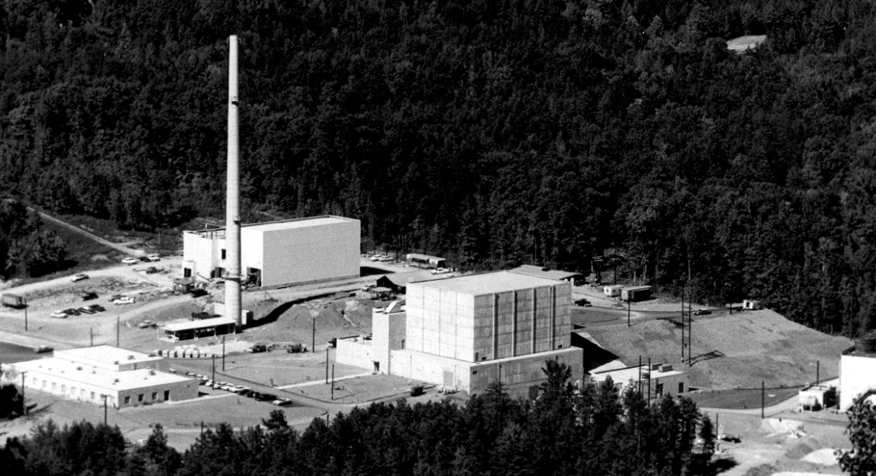
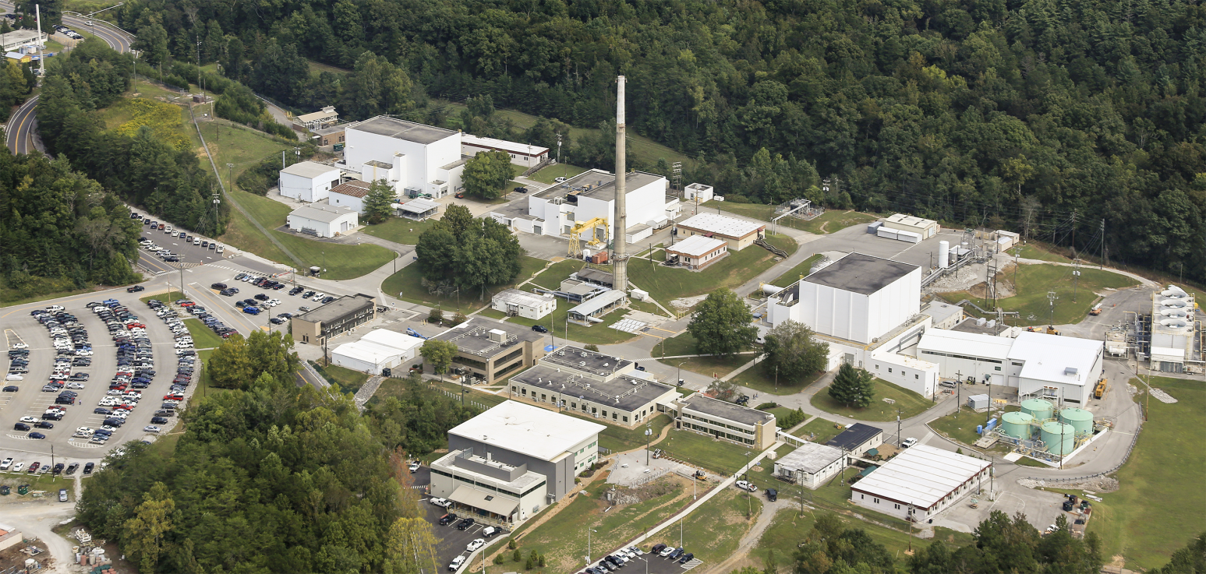
Then and now
1965
Today

Slide 22
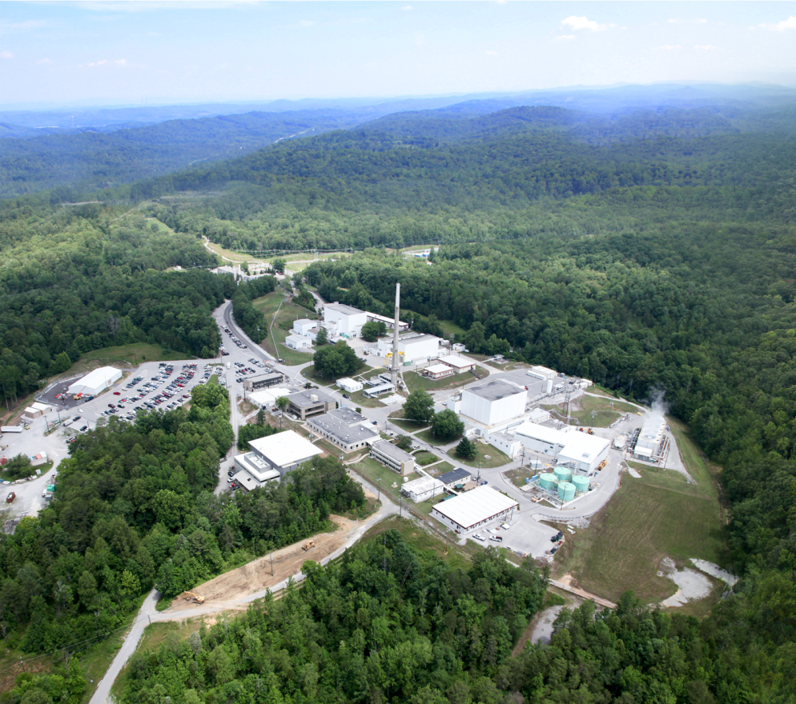
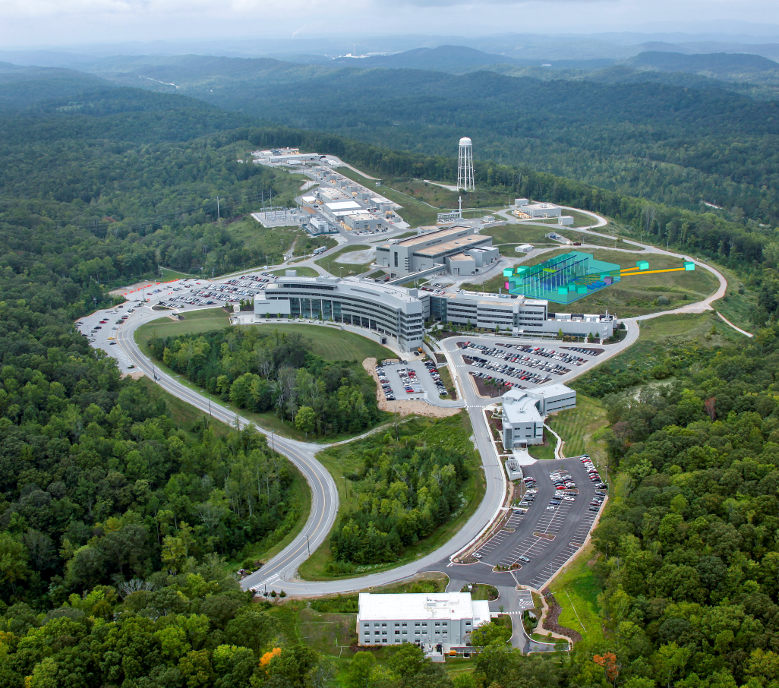
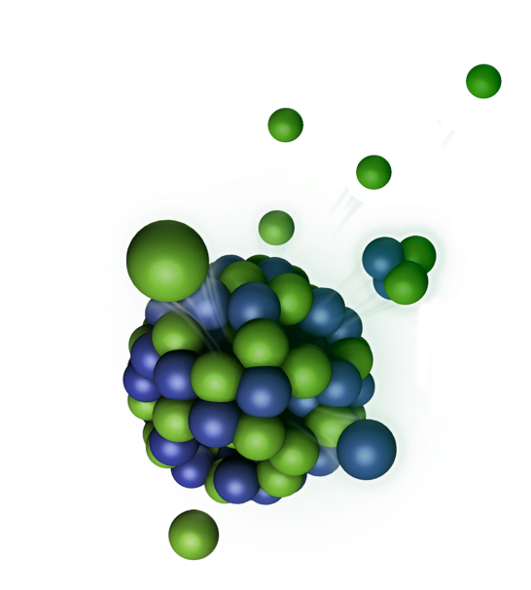
With 2 complementary neutron sources,
ORNL leads the world in neutron science
“Together, these facilities can and will support the most potent
and complete range of neutron beam facilities available
in the world, now and in the foreseeable future.”
ORNL Neutron Advisory Board, 2013
Notes:
22

Slide 23
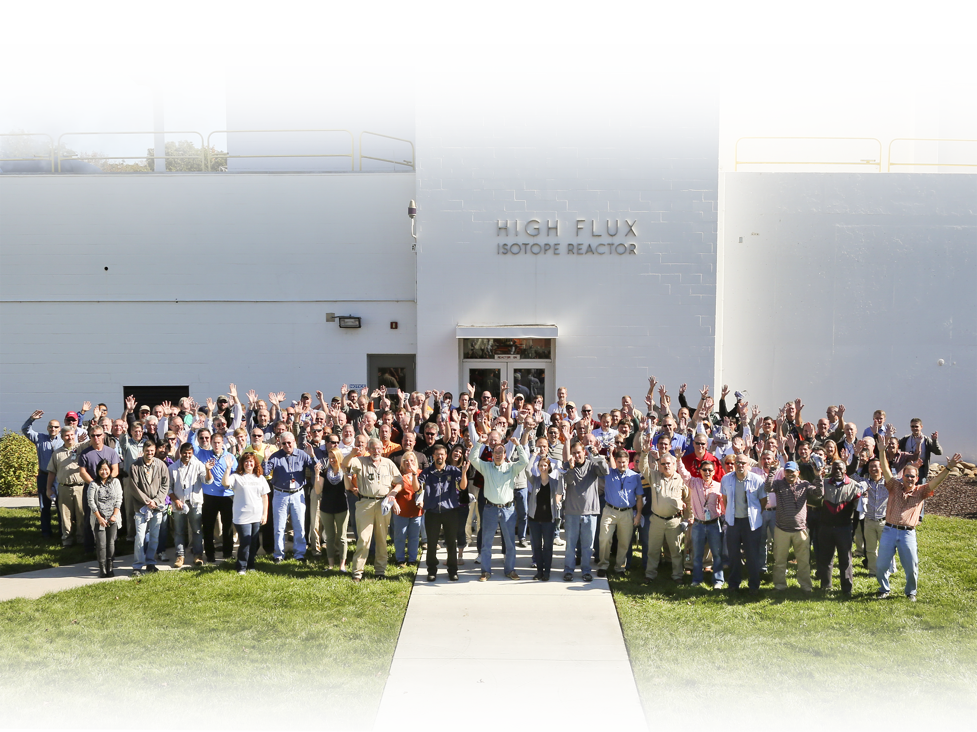
HFIR’s contributions have been made possible by capable and dedicated staff
Thank you, and congratulations!
HFIR staff,
October 2014

