Slide 1
Proposal Writing:
Hints for maximizing your chances for getting beam time
John Budai
Materials Science & Technology, ORNL
Facility User – Proposal writer – Proposal reviewer
Also - How DOE user facilities function and evolve
Now for something completely different
No equations!
Scientists spend a lot of time writing proposals, reviewing proposals, giving presentations and getting funding.

Slide 2
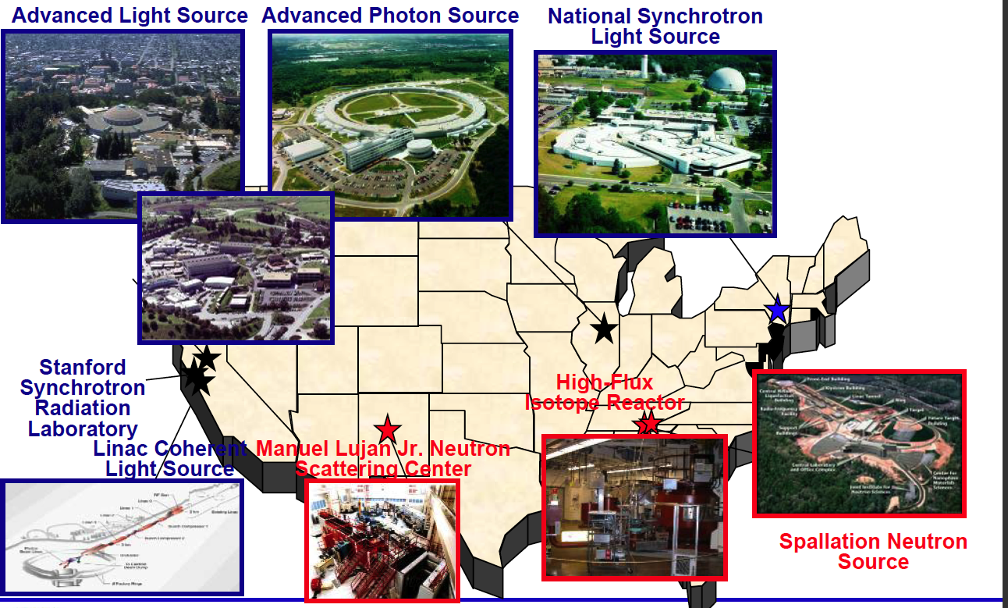
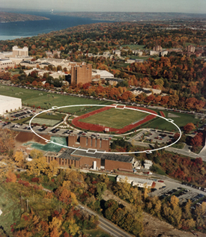
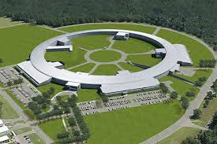
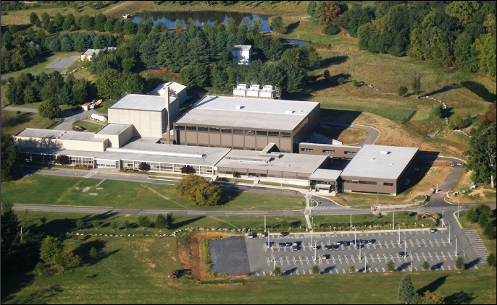
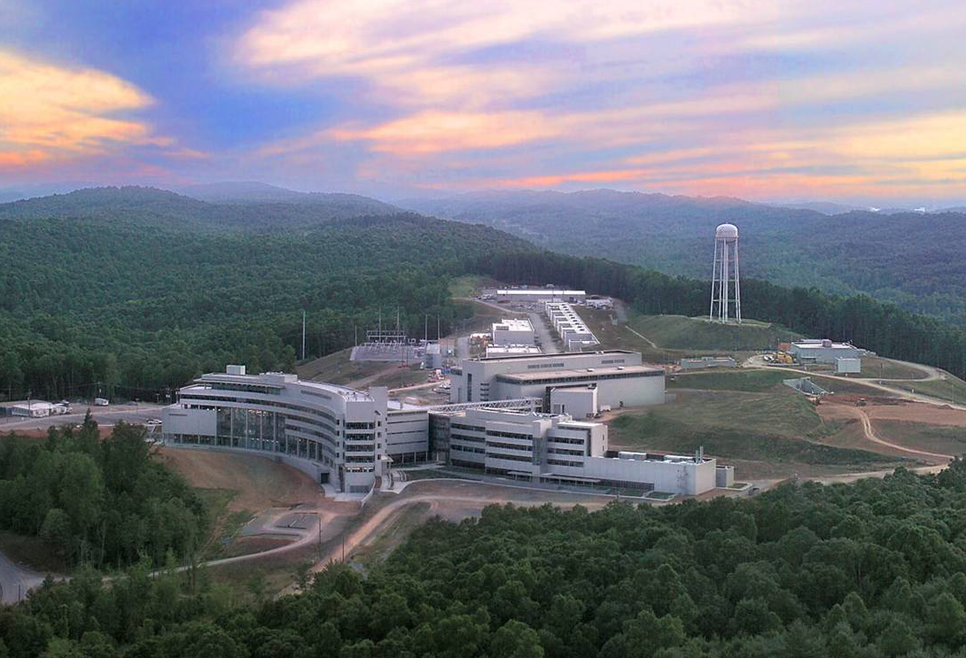
X-ray and Neutron Sources (most DOE-Basic Energy Sciences)
CHESS
-II
NIST NCNR
Also
5 DOE Nanoscience Centers (BNL, SNL/LANL, ORNL, ANL, LBNL)
DOE Electron Microscopy Centers (ANL, LBNL, ORNL)

Slide 3

DOE-BES Scientific User Facilities
Electron Microscopy Center for Materials Research
Advanced Photon Source
Materials Preparation Center
Advanced Light Source
Center for Nanoscale Materials
Intense Pulsed Neutron Source
Center for Functional Nanomaterials
National Center for Electron Microscopy
National Synchrotron Light Source
Molecular
Foundry
National Synchrotron Light Source-II
Stanford Synchrotron Radiation Lab
Spallation Neutron Source
Linac Coherent Light Source
Center for Nanophase Materials Sciences
Combustion Research Facility
Los Alamos Neutron Science Center
BES
Defense
Shared Research Equipment Program
Center for Integrated Nanotechnologies
High-Flux Isotope Reactor
Pulse Radiolysis Facility
Also
~42 EFRCs – Energy Frontier Research Centers, 4 HUBs
Advanced Scientific Computing Centers (e.g. NERSC)
NSF facilities (e.g. National High Magnetic Field Lab, CHESS, Nanotech)

Slide 4
ORNL Home to many User Facilities (acronym required)
HFIR - High Flux Isotope Reactor
SNS - Spallation Neutron Source
CNMS - Center for Nanophase Materials Sciences
OLCF - Oak Ridge Leadership Computing Facility
MDF – (additive) Manufacturing Demonstration Facility
BTRIC - Building Technologies Research and Integration Center
CSMB - Center for Structural Molecular Biology (Bio-SANS)
CFTF - Carbon Fiber Technology Facility
NTRC - National Transportation Research Center
SL - Safeguards Laboratory
SHaRE - Shared Research Equipment (TEM, merged in CNMS)
Also, 2 EFRC’s (Energy Frontier Research Centers), 1 Energy Hub (Nuclear Modeling and Simulation )
Try a google search of National Labs for your area

Slide 5
X-ray and Neutron Sources Available Worldwide
Scattering Science Goes Global – access varies
◆ Light Sources summarized at www.lightsources.org
>50 facilities, synchrotrons + free electron lasers (FELs)
•European Synchrotron Radiation Facility (ESRF), Grenoble, France
•SPRING-8, Japan
•PETRA III, Germany
•CLS, SLS, Shanghai, DIAMOND, BESSYII, SOLEIL, Taiwan, Pohang, …
•XFEL.EU, SACLA, FLASH, …
◆ Neutron Sources summarized at www.neutronsources.org
~50 research centers:
•Institut Laue-Langevin (ILL), Grenoble, France
•JSNS at J-PARC, Japan
•ISIS UK
•China Spallation Neutron Source, Dongguan (~2018, neutrons produced)
•European Spallation Source (ESS), Lund, Sweden (~2019, users 2023)

Slide 6
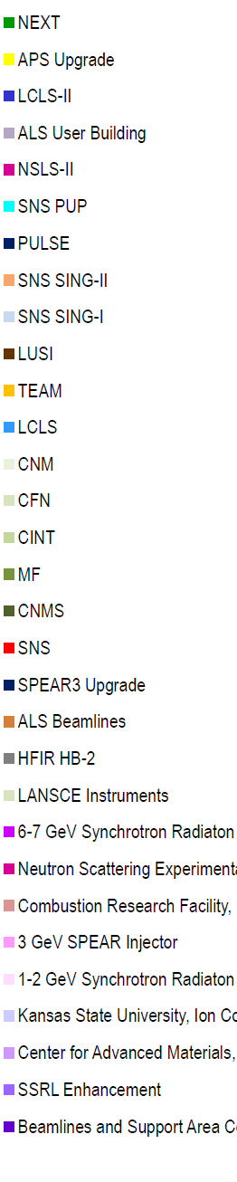
DOE-BES Facilities Construction ~35 Years
Funding
$400M
$300M
$K
APS-U
$200M
$100M
SNS
$1.4B
NSLS-II
LCLS-II
APS
LCLS
NSLS
1984
ALS
1994
2004
2014
2019
Year
What’s next ➔?

Slide 7
BES Construction Funding Decisions
Current & Near Future? BESAC – Basic Energy Sciences Advisory Committee
LCLS-II (ultrafast FEL, high rep MHz, $200M in FY18 & -HE started)
APS Upgrade (bright MBA, $93M in FY18, CD-2 review soon)
SNS Proton Power Upgrade (CD-1, $36M in FY18)
SNS 2nd Target (hi-res cold neutrons, CD-0)
ALS-U (MBA, $30M in FY18)
FY18 funding ↑ unexpected! Future? ↑↓? ? ? ? ? ?
Difficult choices with large impact.
X-ray coherence and ultrafast are growth areas (opportunities for you).
Ideally science driven, but sometimes ...
Official “Critical Decisions”
CD-0, Mission Need (proposal)
CD-1, Alternative Selection & Cost Range
CD-2, Performance Baseline
CD-3, Start of Construction
CD-4, Start of Operations

Slide 8
Critical Decisions are Critical
soon
CAUTION, big projects can be terminated or changed
ISABELLE (1983 p-p BNL) WASABELLE
Clinch River Breeder Reactor (1983 ORNL)
Superconducting Super Collider (1993 after $2B)
APS-Upgrade - at least 3 different themes (ERL, timing, MBA)
“If you like laws and sausages, you should never watch either one being made”
Otto von Bismarck

Slide 9
FY 2018 DOE BES Budget (unexpected +12%!)

Slide 10
BES User Facilities Hosted Over 15,000 Users in FY 2016
HFIR
SNS
LCLS
APS
ALS
SSRL
NSLS
NSLS-II
NSLS-II started early operations in FY 2015.
The three electron beam microcharacterization centers were merged administratively with their respective neighboring NSRCs in FY 2015.
The BES operations at the Lujan Neutron Scattering Center ceased operations in FY 2014.

Slide 11
Users by Discipline at the DOE Light Sources

Slide 12
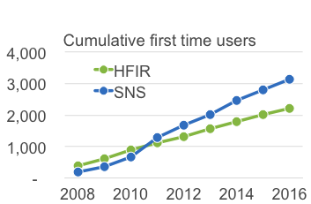
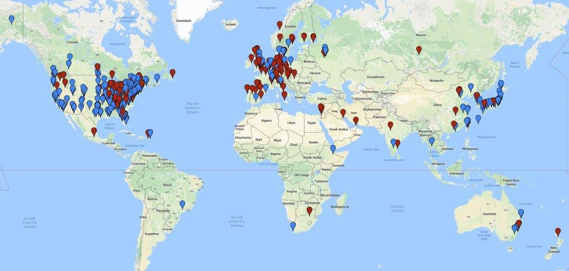
SNS and HFIR impact continues to grow
1355 experiments
~400/yr
Global SNS/HFIR Users

Slide 13
Overall subscription rates at HFIR/SNS remain high
HFIR
SNS
100%
~30%
receive beamtime

Slide 14

Neutron User Communities
Smaller than x-ray

Slide 15
Basics of the facility proposal systems
How do you get beamtime with enhanced success rate?
All the DOE (NIST & NSF) neutron and x-ray sources offer access to beam time through an experimental proposal system. “General Users (GU)”.
Proposal submission is done through a web-based application. When and how often proposals are submitted varies by facility.
  APS and NSLS-II three times (“cycles”) per year.
  SNS/HFIR and ALS two times per year
All proposals are peer-reviewed and rated, and beam time is allocated using the scores of these reviews. Once time has been allocated, the beamline staff schedule the proposals.

Slide 16
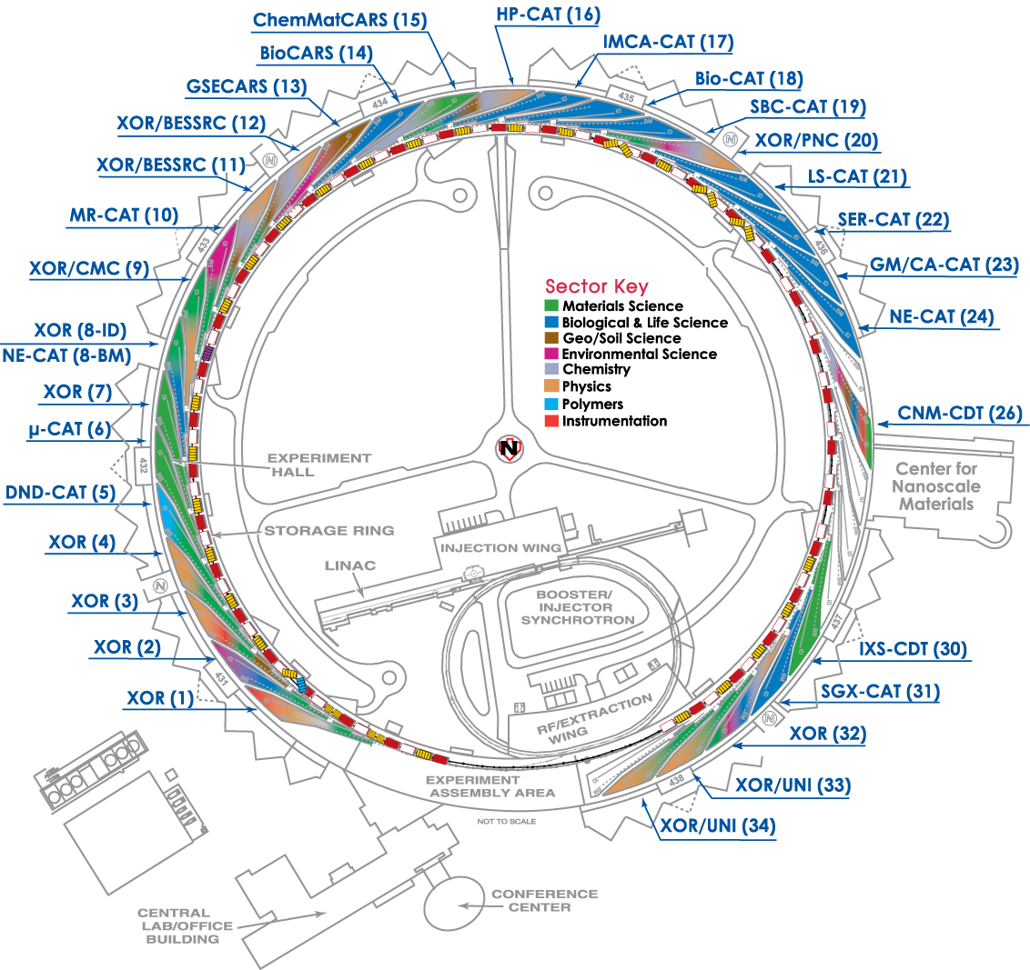
Amount of general user time available
APS/NSLS/SSRL/ALS
  All beamlines offer GU beam time.
  Most DOE/NSF funded beamlines provide 80-100% of their time to general users.
SNS/HFIR
  Amount varies by instrument.
  ~75% of time will be for general users.
For most, you can search facility websites by technique or by beamline. Quality of proposal websites varies.

Slide 17
Upcoming Proposal Deadlines
X-ray sources (cycles/yr) Deadlines
APS (3) Oct 26, 2018 (every 4 months)
ALS (2) Sept 5, 2018 (every 6 months)
NSLS-II (3) Sept 30, 2018
LCLS (~2) Feb 8, 2018 (down in 2019)
SSRL (3) May 1, Aug 1, Nov 1
CHESS Down for MBA upgrade
Neutron sources HFIR/SNS (2) Sept 18, 2018
NIST-NCNR (~2) July 11, 2018 (less regular)
These are hard deadlines.
APS at Friday midnight (12:05 → next cycle)
Inside Tip: Starting APS application process early (save without submitting) gives you a lower ID #.

Slide 18


Users Get Started with Assistance of the Instrument Scientists
Study instrument web pages
Contact an Instrument Scientist to discuss your research
  What is the research problem?
  Which instrument(s) are appropriate? (scores?)
  How mature is the research project (risk, size)?
  What is the material – sample composition, form, size, availability?
  What are the experimental conditions (temperature, pressure, magnetic field, etc)?
  What will be measured?
  Probability of success? Impact? Significance?
  How will results be presented and to whom?
  What is the timeline?

Slide 19
Instrument Scientists Assist First-time and Returning Users
Provide technical advice, guidance, and assistance
  Instrument options
  Sample and experiment preparation
  Number of experiment days
  Logistics (scheduling, transporting and storing samples)
  Proposal preparation tips and assistance
  Experiment team members
  Data analysis
  Publication considerations
In general, consider beamline staff as collaborators, include as co-authors if appropriate.

Slide 20
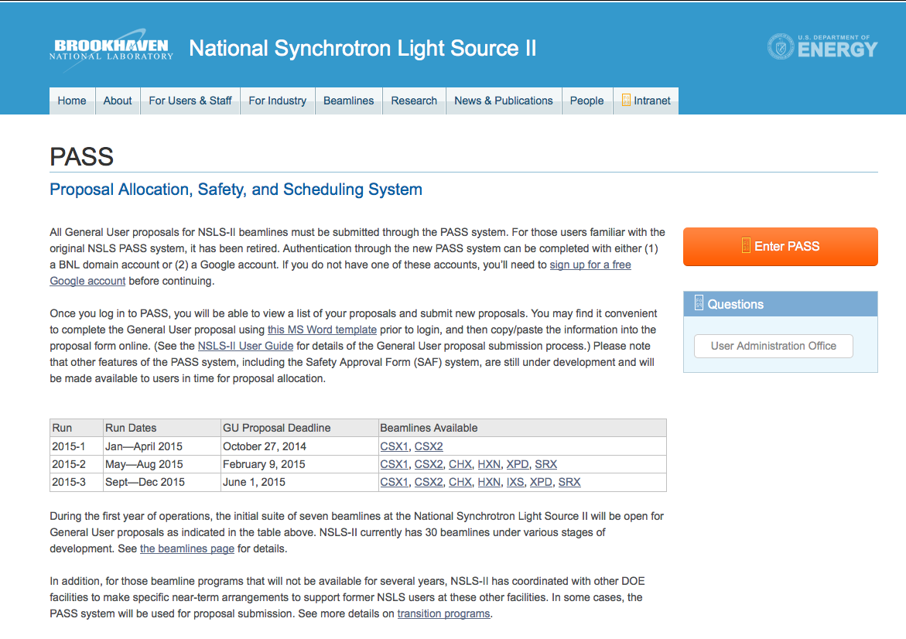
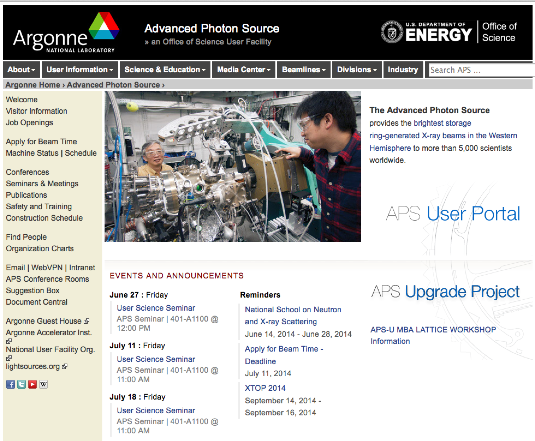
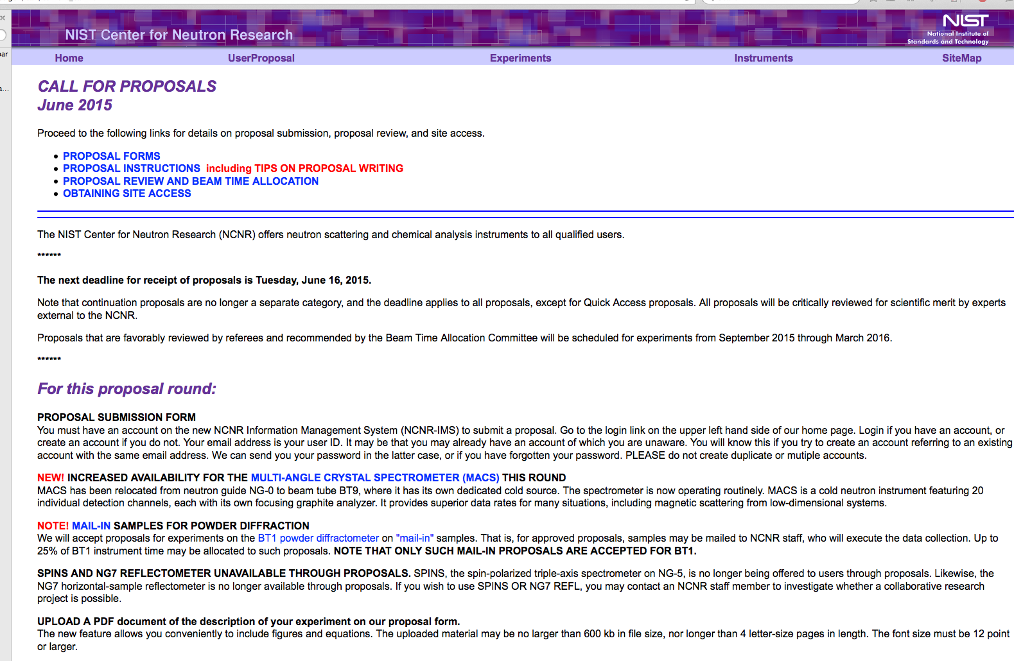
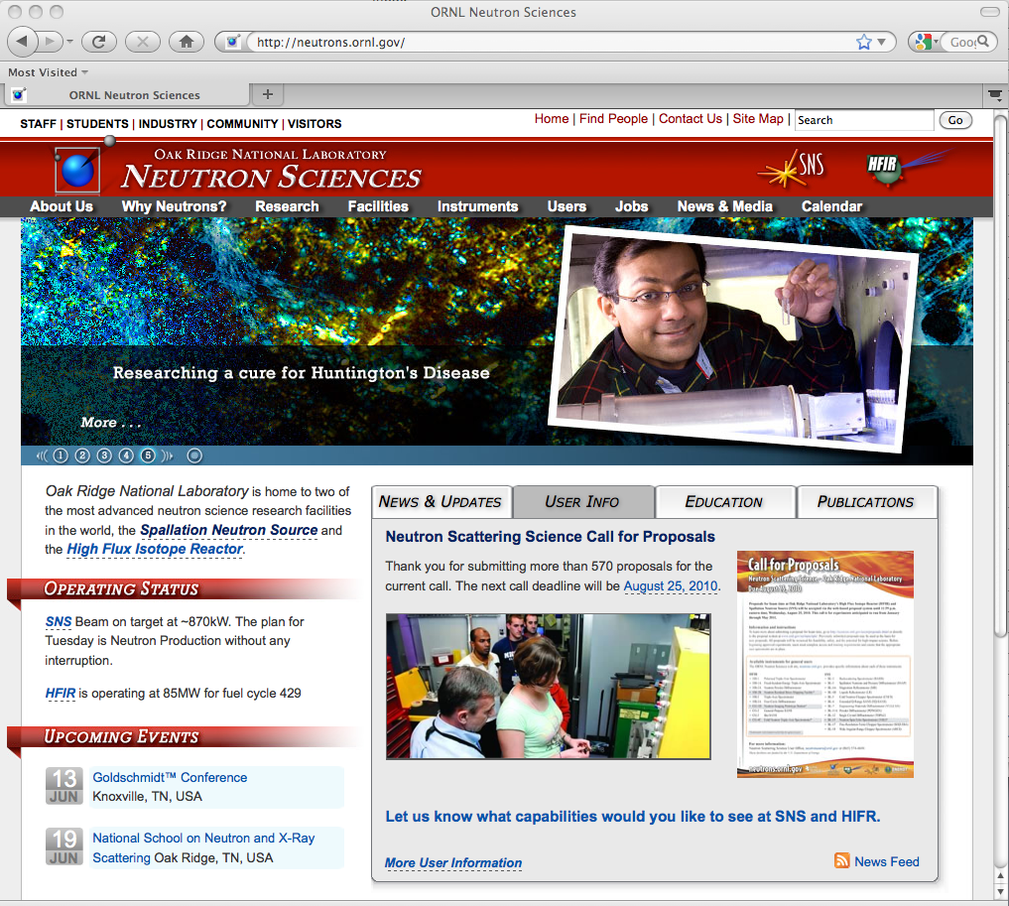
Submitting a proposal
Facilities have link on home page
NSLS-II
APS
NIST
SNS
HFIR

Slide 21
Different types of proposals allow facility flexibility
Each facility has particular systems or proposal modes:
APS
GUP - General User Proposal. A "rapid-access beamtime request" against a submitted proposal can be considered for any unallocated general user time during the current run.
PUP – Partner User Proposal - Groups whose work involves a greater degree of collaboration with the APS. (e.g. major new instrumentation or technique).
Rapid Access – after deadline, beamline staff can run if time available (quick, high impact)
Mail –in – 11 BM powder XRD accepts both on-site and rapid-access mail-in service. Very easy – they send you capillary tubes. This capability is not obvious on the GUP website.
CHESS – Cornell (currently down for an upgrade)
Express-Mode proposals are for a single visit of limited duration to CHESS to perform a straight-forward experiment. Express-Mode proposals undergo a rapid on-line review process to enable users to quickly gain access to beam time.
Feasibility Study proposals are to test an idea or procedure at one of the CHESS stations.
NSLS ➔ NSLS-II
17 NSLS-II beamlines now accepting General User Proposals
Commissioning on some other beamlines – opportunity to test ideas
Proposal types: General user, Discretionary (staff), Partner, Proprietary, Rapid Access

Slide 22
Different types of proposals allow facility flexibility – cont.
SNS HFIR
General User (majority of proposals – one cycle)
Programmatic (allows >1 cycle, e.g. your thesis)
Mail-in powder POWGEN, NOMAD, and VISION
Proof of principle (feasibility – 1 day)
Sample alignment (add to other proposal) HFIR CG-1B Laue
Rapid Access - high impact, can be submitted anytime
NIST NCNR
MAIL-IN SAMPLES FOR POWDER DIFFRACTION
Accepts proposals for experiments on the BT1 powder diffractometer on ”mail-in” samples. That is, samples may be mailed to NCNR staff, who will execute the data collection.
QUICK ACCESS PROPOSALS
If a user feels that beam time is required very soon to carry out important measurements that cannot be delayed, a proposal may be submitted requesting expedited access. The proposal will be reviewed by the BTAC, and held to a substantially higher standard than regular proposals.
Macromolecular Crystallography is often a separate, self-contained community
A separate proposal system at APS.
Highly automated for mail-in measurements.
Beamtime relatively available.

Slide 23
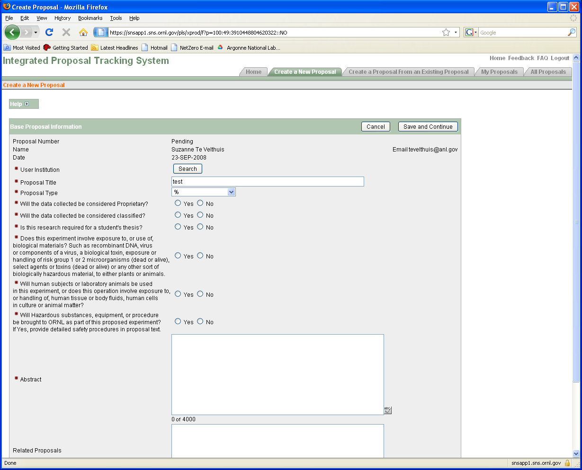
Proposal forms at SNS and APS
SNS/HFIR
APS
Each proposal system will ask very similar questions

Slide 24
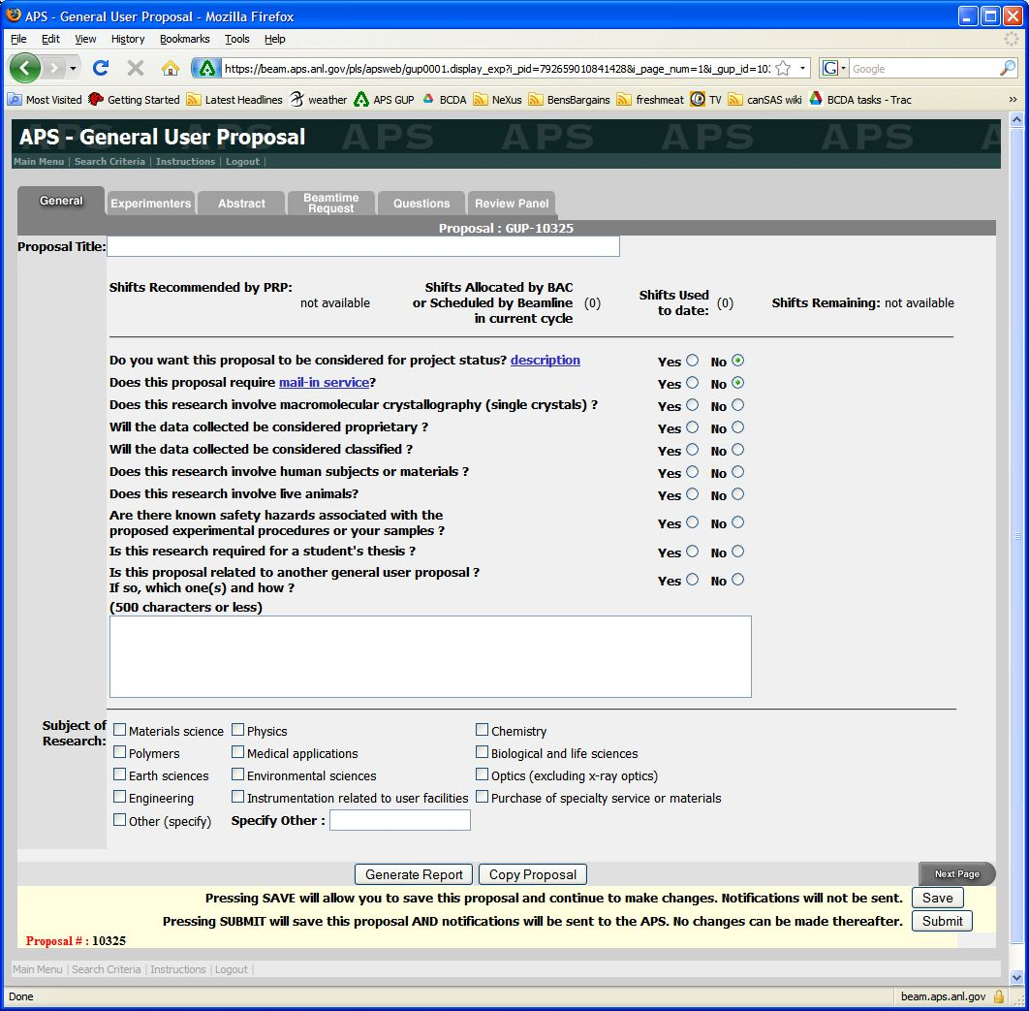
Proposal forms at SNS and APS
SNS/HFIR
APS
Each proposal system will ask very similar questions

Slide 25
Questions asked
Proposal Title
General Info (Title, Experimenters, Funding source, etc.)
Abstract - What is the scientific importance of the proposed research?
Why do you need the facility to do this research?
  (Neutron vs. X-rays) or (Neutrons + X-rays)?
  Why do you need an insertion device beamline instead of a bending magnet?
  Spallation source vs. reactor source
  Hard X-rays vs. Soft X-rays
Why do you need the beam line (and/or instrument)?
  Particular technique or sample environment
What previous experience / results do you have (pubs important)?
Describe the proposed experiment(s), including samples and procedures. Show that you’re prepared.
Justification of the amount of time requested. Don’t be greedy or unrealistic about time needed. Ask beamline staff.

Slide 26
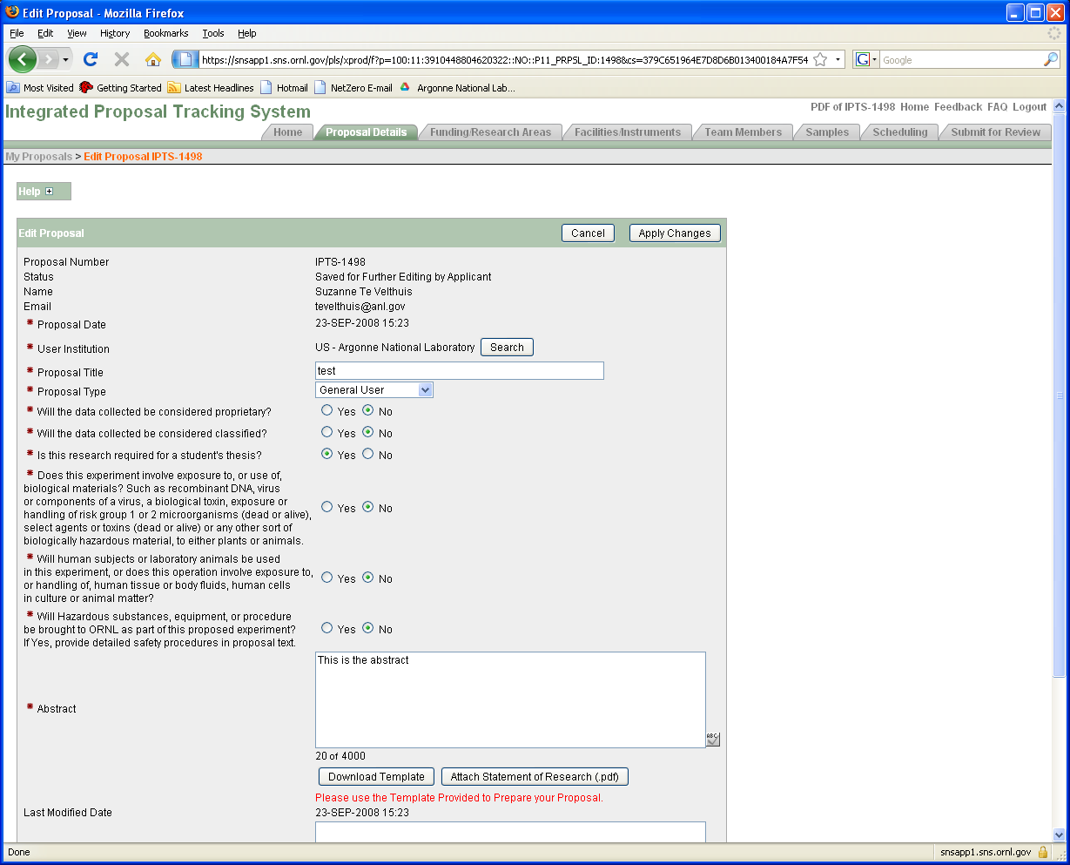
General Information

Slide 27
Proposal: General information
Pick a good title. Specific and to the point is better than spectacular and vague. Spectacular and specific is fine if credible.
  Good: “XAS study of Fe valence in CaFe2As2 under pressure ”
  Bad: “Understanding superconductivity in superconductors”
Is it thesis related? Is there a deadline?
  Will push your proposal up if scores are close
Fill in the abstract - This is where reviewer develops first impression.
  Do not just upload a PDF document! More work for reviewer.
  Science impact in abstract is most important criteria for score.
Do upload a figure/publication from previous work.
  Shows you made good use of beam time. Becoming more important.
  Do not upload a 20 pages of supplemental information (figures often help, couple of plots with text OK)

Slide 28
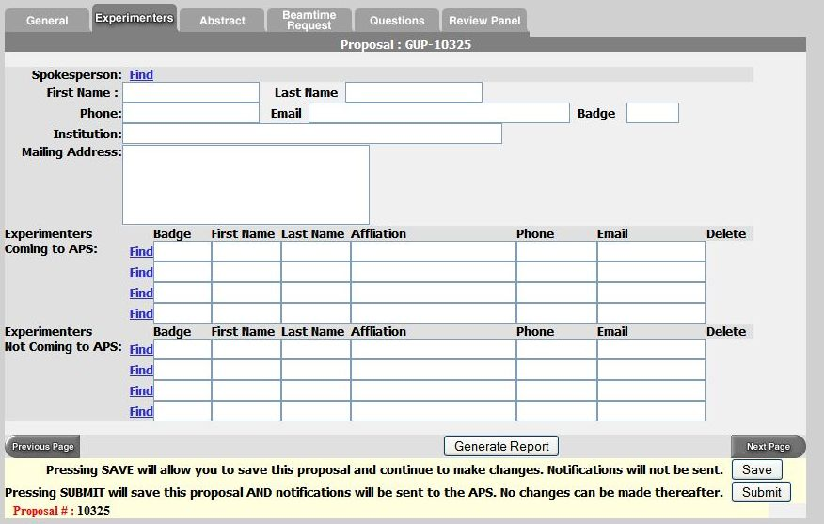
Proposal: Experimenters page
Use the “find” feature
List everyone involved in experiment
Even theorists are useful to show impact and collaborations

Slide 29
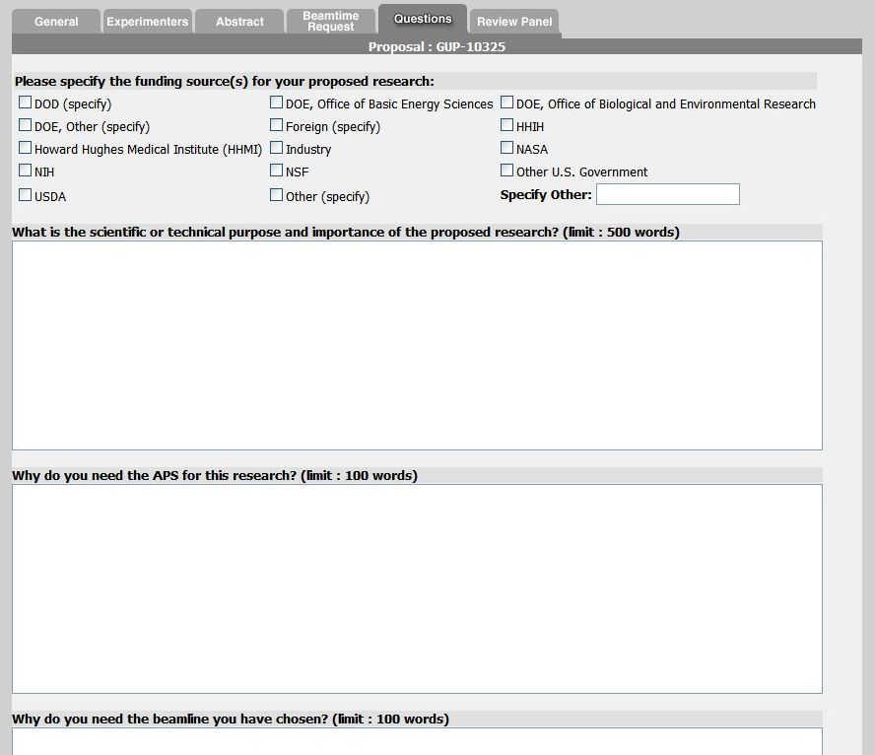
Experiment Description
Note guidance! Don’t write one sentence or 1000 words.
Do not use undefined jargon or acronyms that could frustrate reviewer!

Slide 30
Experimental Details
Give background information why it is important.
  Science at facilities is very diverse. Reviewer is not necessarily an expert on your subject. Try to capture imagination of reviewer with basic idea.
  Each committee gets many proposals each cycle. Proposal needs to be clear.
Clearly state what you want to measure and how
  Give some details. Temperature range, X-ray Energy, Sample geometry
  Sample characterization (XRD, SEM, etc.) and preliminary data important.
  Reviewer and beamline need to judge if experiment is feasible
    Does x-ray energy match laser penetration depth
    % of dilute atoms OK for fluorescence measurements
Why use x-rays or neutrons?
  Neutron vs. X-rays OR Neutron + X-rays?
  TEM, Mössbauer, Laser Raman, etc. (Have you done your homework?)
Justify the amount of beam time requested (ask instrument scientist!)
Be reasonable.

Slide 31
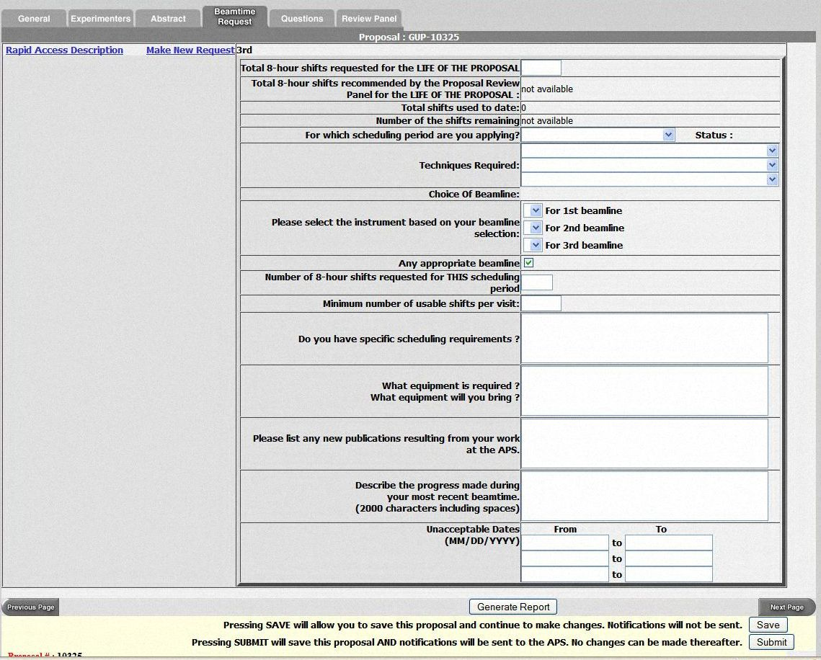
Beamtime Request
APS proposals are valid for two years, but need to put in beam time request each cycle.
Chose multiple beamlines.
  SAXS (12-ID, 5-ID, 15-ID)
  XAFS (20-BM, 10-ID,12-BM)
  General Diffraction
Don’t list only one week that you can come. Holidays?
Special sample environment / detectors will place more constraints on schedule.
  GE amorphous Si detector
  Magnet
  ….

Slide 32
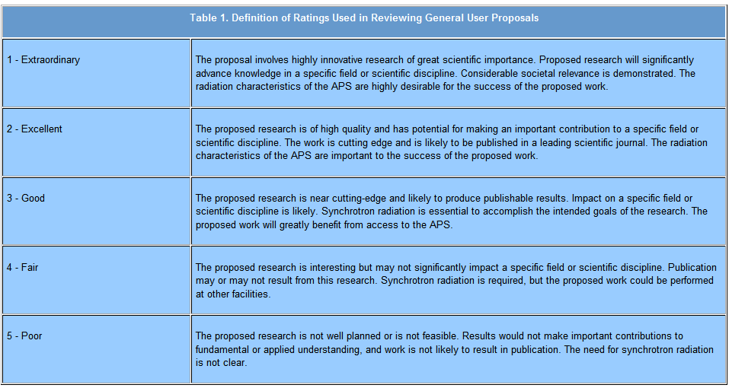
Ratings for APS Proposals
APS proposals are rated on a scale from 1 to 5
Average score was ~2.2, but seems to slowly decrease
Cut off score for receiving beam time varies by beamline (1.5 - 2.2)
Proposal “ageing” (score improves by 0.2 each cycle it does not receive time). This is needed for getting time at some oversubscribed beamlines, so long-term planning is needed. But you have to remember to request beamtime again for every cycle.

Slide 33
Pick appropriate panel!
13 Current Panels
High Pressure
Instrumentation
Imaging/Microbeam
Macromolecular Crystallography
Scattering - Condensed Matter
Scattering - Applied Materials
Scattering – Chem / Biol / Environment
Small Angle Scattering (SAXS)
Spectroscopy
Structural Science
Inelastic X-ray scattering
Pump Probe
Dynamic Compression
If multiple possibilities - Look at members & Ask staff
https://www1.aps.anl.gov/About/Committees/Proposal-Review-Panels

Slide 34
ALS provides cutoff scores – Helps you know what to expect
https://als.lbl.gov/general-user-proposal-score-statistics/
Beamline cutoff scores
easier
10,010 shifts requested. 3,375 shifts allocated
“Medium priority”
at Lake Wobegon
harder
1
2
3
4
harder
SNS/HFIR does not tell you a score or panel members.
You can try asking user office or beamline.

Slide 35
Tips (see also https://neutrons.ornl.gov/users/tips)
Give a concise explanation of this specific proposal
  Provide background on importance (i.e., “bigger picture”)
  State clearly and exactly what you are going to measure and why.
    Reviewer want to assess likelihood of success.
Include relevant details to experiment but do not get too verbose
  Reviewer needs to judge not only scientific importance, but also if the experiment is feasible and if you are asking for the right instrument.
Talk to the local contact/instrument scientist.
  Find out about details of the instrument, typical measuring times…
  Over-subscription rate? Can a less popular instrument do the same measurements?
  Send them the proposal ahead of time and ask for advice. Collaborate?
If you have previous results, include them! Stronger proposal.
  Home, other institution, previous experiment.
  Sample characterization.
Take advantage of proposal ageing (APS, NSLS-II). Plan ahead!
Do not submit a bad proposal if you get rushed. Reviewer will not appreciate.

Slide 36
Several common pitfalls
Proposer assumes committee is familiar with their research and jargon. Explain.
Proposal provides minor details, but does not address ”Why should I care?”.
Proposer writes large general vague proposal asking for multiple weeks of time. Better to write a shorter proposal with a well defined objective. Be realistic with beam time request.
Proposer submits 2 (or more) similar proposals for related materials thinking that multiple proposals increases chances. Reviewers may not appreciate.
Common Reviewer comments:
“Proposers could improve their score by including more experimental details, attaching previous results and expanding on the purpose and importance of the research.”
“Hasn't the proposed research been published previously?”
“We do not feel that granting 20 shifts/cycle for 2 years is consistent with the history of publication of this work.”
“Proposer should perform initial characterization with lab sources or TEM.”
“Will the signal be strong enough compared to background?”

Slide 37
After submission
Allow time for review and revisions
Expect feedback several weeks from the call close
Be ready to schedule experiment if approved
  Identify participating team members
  Respond to facility access approval information
  Facilitate execution of user agreements
  Complete required training. (APS electrical safety)
  Confirm sample availability and description and laboratory needs
Consider reviewer comments if not approved and plan to resubmit this proposal or a new proposal in the next call. Opportunities (# of facilities and beamlines/facility) continue to grow.

Slide 38
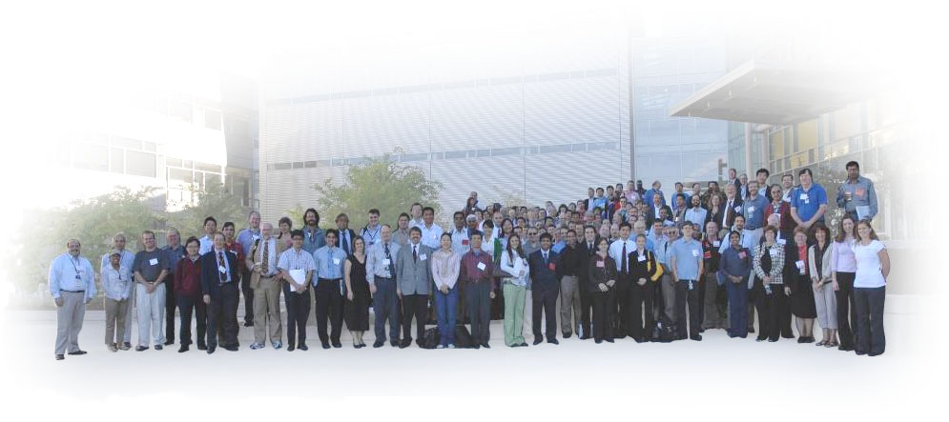
Scientific and Funding Opportunities
As a student
Attend neutron & x-ray schools, workshops & user meetings. Knowledge and
connections have long-term impact. Collaborations are essential.
Join SNS HFIR User Group (SHUG) and other facility user organizations
Advocacy group, learn about and influence new developments
Explore DOE and NSF internships, fellowships, and research programs
SCGSR; ORISE/ORAU (HERE, GO!). Local contacts help (a lot).
https://science.energy.gov/wdts/scgsr/how-to-apply/priority-sc-research-areas/
Invite scientists from national labs to your campus, e.g. for seminar
As a young professional
Continue to use “free” user facilities
New faculty and industrial users can be favored in reviews
Volunteer to be a reviewer on proposal panels
Consider EPSCoR programs if located in an a participating state
Apply for Early Career award – great for tenure application
Notes:
User meeting – only time I have time to see Chicago, Field museum,

Slide 39
Experimental Program to Stimulate Competitive Research
EPSCoR State Institutions are eligible for grants to support research
  http://www.nsf.gov/div/index.jsp?org=EPSC
  https://science.energy.gov/bes/epscor/
~23 states, Puerto Rico, Guam, and the U.S. Virgin Islands are eligible to participate in the DOE EPSCoR program, but the list changes with federal funding.

Slide 40
Office of Science Early Career Research Program
(for your future – very good for tenure)
Purpose: To support individual research programs of outstanding scientists early in their careers and to stimulate research careers in the disciplines supported by the Office of Science
Eligibility: Within 10 years of receiving a Ph.D., either untenured academic assistant professors on the tenure track or full-time DOE national lab employees (no postdocs)
Award Size:
  University grants $150,000 per year for 5 years to cover summer salary and expenses
  National lab awards $500,000 per year for five years to cover full salary and expenses
FY 2017:
  59 scientists funded (typically ~700 applications), 20 National Labs + 39 Universities
  Usually pre-application in Sept, Full applications from those encouraged in November.
Typically:
  Success rate ~5-10%, but you can later use ideas in other funding proposals.
  Physics > Engineering > Chemistry
http://science.energy.gov/early-career/

Slide 41


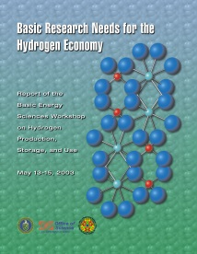









Proposal Resource: “Basic Research Needs Workshop on…”
~50 reports in past ~20 yrs; Participants from academia, industry, and DOE labs
  BES at 40: Remarkable Return on Investment in Fundamental Research
  Basic Research at the Frontiers of XFEL Ultrafast Science (2017)
  Quantum Computing in Chemical and Materials Sciences (2017)
  BRN on Energy and Water (2017)
  BRN for Future Nuclear Energy (2017)
  BRN on Next Generation Electrical Energy Storage (2017)
  BRN on Catalysis Science (2017)
  BRN Synthesis Science for Energy Relevant Technology (2016)
  BRN on Future Electron Sources (2016)
  BES Computing - Exascale Requirements Review (2015)
  BRN Quantum Materials for Energy Relevant Technology (2015)
  BRN for Environmental Management (2015)
  Challenges at the Frontiers of Matter and Energy (2015)
  Controlling Subsurface Fractures and Fluid Flow (2015)
2002-2018
http://science.energy.gov/bes/community-resources/reports/
Focused on current & future, not a scientific review – good source of science motivation

Slide 42

You can help plan future Scientific User Facilities
Under construction at the time of the evaluation
  Spallation Neutron Source
  5 Nanoscale Science Research Centers
  SSRL (SPEAR3) upgrade
Facilities underway since the evaluation
  TEM Aberration Corrected Microscope
  Linac Coherent Light Source
  National Synchrotron Light Source - II
Facilities rated longer-term priority at the time of the evaluation
  Spallation Neutron Source power upgrade (started)
  Spallation Neutron Source 2nd target station (planned)
  Advanced Light Source upgrade (started)
  Advanced Photon Source upgrade
What’s next in planning?
  Ongoing BESAC Future Science Needs and Opportunities Evaluations
operating
operating
operating
operating
operating
operating
(started - 3 times!)
BESAC evaluation
Report released late 2003
Available at
www.science.energy.gov/bes/archives/plans/FFS_10NOV03.pdf

Slide 43
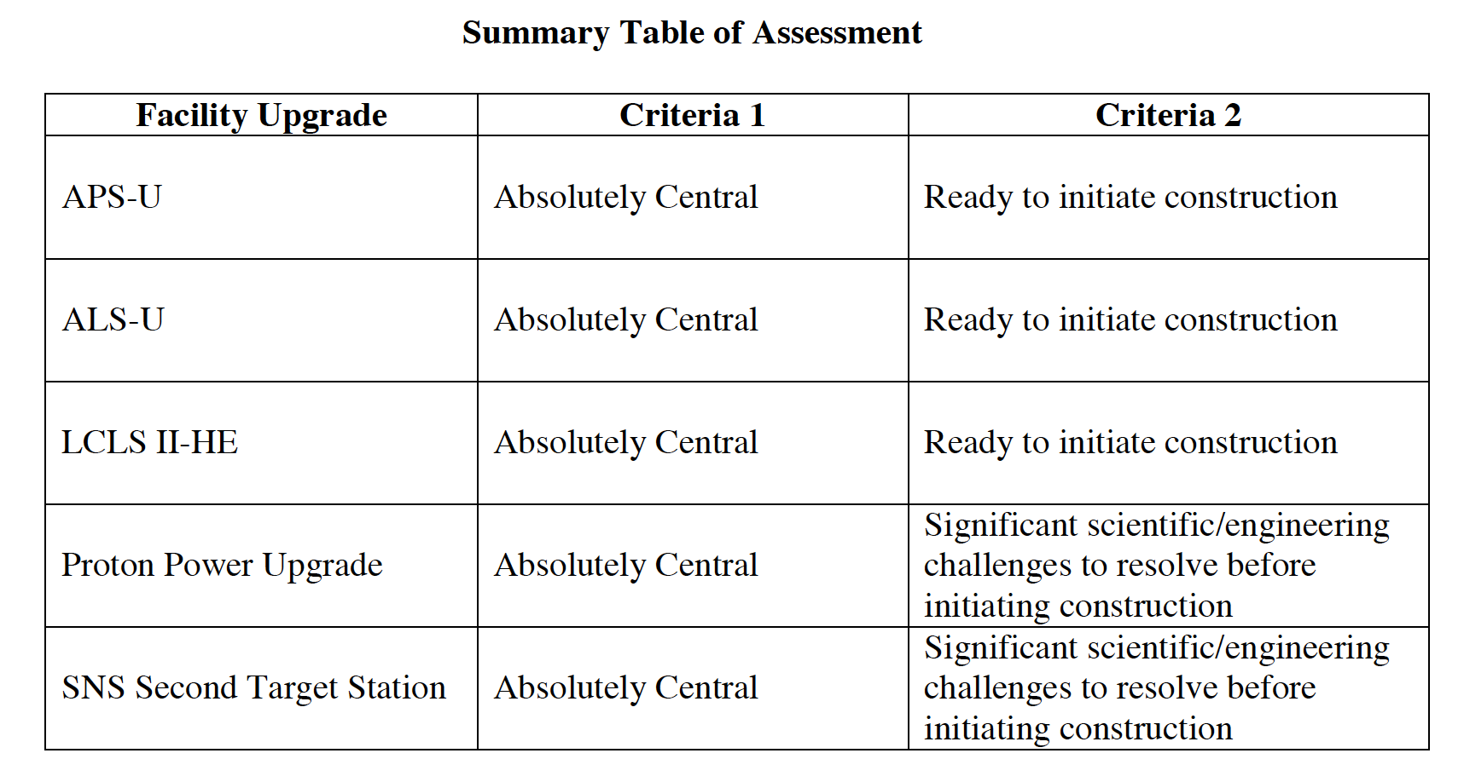
Next Generation Light/Neutron Sources continuously debated
BESAC = Basic Energy Sciences Advisory Committee
BESAC Report on Facility Upgrades, 2016
http://science.energy.gov/bes/besac/reports/
Many competing choices
Storage ring vs Free electron laser
APS/ESRF based on MAX IV Low-emittance MBA lattice
Energy recovery linac (ERL)?
High rep rate, Hard/soft FEL?
Spallation rep rate, resolution?
Neutron target material/lifetime, power options?
Impact of large Scientific User Facilities has grown significantly in the past ~30 yrs. They represent ~55% of BES budget and growth will continue.
They enable powerful new techniques, but researchers (you) have to drive the science.

Slide 44
Summary - Advice for Getting Beamtime and Funding
Volunteer, be engaged:
Be nice to colleagues
Be nice to beamline staff
Professional organizations
Proposal review panels
Design/Justify facilities
Design/Justify a capability
Better Science, Proposals
Collaborations, favors
Beamtime, experimental help
Research ideas, collaborations
Write better proposals
Know how to use facilities
Get capabilities you want
Submit great proposals
Good science, enthusiasm, politics, luck & perseverance
GOOD LUCK AND HAVE FUN!

Slide 45
QUESTIONS?

