Slide 1
Dynamic Nuclear Polarization for Neutron Scattering
Josh Pierce
Neutron Technologies Division
Oak Ridge National Laboratory

Slide 2
Community Scientific Needs: Smaller Samples and Faster Data Collection
Grand Challenges: Cold neutron flux: “Radically increase the flux of neutron beam lines at long wavelengths in particular for small angle scattering, crystallography, and spin echo.”
How can we accomplish this without building a new facility?
Gains Required
Data set in 1 day x20
Reduce crystal size to 0.001mm³ x100
At the workshop, 37 invited leading researchers from more than 20 different universities and institutes joined 5 participants from the Neutron Sciences Directorate of ORNL to map out 10 grand challenges that we face in biological research over the next 10 years.

Slide 3



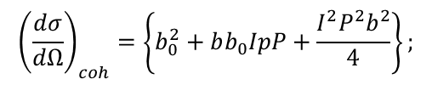
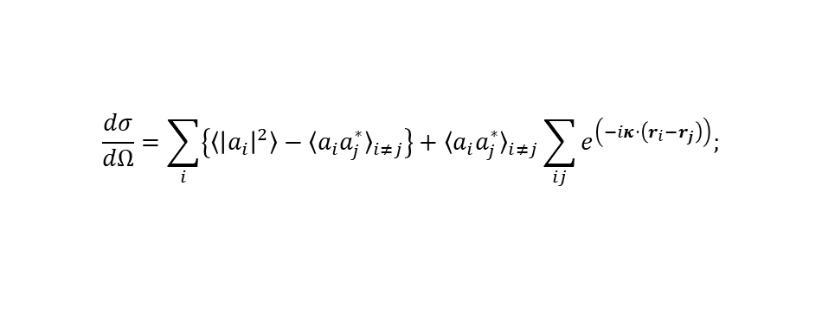
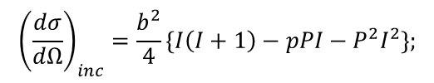

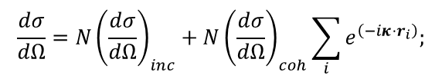
Spin Dependence of Neutron Scattering
$$a=b_{0}+bI⋅s$$
For a lattice of identical atoms with non-zero spin, the incoherent and coherent cross section for neutron scattering has a dependence on the spin alignment of the neutron and the struck nucleus
Control over spin orientation gives control over scattering.
Neutron Polarization is well developed
  Supermirror polarizers
  3He filters
Nuclear Polarization is more challenging
${\left(I⋅s\right)}_{±}=\frac{1}{2}\left\{\left(I±\frac{1}{2}\right)\left(I±\frac{1}{2}+1\right)−I\left(I+1\right)−\frac{3}{4}\right\}$;
$$\frac{dσ}{dΩ}=\sum_{i}{\left\{〈{\left|a_{i}\right|}^{2}〉−{〈a_{i}a_{j}^{∗}〉}_{i≠j}\right\}}+{〈a_{i}a_{j}^{∗}〉}_{i≠j}\sum_{ij}{e^{\left(−iκ⋅\left(r_{i}−r_{j}\right)\right)};}$$
$$〈I_{i}⋅I_{i}〉=〈I_{i}⋅I_{j}〉=P^{2}I^{2}; 〈I_{i}×I_{i}〉=0; 〈s⋅I_{i}〉=\frac{pPI}{2};$$
$${〈a_{i}a_{j}^{∗}〉}_{i≠j}=b_{0}^{2}+bb_{0}IpP+\frac{b^{2}I^{2}P^{2}}{4};$$
$$〈{\left|a_{i}\right|}^{2}〉=b_{0}^{2}+bb_{0}IpP+\frac{b^{2}}{4}\left\{I\left(I+1\right)−pPI\right\};$$
$$\frac{dσ}{dΩ}=N{\left(\frac{dσ}{dΩ}\right)}_{inc}+N{\left(\frac{dσ}{dΩ}\right)}_{coh}\sum_{i}{e^{\left(−iκ⋅r_{i}\right)};}$$
$${\left(\frac{dσ}{dΩ}\right)}_{inc}=\frac{b^{2}}{4}\left\{I\left(I+1\right)−pPI−P^{2}I^{2}\right\};$$
$${\left(\frac{dσ}{dΩ}\right)}_{coh}=\left\{b_{0}^{2}+bb_{0}IpP+\frac{I^{2}P^{2}b^{2}}{4}\right\};$$

Slide 4
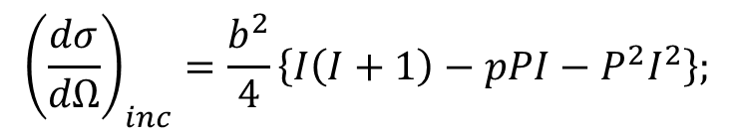
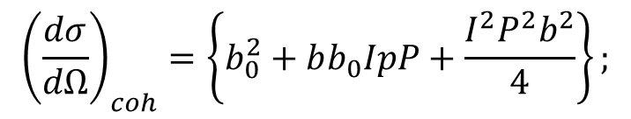
Spin Dependence of Neutron Scattering
For a lattice of identical atoms with non-zero spin, the incoherent and coherent cross section for neutron scattering has a dependence on the spin alignment of the neutron and the struck nucleus
Control over spin orientation gives control over scattering.
Neutron Polarization is well developed
  Supermirror polarizers
  3He filters
Nuclear Polarization is more challenging
$${\left(\frac{dσ}{dΩ}\right)}_{inc}=\frac{b^{2}}{4}\left\{I\left(I+1\right)−pPI−P^{2}I^{2}\right\};$$
$${\left(\frac{dσ}{dΩ}\right)}_{coh}=\left\{b_{0}^{2}+bb_{0}IpP+\frac{I^{2}P^{2}b^{2}}{4}\right\};$$

Slide 5
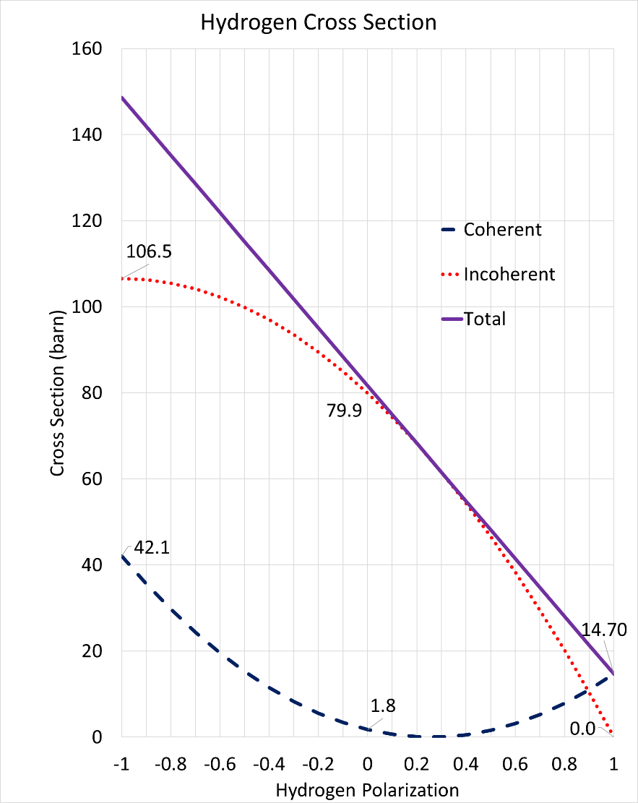
Spin Dependence of Neutron Scattering from Hydrogen
Hydrogen is a special case
  The spin dependence of the hydrogen cross section is very large
  Looking for hydrogen locations is a primary motivation for Neutron Protein Crystallography
Incoherent scattering can be removed entirely (true for any nucleus)
Coherent scattering can be increased by a factor of 7 (or 20)
An increase in signal to noise enters squared into the calculation figure
of merit
  Factor of 10 in signal to noise is a
  factor of 100 in flux/sample size/data collection time
The hydrogen nucleus is polarizable
Coherent, incoherent and total scattering cross section of hydrogen as a function of the proton polarization for fully polarized neutrons.

Slide 6
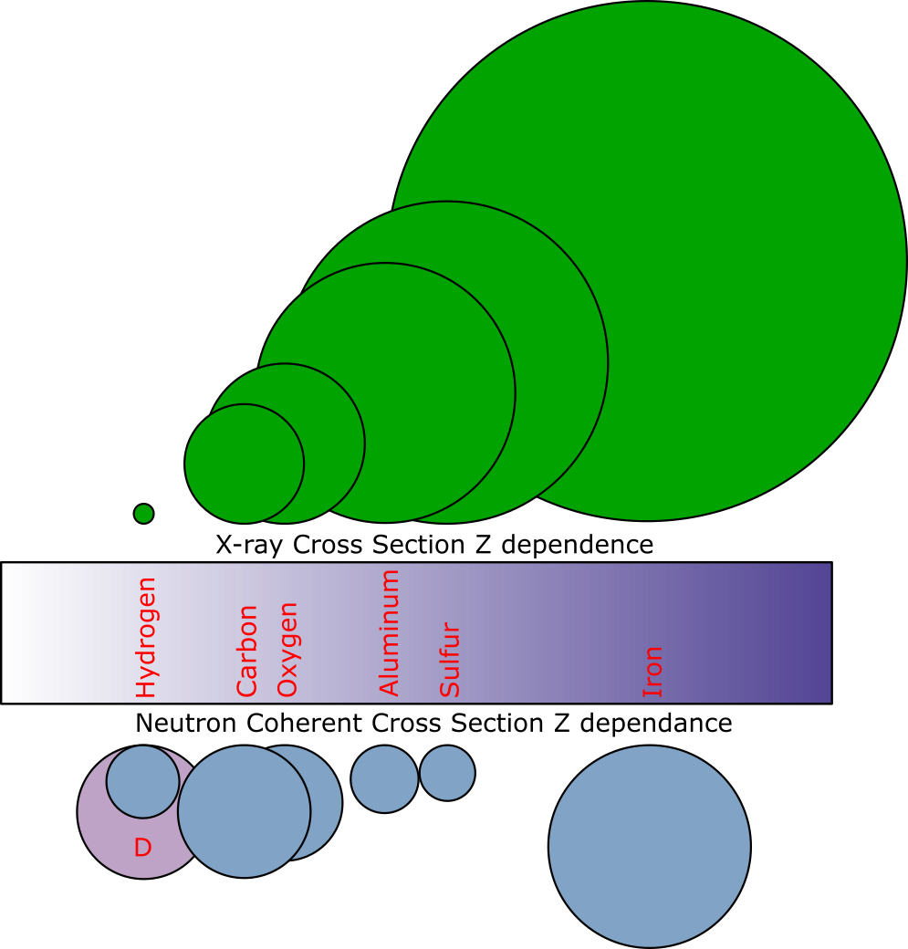
Spin Dependence of Neutron Scattering from Hydrogen
Hydrogen is a special case
  The spin dependence of the hydrogen cross section is very large
  Looking for hydrogen locations is a primary motivation for Neutron Protein Crystallography
Incoherent scattering can be removed entirely (true for any nucleus)
Coherent scattering can be increased by a factor of 7 (or 20)
An increase in signal to noise enters squared into the calculation figure
of merit
  Factor of 10 in signal to noise is a
  factor of 100 in flux/sample size/data collection time
The hydrogen nucleus is polarizable

Slide 7
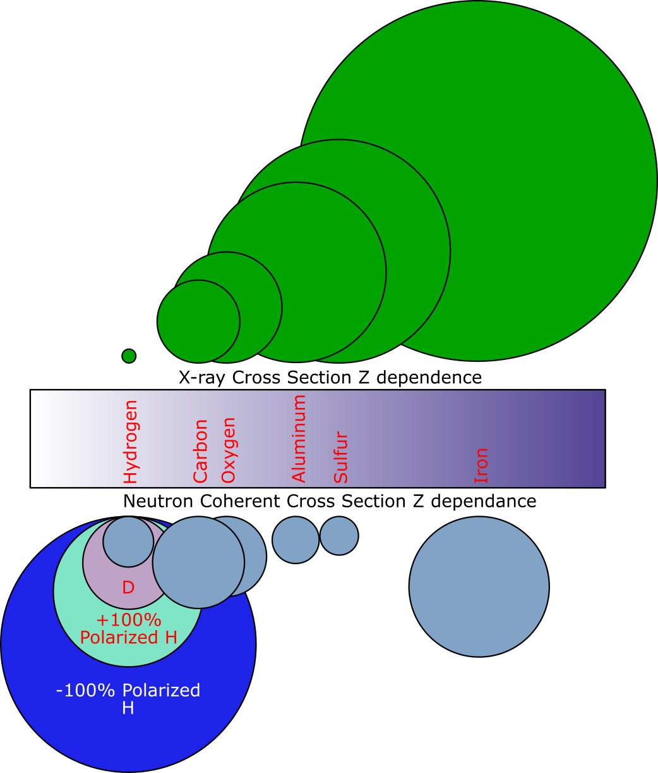
Spin Dependence of Neutron Scattering from Hydrogen
Hydrogen is a special case
  The spin dependence of the hydrogen cross section is very large
  Looking for hydrogen locations is a primary motivation for Neutron Protein Crystallography
Incoherent scattering can be removed entirely (true for any nucleus)
Coherent scattering can be increased by a factor of 7 (or 20)
An increase in signal to noise enters squared into the calculation figure
of merit
  Factor of 10 in signal to noise is a
  factor of 100 in flux/sample size/data collection time
The hydrogen nucleus is polarizable

Slide 8
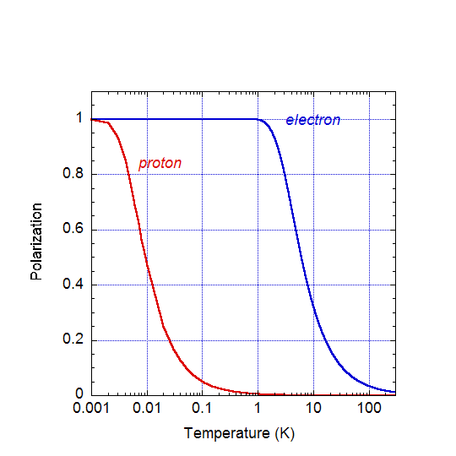
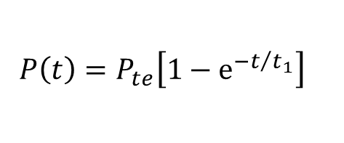
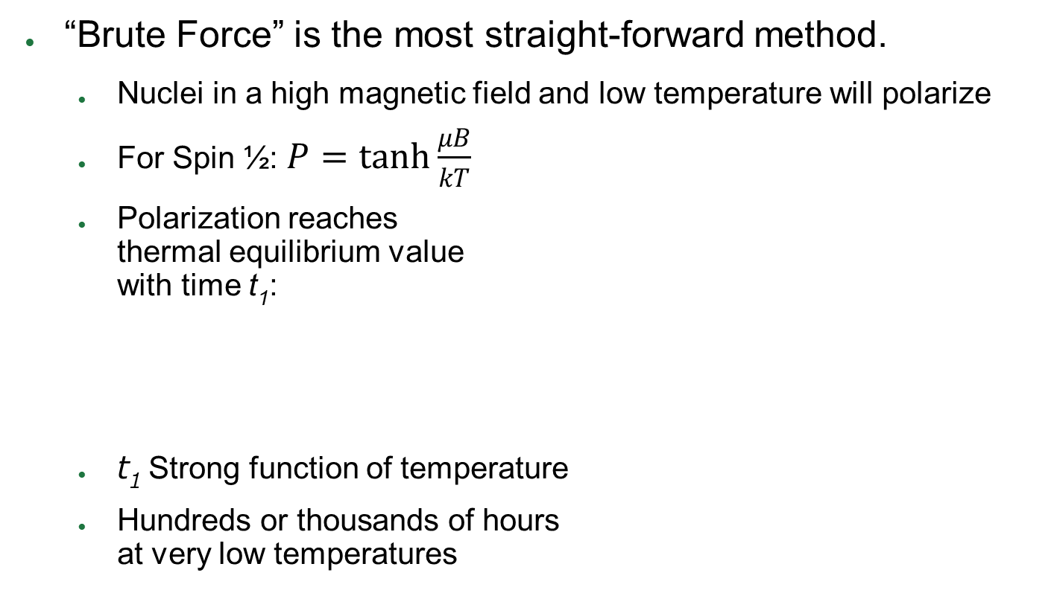
Polarization Methods
“Brute Force” is the most straight-forward method.
  Nuclei in a high magnetic field and low temperature will polarize
  For Spin ½: $P=\tanh{\frac{μB}{kT}}$
  Polarization reaches
  thermal equilibrium value
  with time t₁:
  t₁ Strong function of temperature
  Hundreds or thousands of hours
  at very low temperatures
$$P\left(t\right)=P_{te}\left[1−e^{{−t}/{t_{1}}}\right]$$
Thermal equilibrium polarization at 5 Tesla

Slide 9
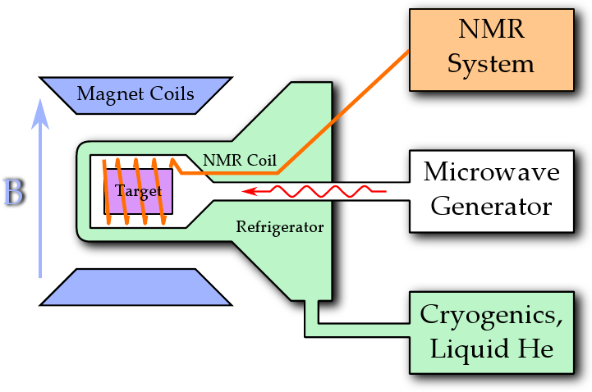
Dynamic Nuclear Polarization
Uses a combination of high B field, low T and microwave irradiation to polarize target material that has been prepared by the addition of paramagnetic centers

Slide 10
Dynamic Nuclear Polarization
At low temperatures and high field, take advantage of the “brute force” polarization of the electron.
  >99% for 5T and 1 Kelvin
  Compare to 0.5% for the proton
Use microwaves to “transfer” the polarization from the electrons to the nucleons
Polarization is created near electrons, the propagates away through spin diffusion
Three main mechanisms
  Solid Effect
  Thermal Mixing
  Cross effect

Slide 11
Solid Effect
e↑ p↓
nmr
e↑
e↑ p↑
B↑
epr
e↓ p↓
e↓
nmr
e↓ p↑

Slide 12
Solid Effect
e↑ p↓
nmr
e↑
e↑ p↑
B↑
microwaves
ν=ν_{epr}-ν_{nmr}
epr
e↓ p↓
e↓
nmr
e↓ p↑

Slide 13
Solid Effect
e↑ p↓
nmr
e↑
e↑ p↑
B↑
microwaves
ν=ν_{epr}-ν_{nmr}
epr
Electron relaxation
e↓ p↓
e↓
nmr
e↓ p↑

Slide 14
Solid Effect
e↑ p↓
nmr
e↑
e↑ p↑
B↑
microwaves
ν=ν_{epr}-ν_{nmr}
epr
Electron relaxation
e↓ p↓
e↓
nmr
e↓ p↑

Slide 15
Solid Effect
e↑ p↓
nmr
e↑
e↑ p↑
B↑
microwaves
ν=ν_{epr}-ν_{nmr}
epr
Electron relaxation
e↓ p↓
e↓
nmr
e↓ p↑

Slide 16
Solid Effect
e↑ p↓
nmr
e↑
e↑ p↑
B↑
microwaves
ν=ν_{epr}-ν_{nmr}
epr
Electron relaxation
e↓ p↓
e↓
nmr
e↓ p↑

Slide 17
Solid Effect
e↑ p↓
nmr
e↑
e↑ p↑
B↑
microwaves
ν=ν_{epr}-ν_{nmr}
epr
Electron relaxation
e↓ p↓
e↓
nmr
e↓ p↑

Slide 18
Solid Effect
e↑ p↓
nmr
e↑
e↑ p↑
B↑
microwaves
ν=ν_{epr}-ν_{nmr}
epr
Electron relaxation
e↓ p↓
e↓
nmr
e↓ p↑

Slide 19
Solid Effect
e↑ p↓
nmr
e↑
e↑ p↑
B↑
Equilibrium Reached
microwaves
ν=ν_{epr}-ν_{nmr}
epr
Electron relaxation
e↓ p↓
e↓
nmr
e↓ p↑

Slide 20
Thermal Mixing
Spin-spin interaction means that there are no longer discrete electron energy levels
Three important temperatures determine the state of the electrons
  T_{L} The temperature of the lattice
  T_{Z} The temperature of the electron Zeeman System
    Determines number of electrons oriented parallel or antiparallel with magnetic field
  T_{SS} The temperature of the electron spin-spin system
    Determines the energy distribution of the electrons within the two separate Zeeman states

Slide 21
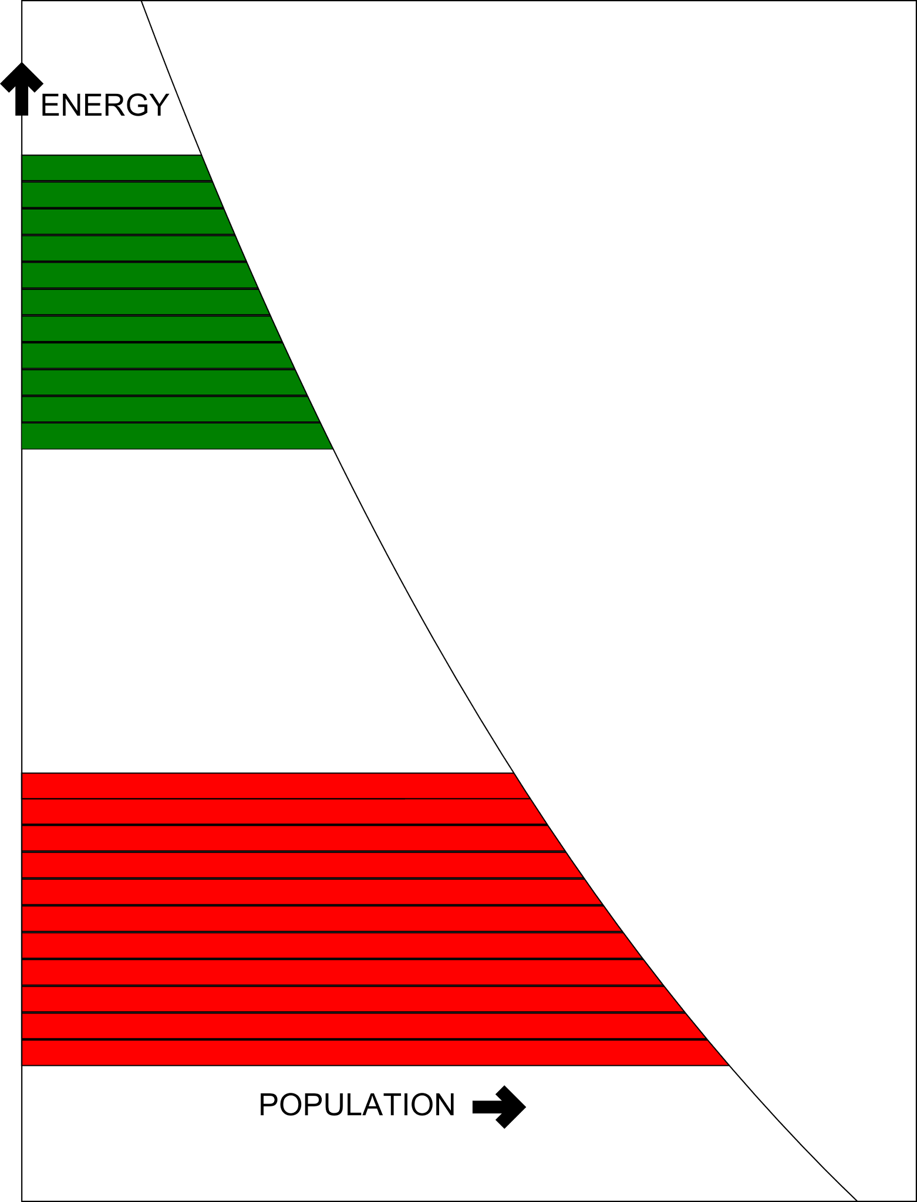
Thermal Mixing
T_{ZP} is the temperature of the proton Zeeman system
  Determines the
  proton polarization
At thermal equilibrium
  T_{L}=T_{Z}=T_{SS}=T_{ZP}
Electrons

Slide 22
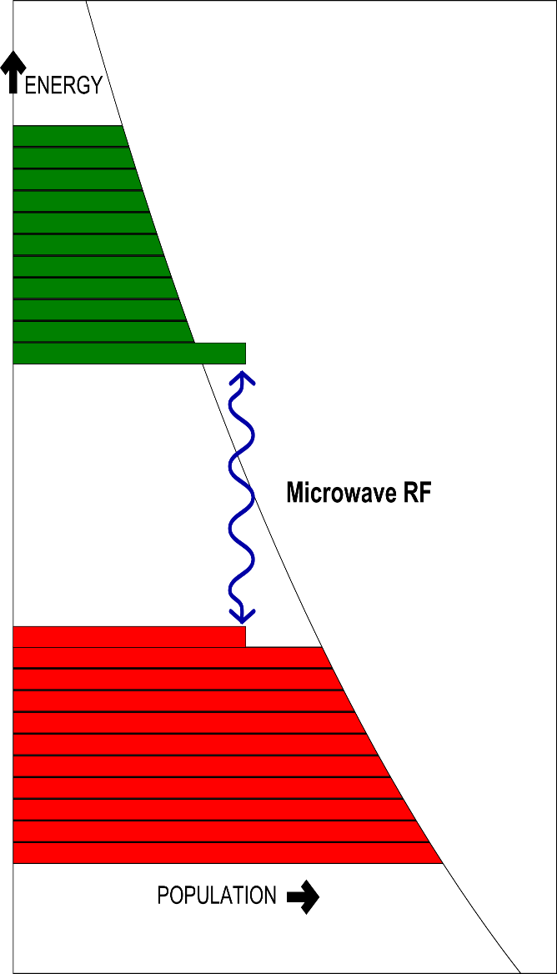
Thermal Mixing
Irradiation with microwaves close to the larmour frequency E=h(ν+δ)
Small amount of energy must be emitted (or absorbed) by the electron spin-spin system in order for the microwaves to interact with the electron Zeeman system
This lowers (or raises) the temperature of the electron spin-spin system
  Fast electron relaxation time preserves the Electron Zeeman Populations
Dipolar Coupling through the electron Zeeman System puts the Nucleon Zeeman system in thermal contact with the electron spin-spin system
Reduced Temperature of Nucleon Zeeman system corresponds to higher nucleon polarization
  Like the solid state effect if a microwave frequency higher than the larmour frequency of the electron is used, negative polarization can be reached
  This corresponds to a negative spin temperature
Electrons

Slide 23
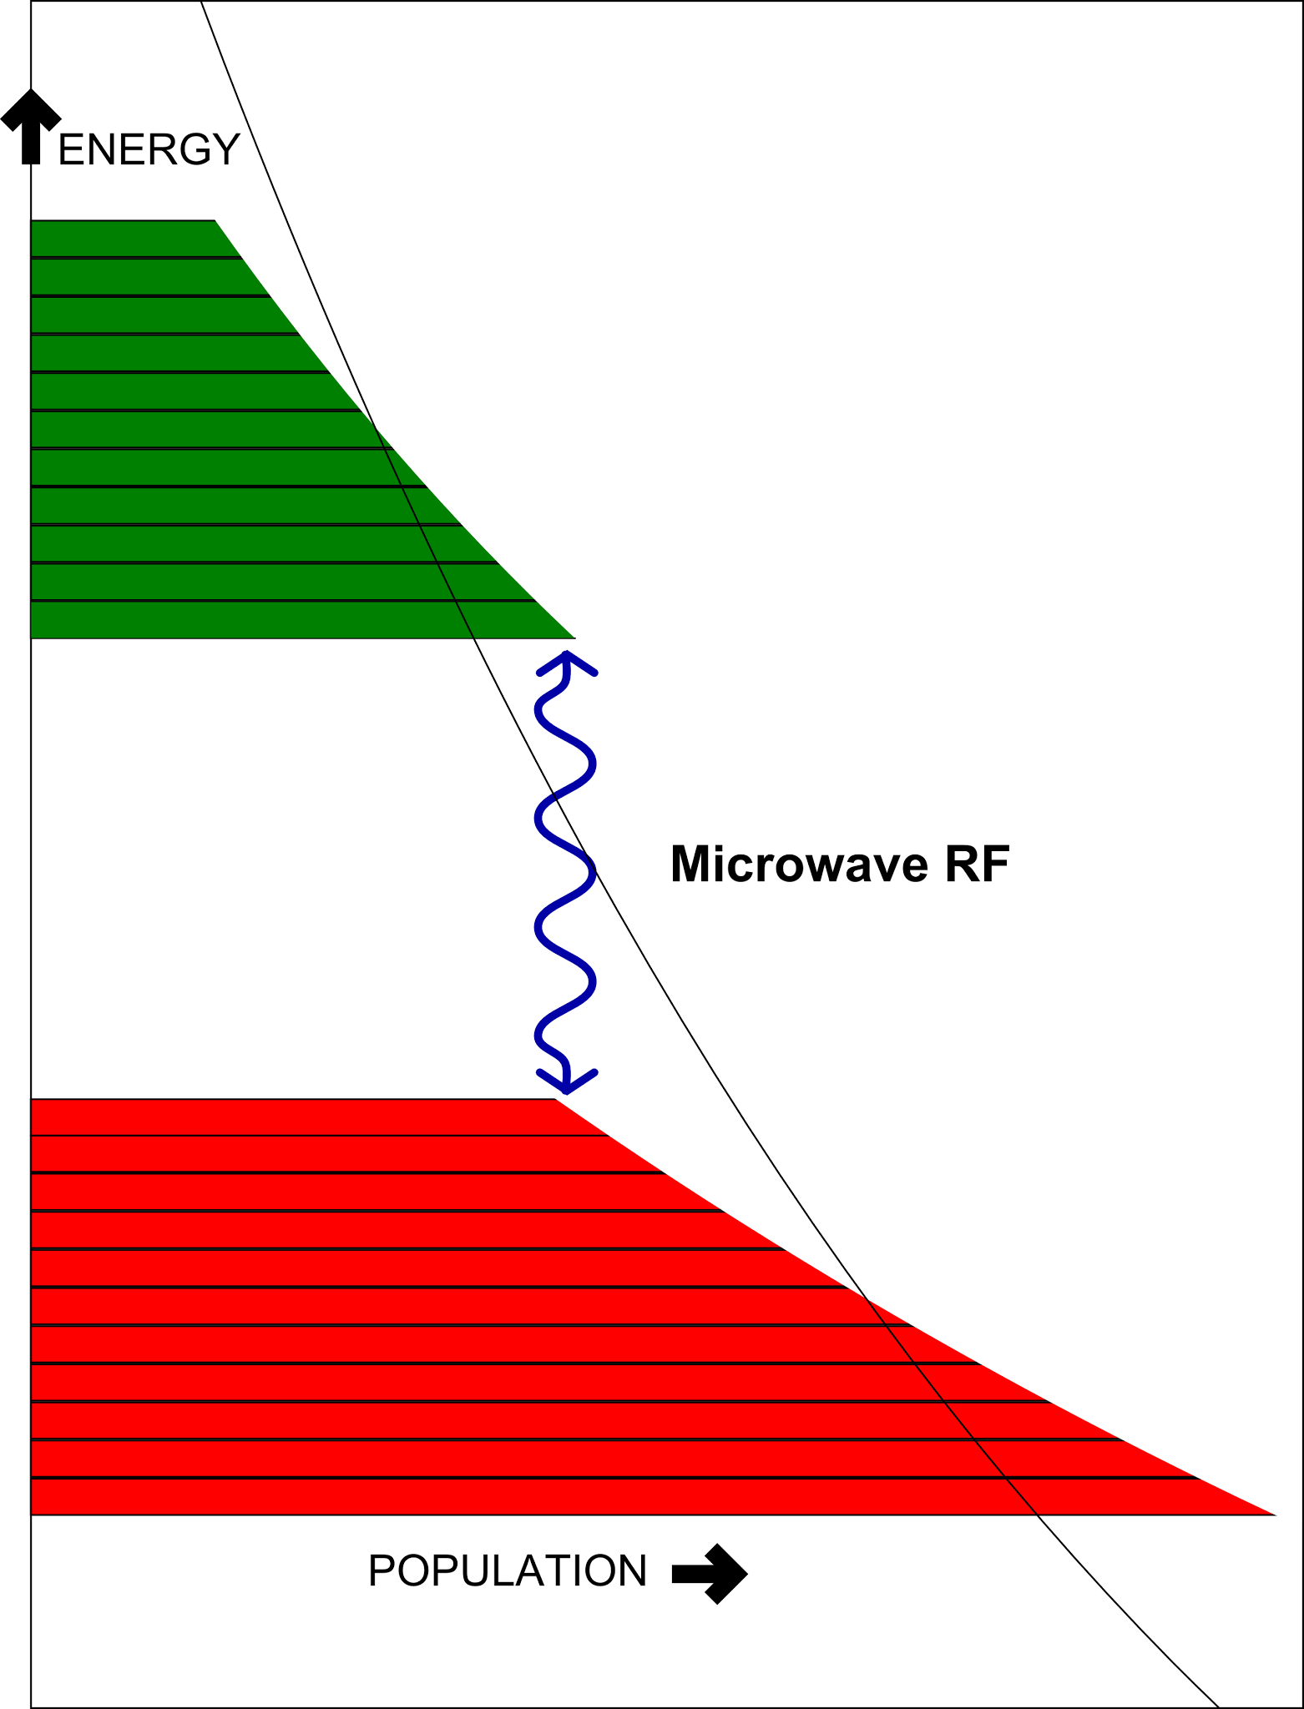
Thermal Mixing
Irradiation with microwaves close to the larmour frequency E=h(ν+δ)
Small amount of energy must be emitted (or absorbed) by the electron spin-spin system in order for the microwaves to interact with the electron Zeeman system
This lowers (or raises) the temperature of the electron spin-spin system
  Fast electron relaxation time preserves the Electron Zeeman Populations
Dipolar Coupling through the electron Zeeman System puts the Nucleon Zeeman system in thermal contact with the electron spin-spin system
Reduced Temperature of Nucleon Zeeman system corresponds to higher nucleon polarization
  Like the solid state effect if a microwave frequency higher than the larmour frequency of the electron is used, negative polarization can be reached
  This corresponds to a negative spin temperature
Electrons

Slide 24
DNP Components
High Magnetic field
  Superconducting magnets
    5T or 2.5T being the most common
Low Temperature
  1K using a ⁴He
  evaporation refrigerator
  300mk using a dilution
  refrigerator
Microwaves
  Near the electron Larmor frequency
Prepared sample material
NMR system for polarization measurement

Slide 25
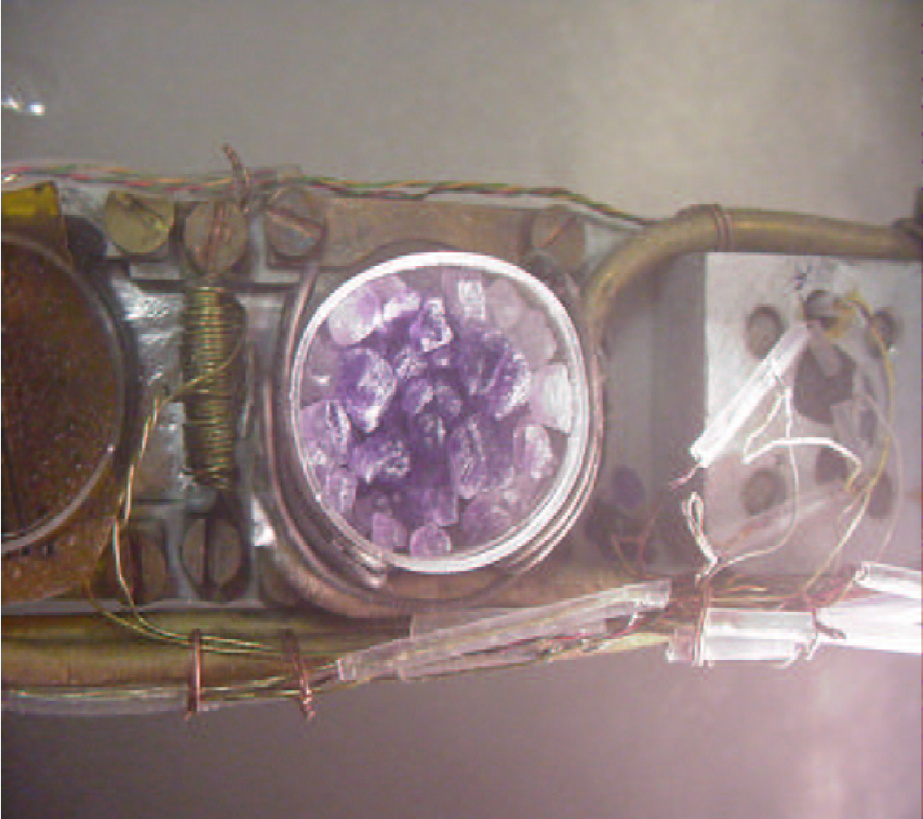
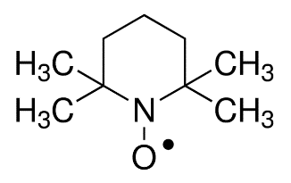
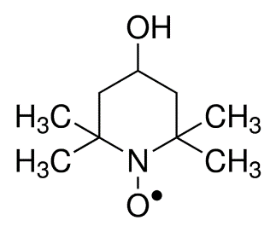
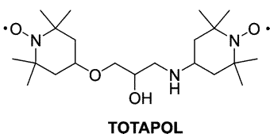
Sample Preparation
Unpaired electrons usually need to be
added to the material
  Spin Labels
  Irradiation
    Irradiation in an electron beam makes paramagnetic centers
    Inherently destructive to the sample molecule
Spin labels can be added to many samples
  Variety of forms, methods of addition, ESR properties
    Some now have been designed specifically for DNP

Slide 26
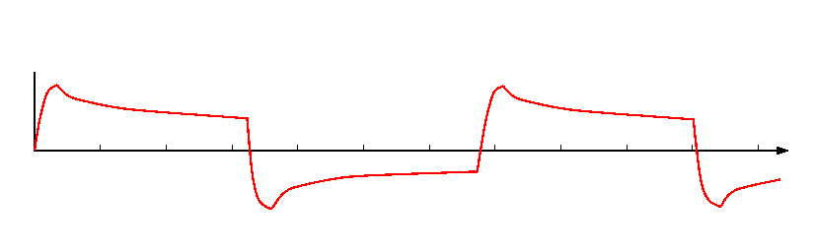
Frozen Spin System Solves Acceptance Problem
Starts out as a normal DNP system
  Spins and polarized through DNP at a high field and reasonably low temperature (300mK)
Once the sample is polarized, the temperature is greatly decreased
  Final operating temperature ideally <100mK
Nuclear spin relaxation time can become very long (tens to thousands of hours)
  Microwaves no longer necessary
Magnetic field can be lowered!
Polarize (+)
Polarize (+)
Take beam
Take beam
Polarization
Time
Polarize (-)
Take beam

Slide 27
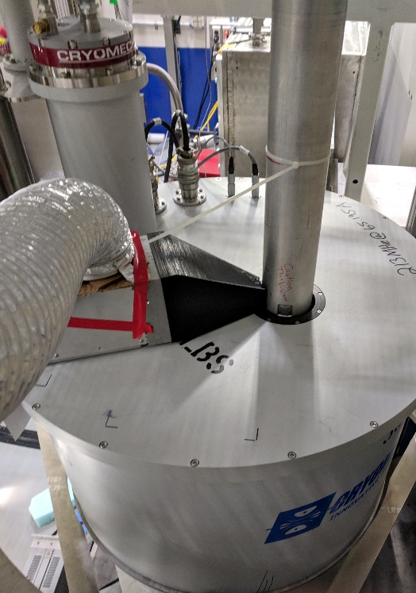
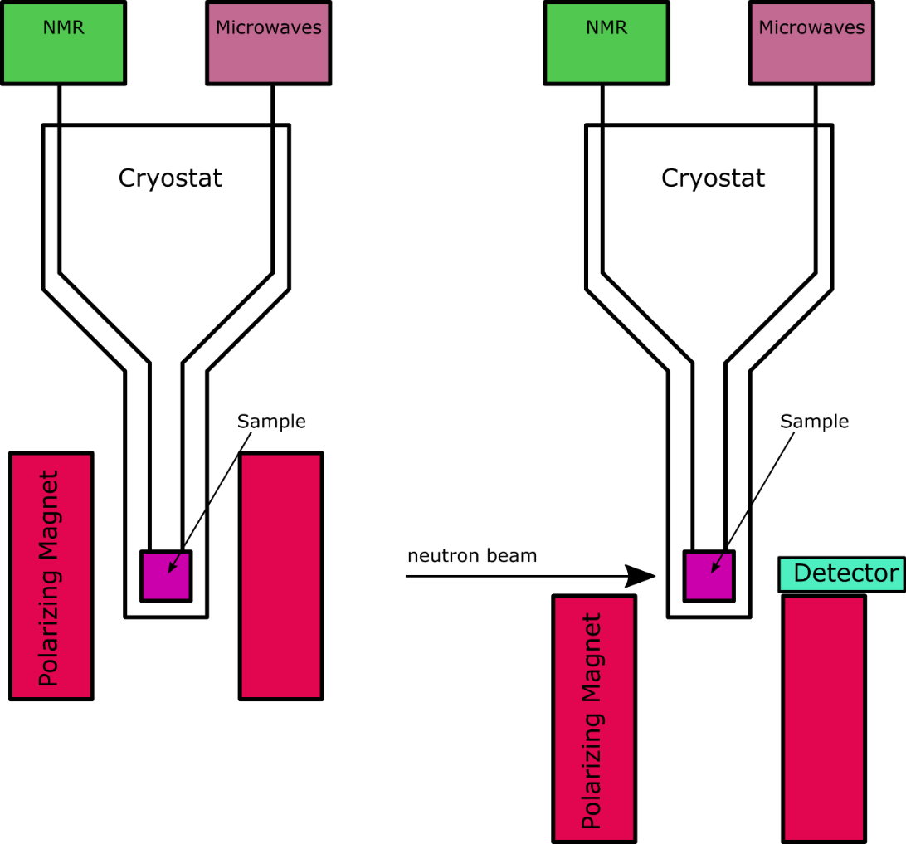
Tests at IMAGINE

Slide 28

T4 Lysozyme Results
Doped with TEMPO
“Large” crystals
  ~0.5mm-1.0mm on edge
Detector was uncalibrated, and shifted
between frames
Short hold times in “frozen spin” mode
  ~60-180 min T₁
  Very high temperatures
    ~230 mK
Measured diffraction pattern change
Enhancements of 2-3 in integrated
diffraction pattern for anti-aligned spins
  The enhancement of individual reflections depends varies depending on the relative contribution of hydrogen
Consistent with maximum polarizations of around 50%
Unpolarized

Slide 29
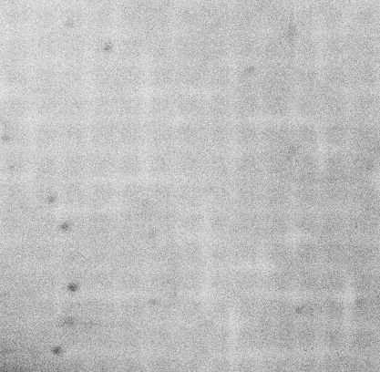
T4 Lysozyme Results
Doped with TEMPO
“Large” crystals
  ~0.5mm-1.0mm on edge
Detector was uncalibrated, and shifted
between frames
Short hold times in “frozen spin” mode
  ~60-180 min T₁
  Very high temperatures
    ~230 mK
Measured diffraction pattern change
Enhancements of 2-3 in integrated
diffraction pattern for anti-aligned spins
  The enhancement of individual reflections depends varies depending on the relative contribution of hydrogen
Consistent with maximum polarizations of around 50%
Polarized

Slide 30
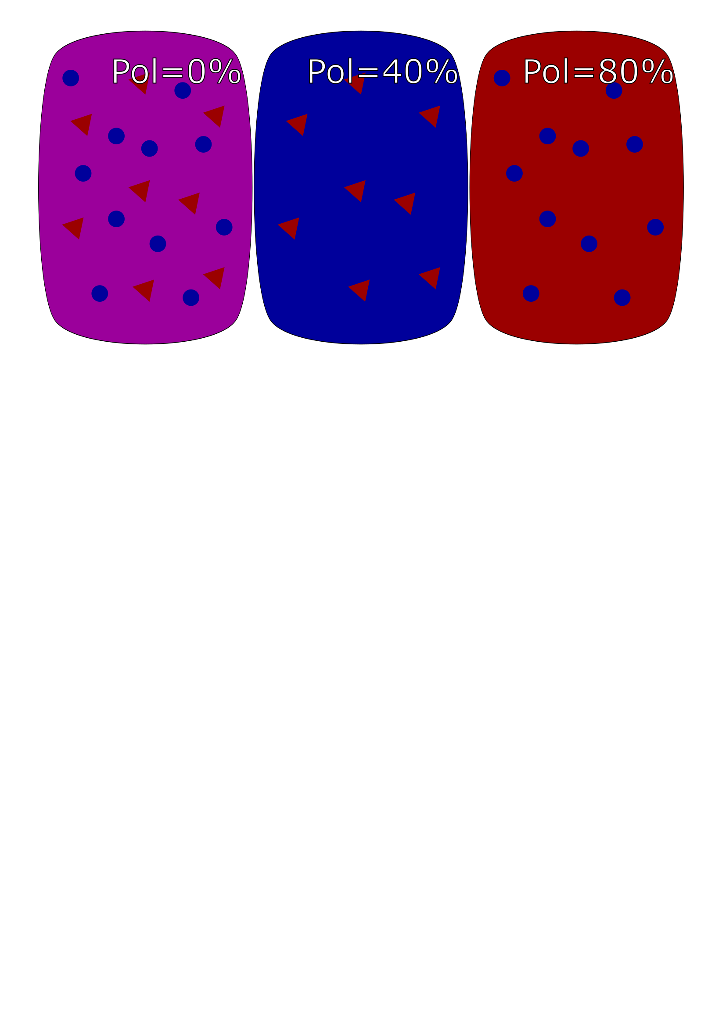
Application to SANS Contrast Matching
Deuteration
  The unpolarized coherent scattering
  length of hydrogen is -3.74 fm
  The unpolarized coherent scattering
  length of deuterium is 6.674 fm
Polarization
  Positive polarization: 10.82 fm
  Negative polarization:
  -18.3 fm
  Can be changed in-situ
    Requires a single sample reparation
  Work done by Stuhrmann et al
  Current work by Kumada et al. (also working on DNP for reflectometry)

Slide 31
Application to SANS Contrast Matching
Deuteration
  The unpolarized coherent scattering
  length of hydrogen is -3.74 fm
  The unpolarized coherent scattering
  length of deuterium is 6.674 fm
Polarization
  Positive polarization: 10.82 fm
  Negative polarization:
  -18.3 fm
  Can be changed in-situ
    Requires a single sample reparation
  Work done by Stuhrmann et al
  Current work by Kumada et al. (also working on DNP for reflectometry)

Slide 32
Application to SANS Contrast Matching
Deuteration
  The unpolarized coherent scattering
  length of hydrogen is -3.74 fm
  The unpolarized coherent scattering
  length of deuterium is 6.674 fm
Polarization
  Positive polarization: 10.82 fm
  Negative polarization:
  -18.3 fm
  Can be changed in-situ
    Requires a single sample reparation
  Work done by Stuhrmann et al
  Current work by Kumada et al. (also working on DNP for reflectometry)

Slide 33
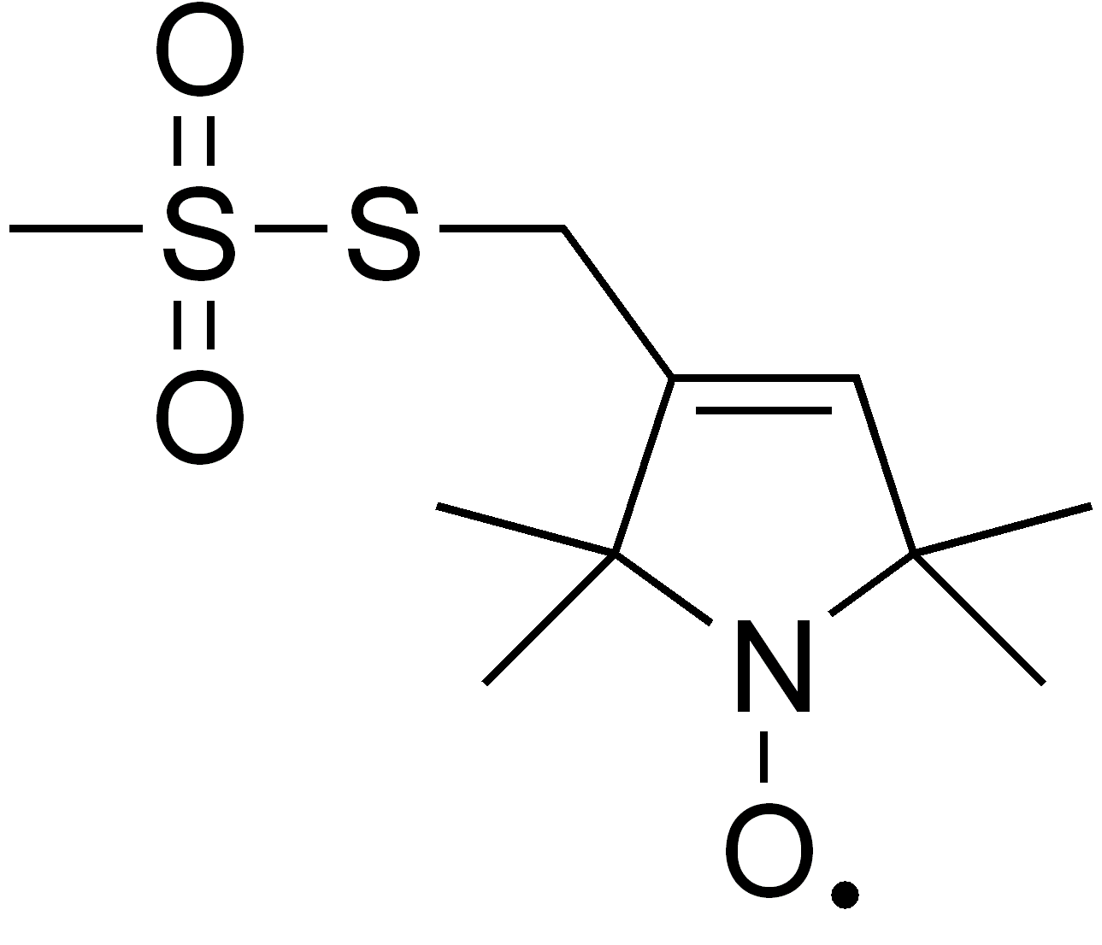
Advanced Techniques: Localized Polarization
If the center is an attached spin label, then the location of the polarized region can be controlled
  Attached to a specific site on a macromolecule
  Size and rate of propagation has been studied with SANS (van den Brandt 2006)
Alternatively, different components of a composite sample could be selectively polarized
  One layer of a sample for example

Slide 34
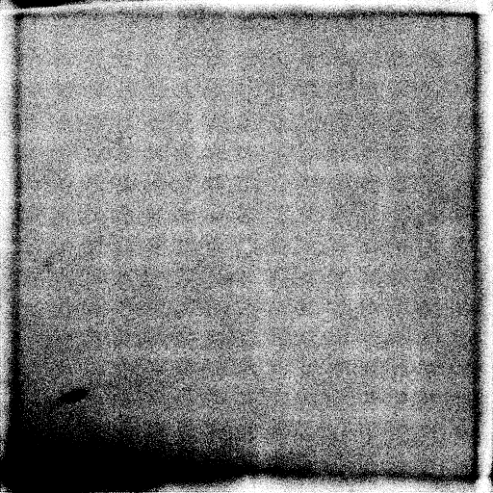
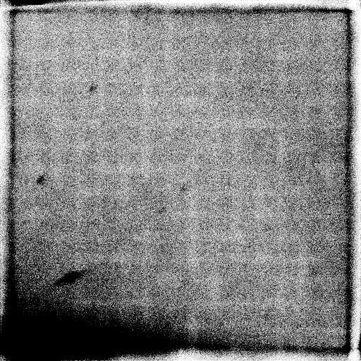
Advanced Techniques:
Difference Measurements
All that is required is to change the microwave frequency to change polarization sign
  Field remains constant
  Temperature remains constant
Adiabatic Fast Passage or neutron spin flipper can reverse polarization more quickly
Only thing that changes is the cross section for the nuclei, and that changes in a predictable manner
This can be used to highlight specific structures
Spins Aligned
Spins Anti-aligned

Slide 35
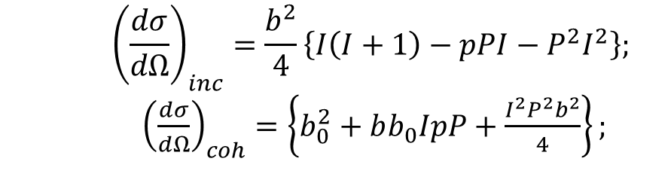


Other Nuclei
All non spin zero nuclei will polarize
Polarization will be different for
different nuclei
  15N and 13C polarize well, are
  used for DNP enhanced MRI
  and NMR measurements
Spin dependent scattering
lengths are different for each
nucleus
  15N and 13C have very little spin
  dependence
Difference measurements may still be possible
  Different nuclei species could be
  selectively polarized/depolarized/flipped using a combination of NMR and DNP techniques
$$a=b_{0}+bI⋅s$$
$$b=\frac{2\left(b_{+}−b_{−}\right)}{\left(2I+1\right)}$$
 | $${\left(\frac{dσ}{dΩ}\right)}_{inc}=\frac{b^{2}}{4}\left\{I\left(I+1\right)−pPI−P^{2}I^{2}\right\};$$ ${\left(\frac{dσ}{dΩ}\right)}_{coh}=\left\{b_{0}^{2}+bb_{0}IpP+\frac{I^{2}P^{2}b^{2}}{4}\right\};$

Slide 36
Conclusion
The nuclear spin dependence of neutron scattering can be used to manipulate scattering
Polarized hydrogen has a large potential benefit to protein crystallography
  Could allow the use of sustainably smaller samples or greatly reduced data collection time
DNP is an effective means to polarize the hydrogen within a sample
  Sample preparation and sample environment requirements are substantial
Control of scattering opens up the possibility for new measurement techniques

