Slide 1
Information about SHUG and Graduate Student Research Opportunities at ORNL
A.A. Aczel, ORNL NSD
SHUG-EC secretary

Slide 2
Purpose of SNS-HFIR user group (SHUG)
SHUG consists of all persons interested in using the neutron scattering facilities at Oak Ridge
Input to NScD management on user concerns
Make recommendations to NScD management for new neutron scattering capabilities and instruments
Forum for keeping the community informed of issues and progress at these facilities

Slide 3
SHUG: integral part of shaping neutron sciences at ORNL
Topics important to SHUG
User support from instrument teams
New capabilities for existing instruments
Data acquisition and analysis software
Sample environment equipment and support
Planning for new instruments at SNS, HFIR, and the STS
And more…
Notes:
First, let me explain what heavy transition metal magnets are and why the field is interesting.

Slide 4

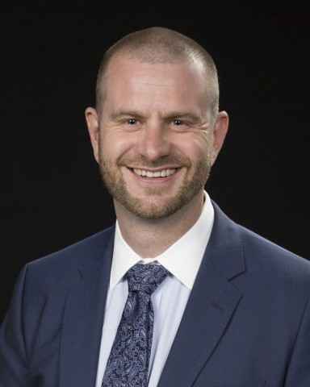
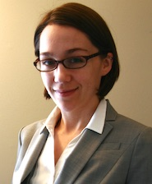
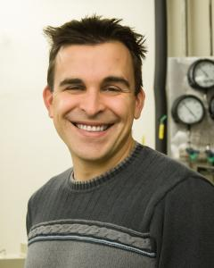


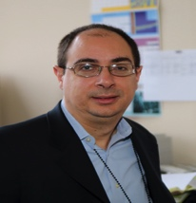

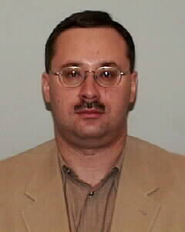
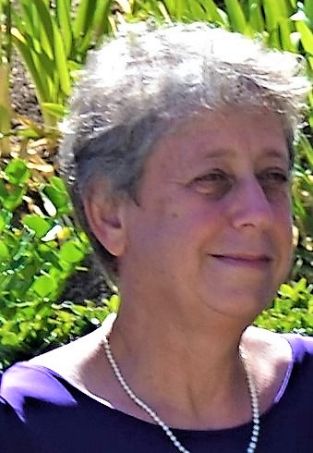

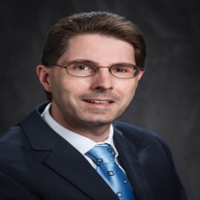
SHUG Executive Committee
Michelle Dolgos (Oregon State University) – Chair
Marc Janoschek (LANL – Vice Chair)
Kate Ross (Colorado State University – Past Chair)
Adam Aczel (ORNL) - Secretary
Allyson Fry-Petit (Cal State University - Fullerton)
Sudipta Gupta (Louisiana State University – Postdoc/Grad Student Representative)
Antonio Faraone (NIST)
Sara Haravifard (Duke)
Eugene Mamontov (ORNL)
Dvora Perahia (Clemson University)
Stephen Wilson(University of California, Santa Barbara)
Gerald Schneider (Louisiana State)
Notes:
Diverse group: assistant prof, instr scientists from diff facilities, mid-career people,

Slide 5
SHUG Executive Committee Activities
Monthly conference call with NScD management: information exchange and activity planning
Organize an on-site meeting at ORNL every year: talks, tutorials, panel discussions, town hall meeting
Recent activities organized by SHUG-EC at the ACNS:
  ORNL new instrumentation workshop
  Proposal writing tutorial
  Town hall meeting
Notes:
Diverse group: assistant prof, instr scientists from diff facilities, mid-career people,

Slide 6
Providing feedback to SHUG is important
  End of experiment survey questions
  SHUG email address (shug-ec@email.ornl.gov)
  Online comment card: http://neutrons.ornl.gov/shug-online-comment
  LinkedIn page: http://tinyurl.com/SHUG-neutron
  Other suggestions?

Slide 7
Graduate Student Opportunities across DOE
US Department of Energy Office of Science Graduate Student Research Program
  google “DOE SCGSR”
Facilitates “in-residence” stays at DOE Office of Science Laboratories for collaborative research
Graduate student stipend provided by DOE during national lab appointment
Stays must be 3-12 months in duration
Research must be aligned with a DOE priority area
  Neutron scattering science and instrumentation
Restricted to US Citizens and Legal Permanent Residents
Strict application schedule established by DOE

Slide 8
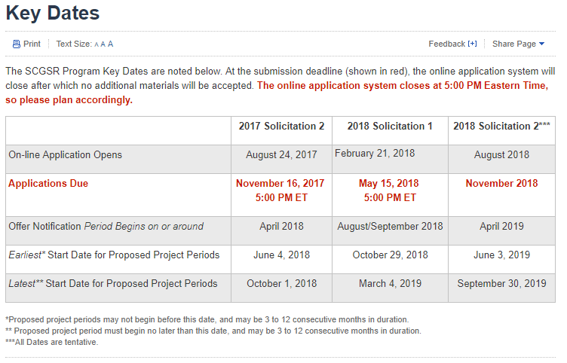
DOE SCGSR Program

Slide 9
Graduate Student Opportunities more specific to ORNL: HERE program
Higher Education Research Experiences (HERE) at ORNL through ORAU
  Google “HERE at ORNL”
Two different programs available for graduate students:
  (1) ‘new’ graduate student program: duration < 1 year)
  (2) thesis/dissertation program: duration 1 – 3 years
  Facilitate access to ORNL so graduate students can work on collaborative research
  Graduate student stipends and housing allowance provided by ORAU/ORNL
  Restricted to US Citizens and Legal Permanent Residents
  Applications accepted by ORAU year round

Slide 10
Graduate Student Opportunities more specific to ORNL: GO! program
Google “ORNL GO! Program”
Students carry out world-leading research at ORNL while earning a Ph.D. degree from their home institution
Time spent at ORNL: 1 – 3 years
Students are funded by ORNL during their residency period
No citizenship requirement, but only students from particular universities are eligible to participate
Coursework must be completed at host university before student residency period at ORNL begins
Agreement reached between ORNL and host university
Point-of-contact: Crystal Schrof, schrofca@ornl.gov
Notes:
Students remain employee of home institution

Slide 11
ORNL GO! Program: Partner Institutions
Boston University
Colorado School of Mines
Florida State University
Georgia Tech
Michigan State
Michigan Tech
Middle TN State
NC State
Ohio State
University State
Purdue
Rensselaer
Rice
TN Tech
Texas A&M
UC-Davis
Univ. FL
UIUC
Univ. Memphis
Univ. Missouri
Nebraska–Lincoln
Univ. TN Chattanooga
Univ. TN Knoxville
UVA
Wisc.-Madison
UNLV
Vanderbilt
Virginia Tech
Washington State
(always open to new partnerships)

Slide 12
Questions?

