Slide 1


Introduction to
Neutron Spin Echo
Spectroscopy
Piotr A. Zolnierczuk
Jülich Centre for Neutron Science, Forschungszentrum Jülich
Introduction
The Principle of NSE
The SNS-NSE Spectrometer
Examples
Summary
NXS 2018
Notes:
Topic-2
1

Slide 2
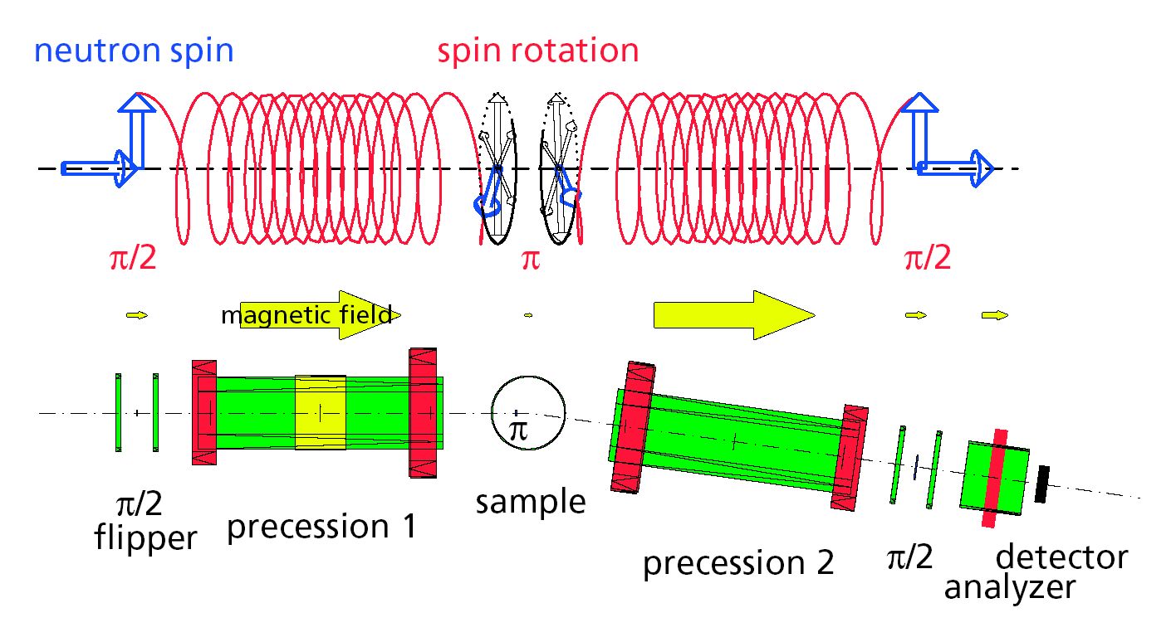
Neutron Spin Echo in a Nutshell
Measures very small velocity changes by using neutron magnetic moment as a clock
Complementary to SANS/SAXS
Broad Δ𝝀/𝝀 and very good resolution
Intermediate Scattering Function: I(Q,𝜏)
Counting intensive
I(Q,𝜏)
𝜏 [ns]
Notes:
Neutron Spin Echo is a particular experimental technique that allows to measure very small neutron velocity changes on objects that are fairly large.
It provides complementary dynamics to the structural information gained with SANS/SAXS techniques. It allows to use relatively broad neutron wavelength band while maintaining very good resolution.
The “end product” is a so-called intermediate scattering function I(Q,t). One drawback is that it is a “counting intensive” method requiring large samples and relatively long counting times.

Slide 3
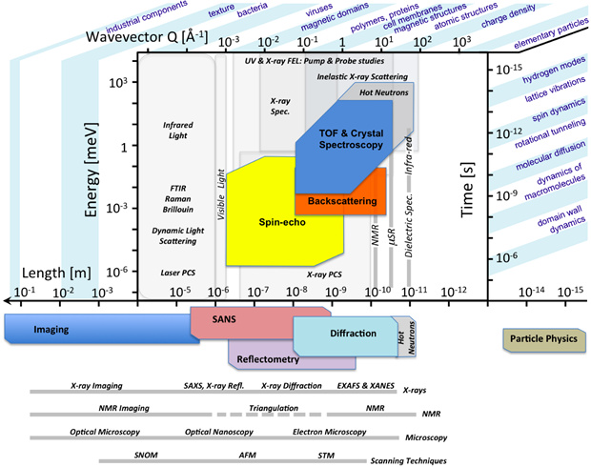
Neutron and X-Ray Instruments Landscape
With NSE one can study:
Coherent Dynamics
  Diffusion
  Shape fluctuations
  Polymer dynamics
  Glassy systems
Incoherent Dynamics
  Hydrogen
Magnetic Dynamics
  Spin Glasses
Source: ESS
Notes:
Let’s see where the NSE is placed in the landscape of neutron and X-ray scattering techniques.
Note:
Pulsed field gradient NMR (PFGNMR) and dynamic light scattering (DLS) are methods that yield information that is related to or similar to the NSE data but on larger length and time scale.
PFGNMR is analogous to incoherent neutron scattering, whereas DLS corresponds to coherent scattering with the index of refraction replacing the scattering length density.
PFGNMR measures the ratio 'P of an NMR spin-echo

Slide 4
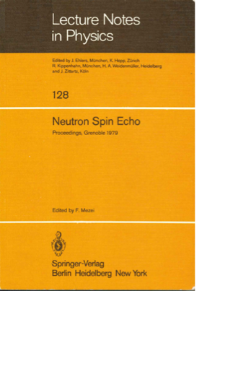
NSE : From an Idea to the Instrument
1972 → 1978
Notes:
NSE is quite mature

Slide 5
The Principle of Neutron Spin Echo

Slide 6
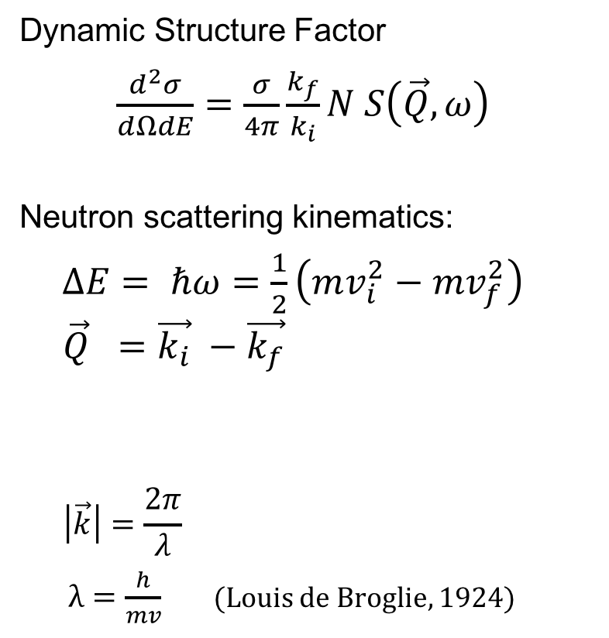



Inelastic Neutron Scattering
Dynamic Structure Factor
$\frac{d^{2}σ}{dΩdE}=\frac{σ}{4π}\frac{k_{f}}{k_{i}}N S\left(\vec{Q},ω\right)$
Neutron scattering kinematics:
$ΔE= ℏω=\frac{1}{2}\left(mv_{i}^{2}−mv_{f}^{2}\right)$
$$\vec{Q} =\vec{k_{i}} −\vec{k_{f}}$$
$$\left|\vec{k}\right|=\frac{2π}{λ}$$
$λ=\frac{h}{mv}$ (Louis de Broglie, 1924)
$$\vec{Q}$$
$$\vec{k_{f}}$$
$$\vec{k_{i}}$$
See lectures by R. Pynn and B. Gaulin
Notes:
In a typical inelastic neutron scattering experiment the spectral response of a sample is probed by the probability of a neutron energy change expressed by the dynamic structure factor (or scattering function) $S\left(Q,ω\right)$
The energy change is determined, in turn, by the change of neutron velocity: $ΔE= ℏω=\frac{1}{2}(mv_{1}^{2}−mv_{2}^{2})$
The so-called scattering triangle on the right illustrates the kinematics of a neutron scattering experiment.

Slide 7
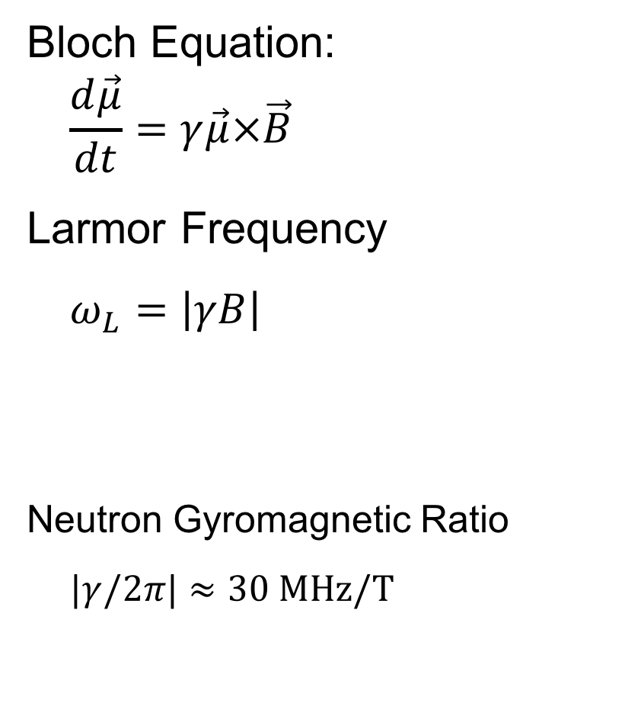
Larmor Precession (I)
Bloch Equation:
$$\frac{d\vec{μ}}{dt}=γ\vec{μ}×\vec{B}$$
Larmor Frequency
$$ω_{L}=\left|γB\right|$$
Neutron Gyromagnetic Ratio
$$|γ/2π|≈30 MHz/T$$
B
μ
n
Source: Wikipedia
See lectures by R. Pynn and C. Majkrzak
Notes:
Another concept that you have learned is the fact that the neutron has magnetic moment
$μ=\frac{gμ_{N}}{ℏ}s$ where $μ_{N}=\frac{eℏ}{2m_{p}}$ is a nuclear magneton 3.1524512550(15)×10⁻⁸ eV/T
$μ_{p}=2.79μ_{N}$ and $μ_{n}=−1.91μ_{N}$
Earth magnetic field ~0.5 mT -> 15 kHz
Note: Do not confuse $ω_{L}$ with $ω$ in $ℏω$

Slide 8
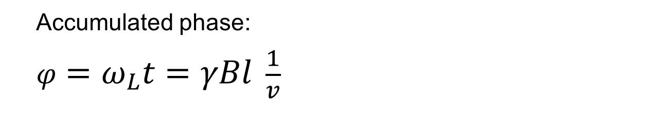
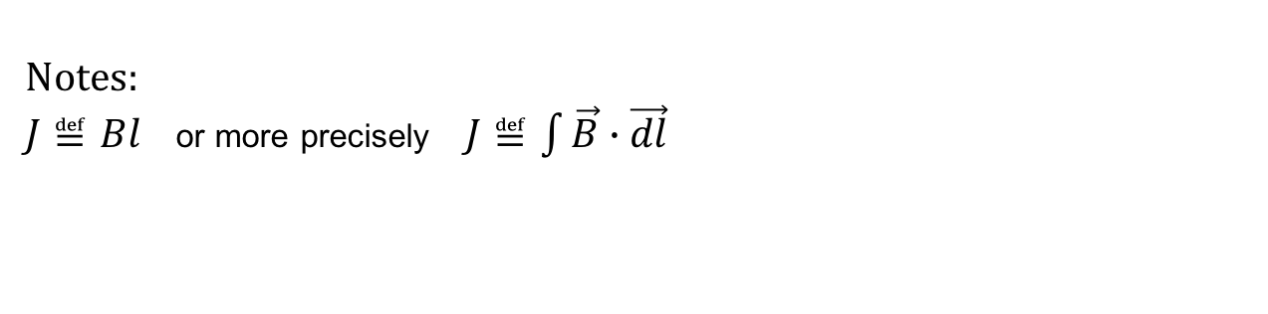
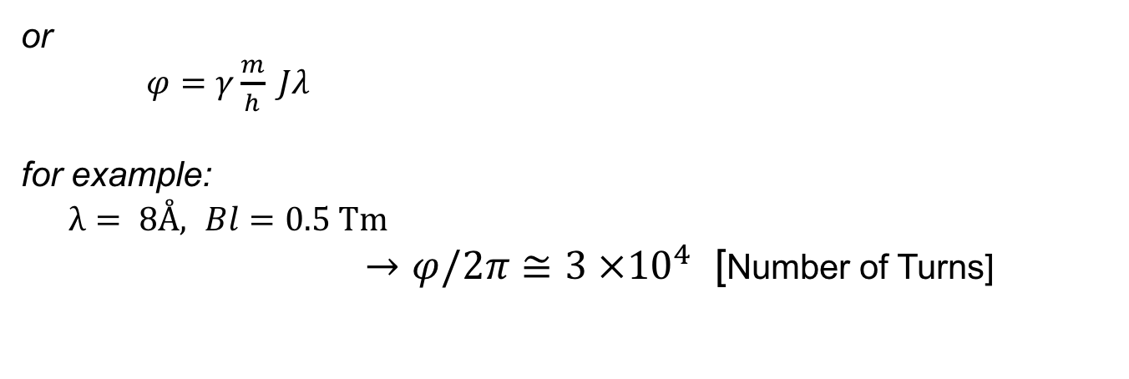
Larmor Precession (II)
s
Accumulated phase:
$φ=ω_{L}t=γBl \frac{1}{v}$
B
or
$φ=γ\frac{m}{h} Jλ$
for example:
$λ= 8Å,$ $Bl=0.5 Tm$
$→φ/2π≅3 ×{10}^{4}$ [Number of Turns]
Notes:
$J≝Bl$ or more precisely $J≝\int{\vec{B}∙\vec{dl}}$
Notes:
So if we have neutron flying through the space (or most likely a neutron guide) it will accumulate phase (see C.Majkrzak lecture).

Slide 9
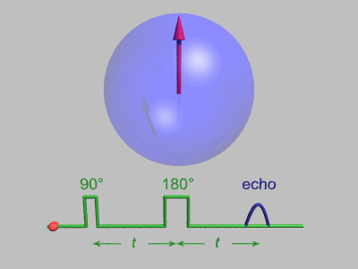
NMR Spin Echo
By Gavin W Morley, CC BY-SA 3.0
Notes:
Another idea borrowed by Mezei was the discovery of a spin echo in the NMR setups by Erwin Hahn.

Slide 10
Neutron Spin Echo (I)
Courtesy: M. Monkenbusch, Forschungszentrum Jülich
Notes:
Now we can demonstrate the basic principle of NSE (following a single neutron)

Slide 11
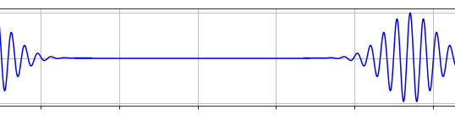
Neutron Spin Echo (II)
Courtesy: M. Monkenbusch, Forschungszentrum Jülich
Notes:
If we have neutrons with different velocities - watch the polarization

Slide 12
Neutron Spin Echo (Inelastic)
Courtesy: M. Monkenbusch, Forschungszentrum Jülich
Notes:
And now if we have something that moves and scatters the neutron.

Slide 13
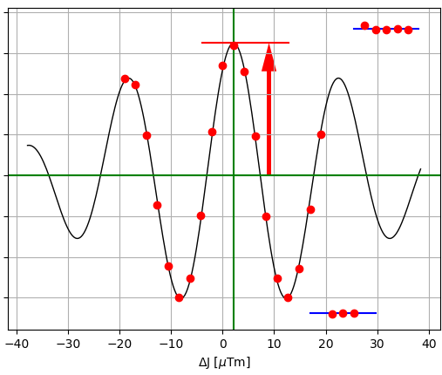
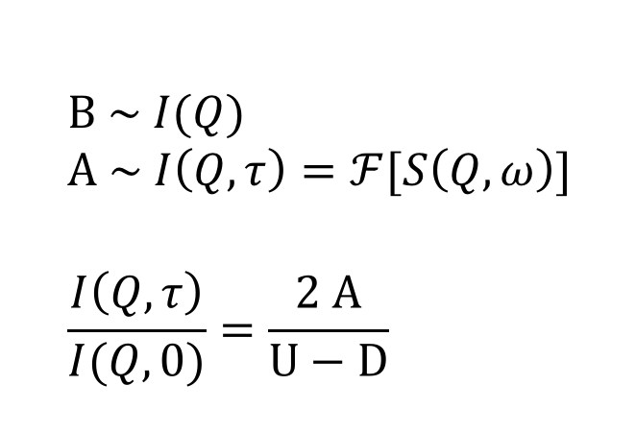
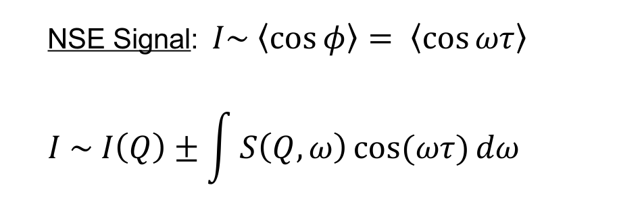
Neutron Spin Echo
NSE Signal: $I\sim \left\langle \cos{φ}\right\rangle = \left\langle \cos{ωτ}\right\rangle$
$$I \sim I\left(Q\right)±\int{S\left(Q,ω\right)cos(ωτ){dω }}$$
Fourier transform (Real part)
$$B \sim I(Q)$$
$$A \sim I\left(Q,τ\right)=ℱ[S\left(Q,ω\right)]$$
$$\frac{I\left(Q, τ\right)}{I(Q,0)}=\frac{2 A}{U−D}$$
U = Up
A=Amplitude
B=Average
D = Down
F. Mezei, Z. Physik (1972) 255: 146.
F. Mezei, C. Pappas, T. Gutberlet (Eds.): Neutron Spin-Echo Spectroscopy, Lecture Notes in Physics 601, Springer, Heidelberg, 2003.
Notes:
Energy change (quasi-elastic scattering)
$$ΔE= ℏω=\frac{1}{2}mv_{1}^{2}−\frac{1}{2}mv_{2}^{2}≅m v dv$$
Accumulated phase:
$$φ_{2}−φ_{1}=γ\left(\frac{B_{2}l_{2}}{v_{2}}−\frac{B_{1}l_{1}}{v_{1}}\right)=γBl \left(\frac{1}{v_{2}}−\frac{1}{v_{1}}\right)$$
$$Δφ≅γBl\frac{ℏω}{{mv}^{3 }}=\frac{γ}{2π}{\left(\frac{m}{h}\right)}^{2}J λ^{3}ω$$
or
$$Δφ=τω$$
where we define Fourier time $τ≝\frac{γ}{2π}{\left(\frac{m}{h}\right)}^{2}J λ^{3}$
For quick computation $τ≅0.2 J λ^{3}$
where $\left[τ\right]=ns, \left[J\right]=Tm$ and $\left[λ\right]=Å$
Example: $λ= 8Å,$ $J=0.56 Tm→ τ≅50ns$ $→∆E≅0.01 μeV$

Slide 14

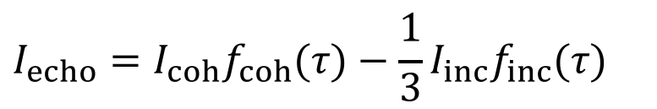
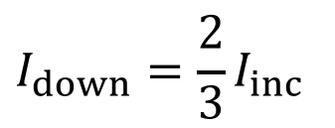
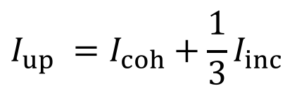
Coherent/Incoherent Scattering
$$I_{up} =I_{coh}+\frac{1}{3}I_{inc}$$
coherent
no-flip
incoherent
+
1/3 no-flip
2/3 flip
$$I_{down}=\frac{2}{3}I_{inc}$$
$$I_{echo}=I_{coh}f_{coh}(τ)−\frac{1}{3}I_{inc}f_{inc}(τ)$$
Notes:
Polarization:
$$P=\frac{N_{+}−N_{−}}{N_{+}+N_{−}}$$
Flip Ratio:
$$FR= \frac{N_{+}}{N_{−}}$$
$$P= \frac{FR−1}{FR+1}$$
$$FR=\frac{1+P}{1−P}$$

Slide 15
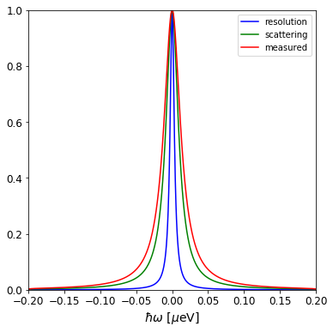
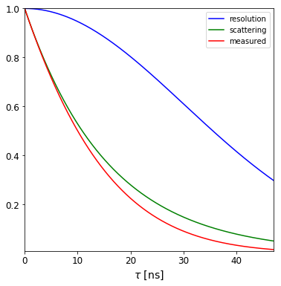
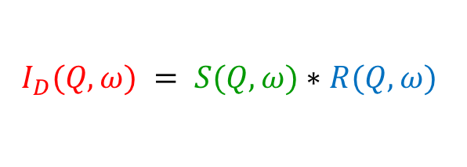
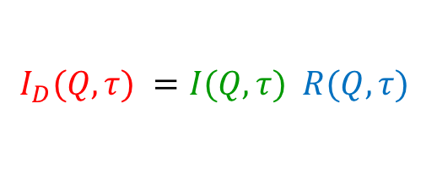
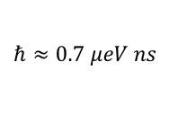
Energy and Time Domain
(QENS/INS ↔ NSE)
QENS: Dynamic Structure Factor
S(Q,⍵)
NSE: Intermediate Scattering Function
I(Q,𝜏)
Fourier Transform
$$I_{D}(Q,ω) = S(Q,ω)∗R(Q,ω)$$
$$I_{D}(Q,τ) =I(Q,τ) R(Q,τ)$$
To get S(Q,⍵) we have to de-convolute
instrument resolution
To get I(Q,𝜏) we just divide out
instrument resolution
$$ℏ≈0.7 μeV ns$$
Notes:
$f(x)∗g(x) := \int{f\left(y\right)g\left(x−y\right) dy}$
$$ℱ\left[f\left(x\right)∗g\left(x\right)\right]=ℱ\left[f\left(x\right)\right]ℱ\left[g\left(x\right)\right]$$

Slide 16
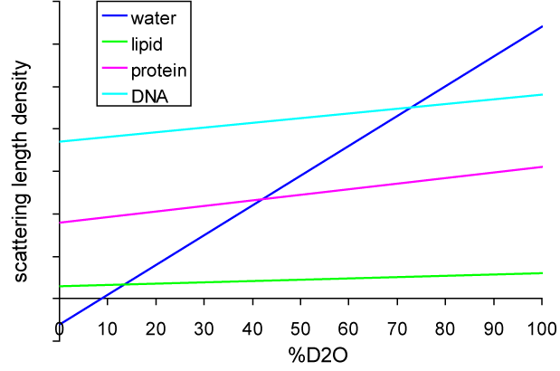
Contrast Matching
Isotope | Scattering Length b_{c} [fm]
¹H | -3.742
²H,D | +6.674

Slide 17
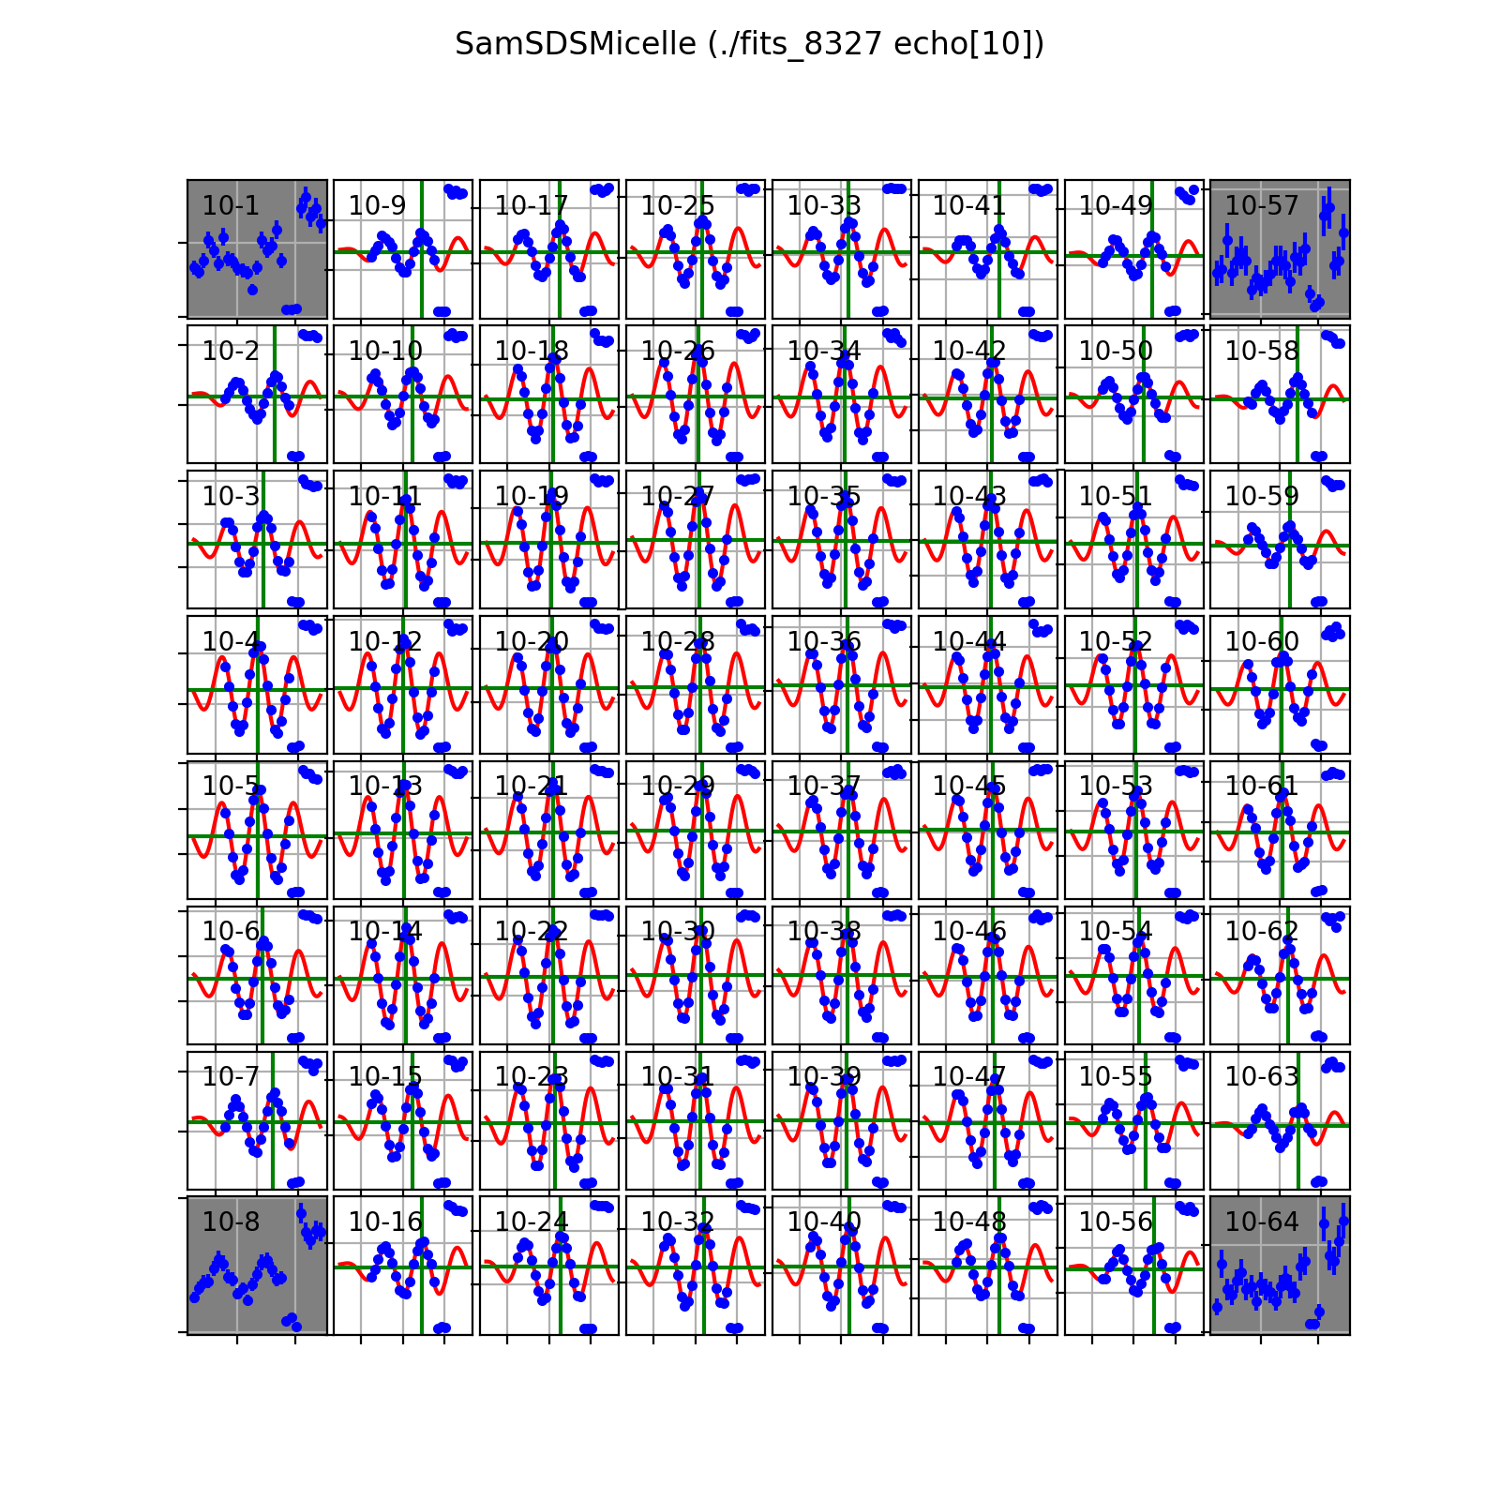
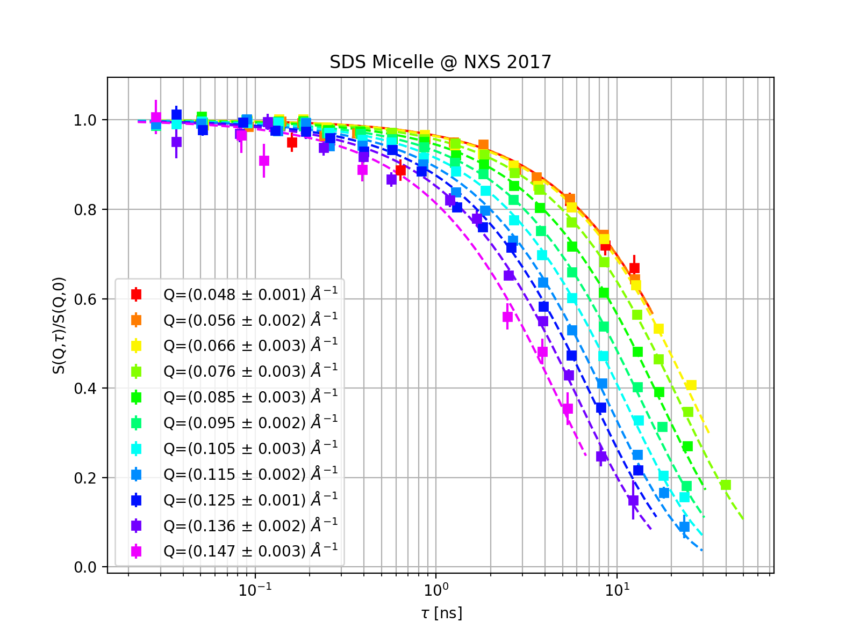
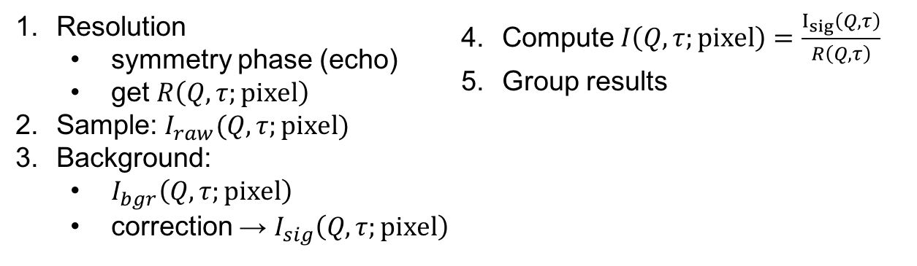
NSE Data Reduction
Resolution
  symmetry phase (echo)
  get $R\left(Q,τ;pixel\right)$
Sample: $I_{raw}(Q,τ;pixel)$
Background:
  $I_{bgr}\left(Q,τ;pixel\right)$
  correction → $I_{sig}\left(Q,τ;pixel\right)$
Compute $I\left(Q,τ;pixel\right)=\frac{I_{sig}\left(Q,τ\right)}{R\left(Q,τ\right)}$
Group results

Slide 18
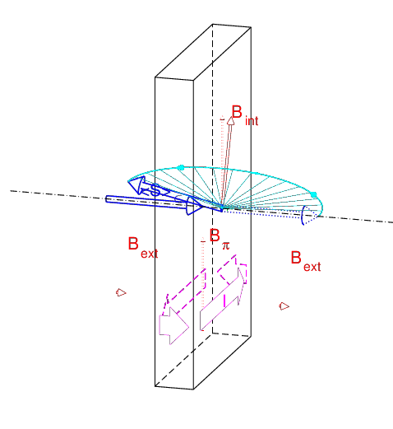
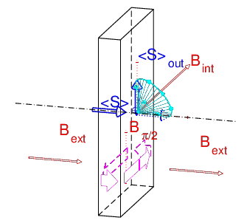
Neutron Spin Manipulation
Mezei Flippers
𝜋-flipper
𝜋/2-flipper
Courtesy: M. Monkenbusch, Forschungszentrum Juelich

Slide 19
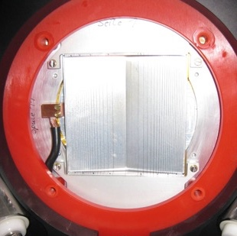
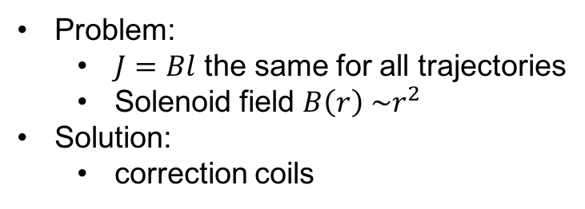
Correction Coils
r
x
Problem:
  $J=Bl$ the same for all trajectories
  Solenoid field $B\left(r\right) \sim r^{2}$
Solution:
  correction coils
F. Mezei (Ed.): Neutron Spin-Echo, Lecture Notes in Physics 128, Springer, 1980.
S. Pasini, M. Monkenbusch, Meas. Sci. Technol. 26 (2015) 035501

Slide 20
Theme Variations

Slide 21
Wide Angle Neutron Spin Echo
Large angular coverage
Higher Q (up to 3Å⁻¹)

Slide 22
Resonance and SANS Spin Echo
NRSE: Neutron Resonance Spin Echo
SESANS
Spin Echo SANS
RF field instead of solenoid
more compact design.
shorter Fourier times
Spin Echo encoded SANS
tilted magnetic field
angle encoded in spin precession

Slide 23
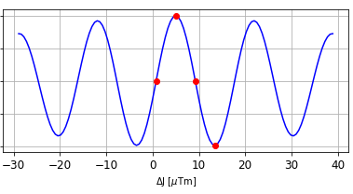
Paramagnetic NSE
sample is the 𝜋-flipper
3M/4
M/2
M/4
C.Pappas, G. Ehlers, F. Mezei, Neutron Spin Echo and Magnetism
in Neutron Scattering from Magnetic Materials, ed. T. Chatterji (2006)
Notes:
Effect of the (para)magnetic scattering on the beam polarization:
a) the component parallel to the wave vector Q undergoes a spin flip
b) the component perpendicular to Q gets depolarized.
As a result, on average, half of the signal precesses by 180 deg around the axis perpendicular to Q (P_{echo}), whereas the other half is phase shifted by 180 deg(P₁₈₀).
P_{echo} gives an echo without the π flipper, in fact the magnetic scattering acts at a π flipper, while P₁₈₀ contributes to the depolarized background

Slide 24
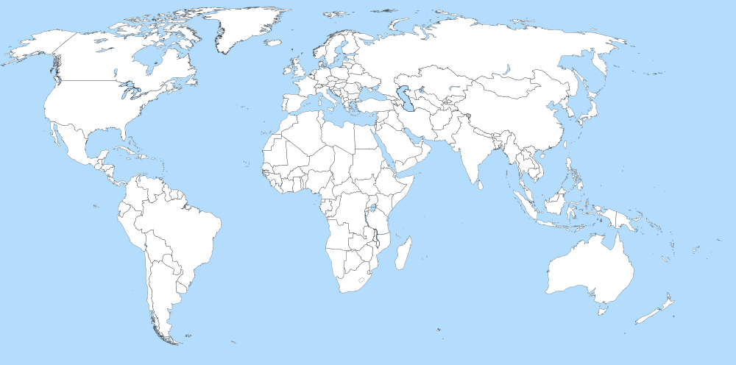
NSE Spectrometers in the World
LARMOR
SESANS
FLEXX
MUSES
J-NSE, RESEDA, MIRA
`
IN11, IN15
VIN-ROSE
SNS-NSE
NG-A NSE
iNSE

Slide 25
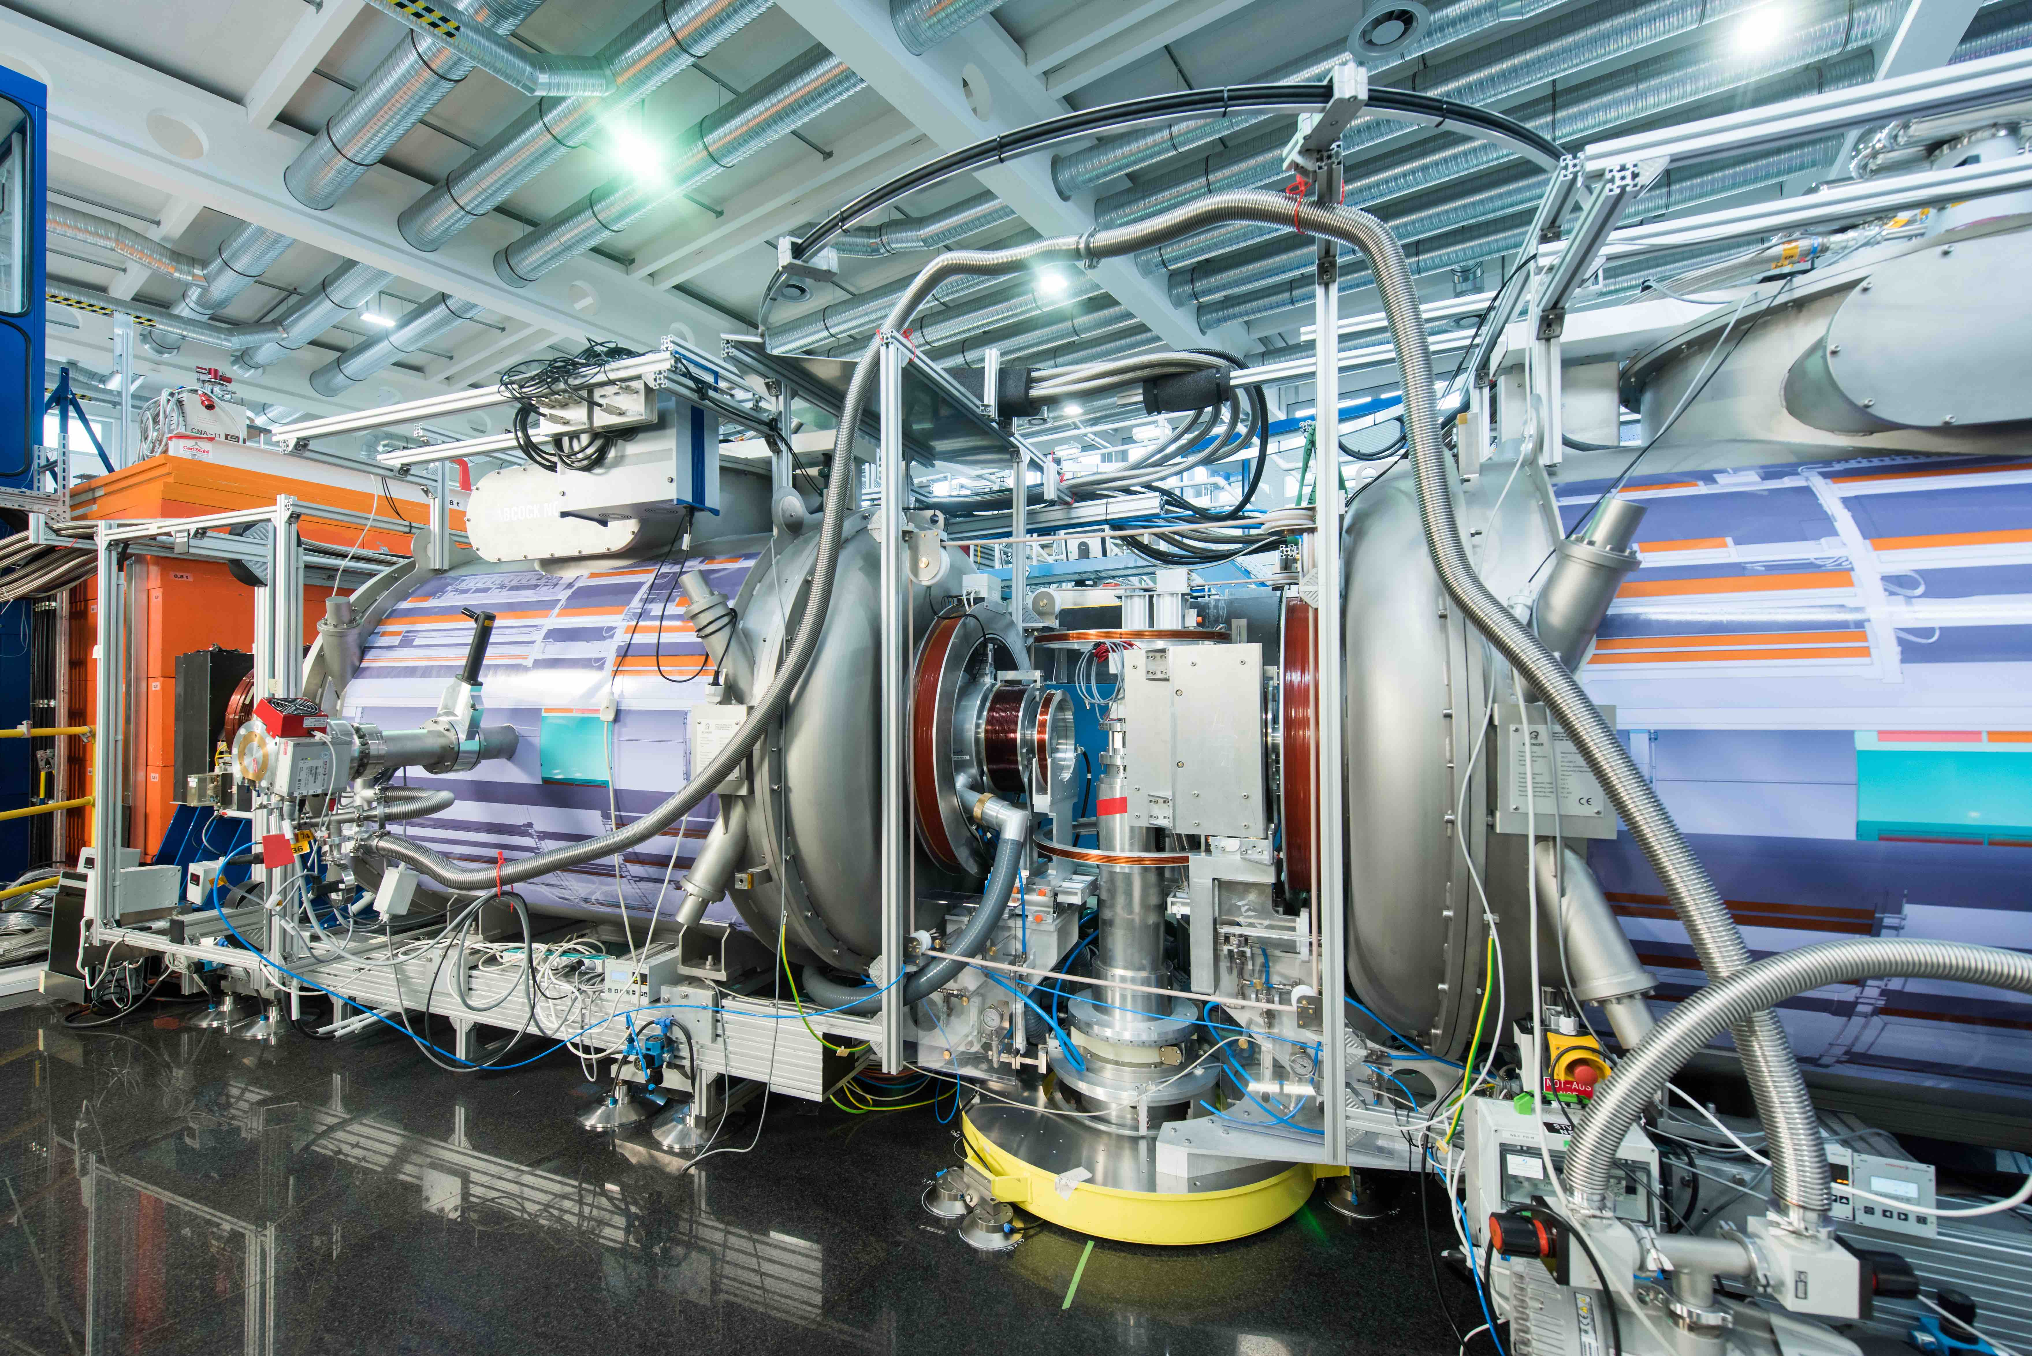
NSE Around the World
IN11C @ ILL
IN15 @ ILL
J-NSE @ FRM II
RESEDA @ FRM II

Slide 26
NSE Spectrometers
Classic “IN11-Type”
IN11 - Institute Laue-Langevin, Grenoble, France
IN15 - Institute Laue-Langevin, Grenoble, France
J-NSE – JCNS hosted by FRM-II, Garching, Germany
NG-A NSE – NIST, Gaithersburg, USA
BL-15 SNS-NSE – JCNS/ORNL, Oak Ridge, USA
C2-3-1 iNSE, ISSP JRR-3M, Tokai, Japan
Other:
MUSES [NRSE] – Laboratoire Léon Brillouin, Saclay, France
RESEDA [NRSE] – FRM-II, Garching, Germany
MIRA [TAS+MIEZE] – FRM-II, Garching, Germany
FLEXX [TAS+NRSE] – HZB, Berlin, Germany
Larmor [SE+SANS] – ISIS, Didcot, UK
SESANS [SE+SANS] – TU Delft, Holland
C2-3-1 iNSE, ISSP JRR-3M, Tokai, Japan

Slide 27
SNS-NSE: NSE Spectrometer at SNS

Slide 28
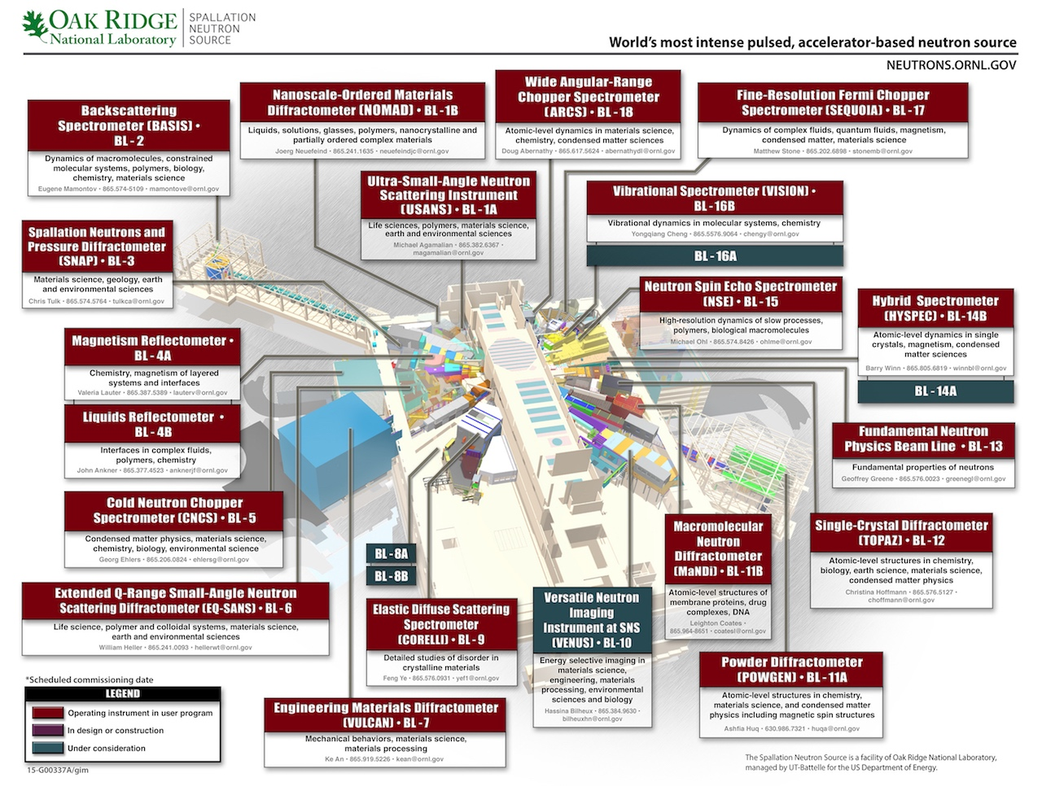
Spallation Neutron Source

Slide 29
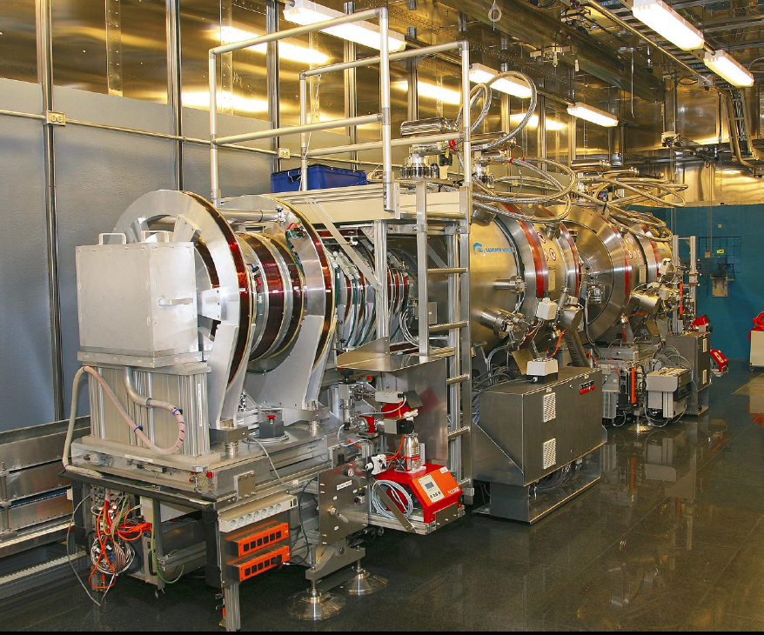
SNS-NSE: IN11-Type NSE
main precession | SC coils, actively shielded
field integral | J = 0.56 Tm
moderator | cold-coupled hydrogen
neutron guide h x b | Ni coated 4 x 8 cm²
wavelength selection | system of 4 choppers
wavelength frame | 2Å < λ < 14Å BW 3.6Å – 2.4Å
declination angle | 3.5°
max. scattering angle | 29/42/56/79° conf. dependent)
sample size | 30 x 30 mm²
analyzer | 3 rotatable supermirrors
temperature range | TFS: -80+375C Cryo: 5K to 650K
moderator - sample distance: → 18 m, 21 m, 24 m, 27 m sample - detector distance: → 4 m | 30x30 cm² ³He DENEX detector → 32x32 pixels TOF up to 99 channels (typical 42) → dλ ~ 0.07Å for @ 42 TOF chan. | mu metal shielding, shielding factor 137 → echo phase stability
main precession | SC coils, actively shielded
field integral | J = 0.56 Tm
moderator | cold-coupled hydrogen
neutron guide h x b | Ni coated 4 x 8 cm²
wavelength selection | system of 4 choppers
wavelength frame | 2Å < λ < 14Å BW 3.6Å – 2.4Å
declination angle | 3.5°
max. scattering angle | 29/42/56/79° (conf. dependent)
sample size | 30 x 30 mm²
analyzer | 3 rotatable supermirrors
temperature range | TFS: -80+375C Cryo: 5K to 650K
moderator - sample distance: → 18 m, 21 m, 24 m, 27 m sample - detector distance: → 4 m | 30x30 cm² ³He DENEX detector → 32x32 pixels TOF up to 99 channels (typical 42) → dλ ~ 0.07Å for @ 42 TOF chan. | mu metal shielding, shielding factor 137 → echo phase stability

Slide 30
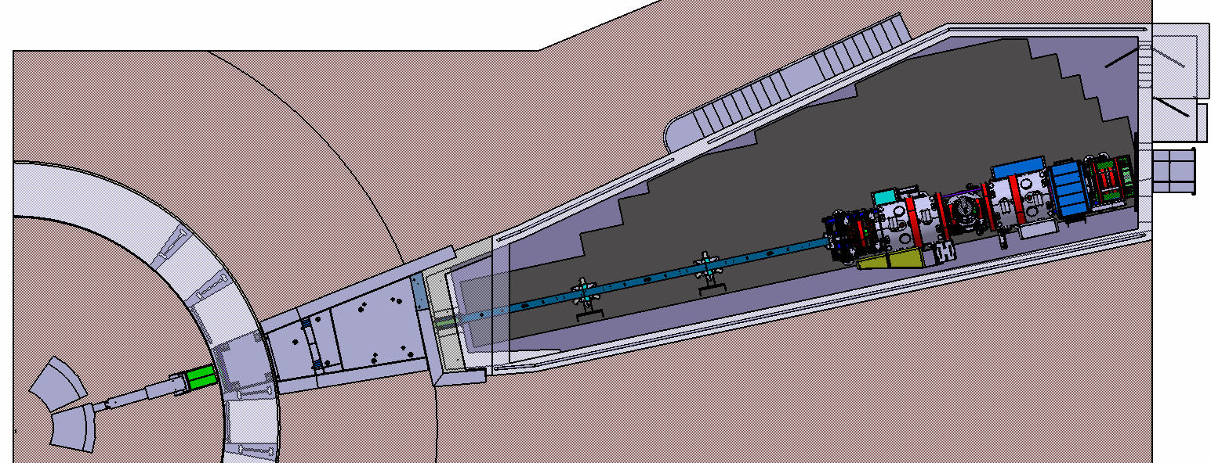
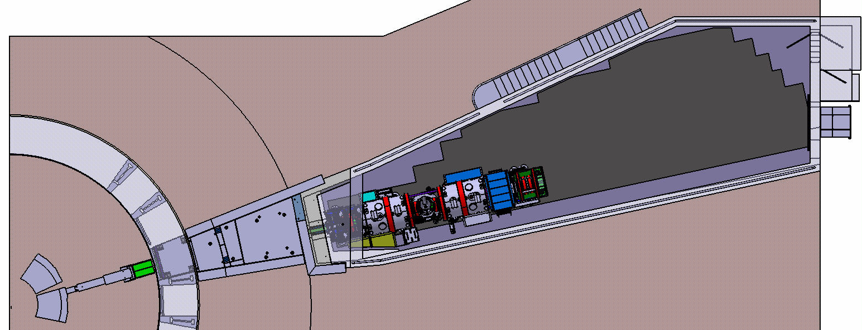
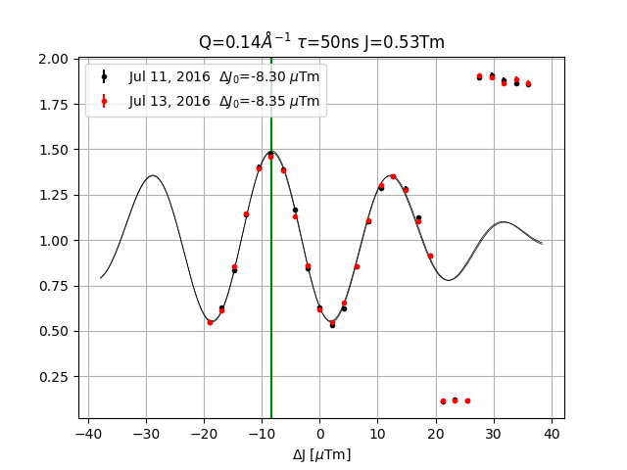
Instrument Layout
Instrument Cave & Magnetic Shielding
Choppers & Polarizers
Phase Stability
Δϕ → 1°

Slide 31
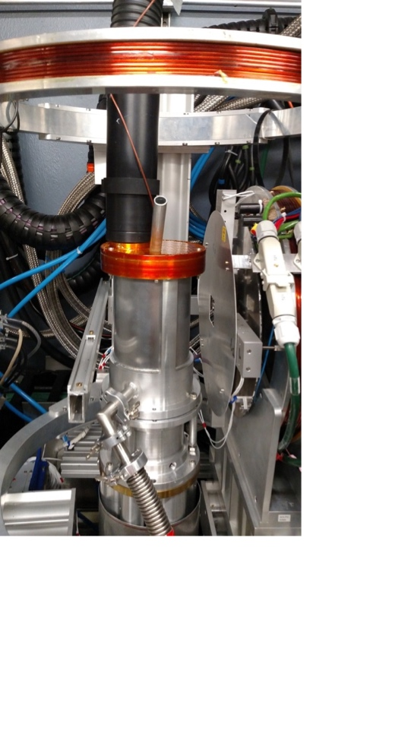
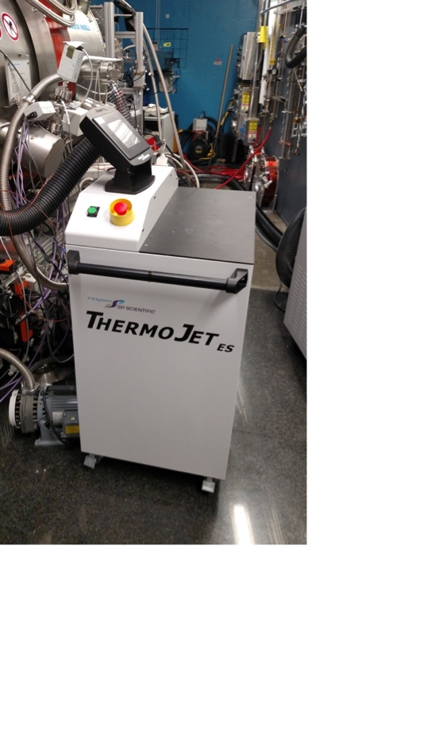
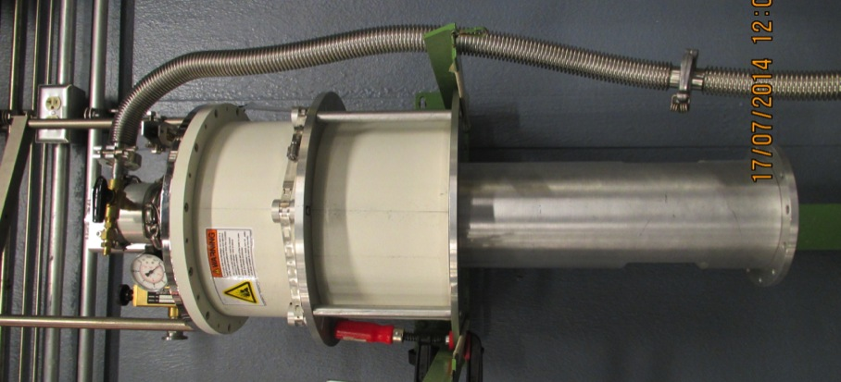
Sample Environment Examples
ThermoJet ES
JANIS CCR Cryostat
T=0 - 130°C
Two samples at a time
Industry Standard
Hot Stick up to 700 K
Cold Stick Down to ~5 K

Slide 32
Examples

Slide 33



SDS Micelles
$$\frac{I\left(Q,t\right)}{I(Q,0)}= e^{−D_{eff}\left(Q\right)Q^{2}t}$$
$$D_{eff}=D_{0}H\left(Q\right)/S\left(Q\right)$$
$$D_{0}=\frac{kT}{6πηR}$$
Stokes-Einstein
J. Hayter, J. Penfold, J. Chem. Soc., Faraday Trans. 1, 1981,77, 1851-1863
Notes:
Sodium dodecyl sulfate (SDS)

Slide 34

Reptation Model
(de Gennes/Doi/Edwards)
Coherent scattering, labeled chain
Melt of long chain linear PEP
$$\frac{S\left(Q,τ\right)}{S(Q,0)}=\left[1−\exp\left(−{\left(\frac{Qd}{6}\right)}^{2}\right)\right]S^{loc}+exp⁡\left(−{\left(\frac{Qd}{6}\right)}^{2}\right)S^{esc}$$
A. Wischnewski et al., Phys. Rev. Lett. 90 (2003), 058301
Notes:
A measurement on a sample with 10% protonated PEP in a matrix of deuterated PEP.
Mw=200 kg/mol
PEP poly-(ethylene propylene)

Slide 35
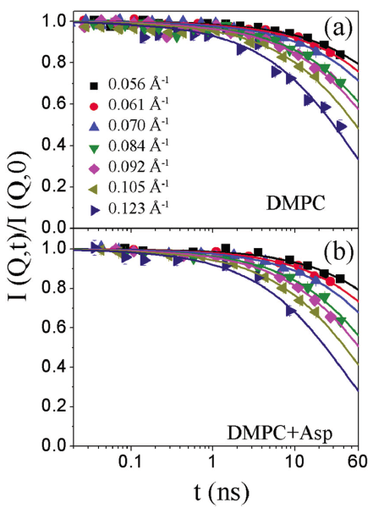
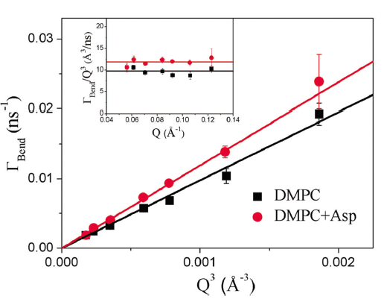
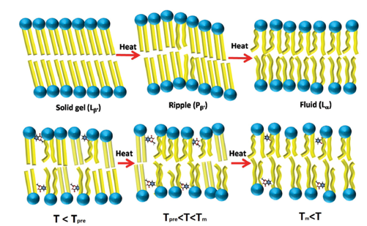
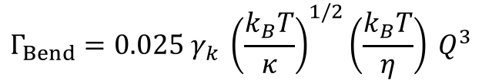
Aspirin modulates the dynamical behavior of membranes
$$\frac{I\left(Q,t\right)}{I(Q,0)}={\exp\left(−{(Γ}_{Bend}t\right)}^{2/3})$$
$$Γ_{Bend}=0.025 γ_{k} {\left(\frac{k_{B}T}{κ}\right)}^{1/2}\left(\frac{k_{B}T}{η}\right) Q^{3}$$
V. K. Sharma et al., Phys. Chem. Chem. Phys. 2017
Notes:
Quasielastic and neutron spin echo (NSE) measurements understand the effect of aspirin, a commonly used NSAID, on the dynamical and phase behavior of the membrane o dimyristoylphosphatidylcholine (DMPC), a prominent representative of phospholipids residing in the outer leaflet of the human erythrocyte membrane. Elastic intensity scans reveal that addition of aspirin not only eliminates the pre-transition (solid gel to ripple phase), but also broadens the main phase transition (ripple to fluid phase) in the membrane - by V. K. Sharma.

Slide 36










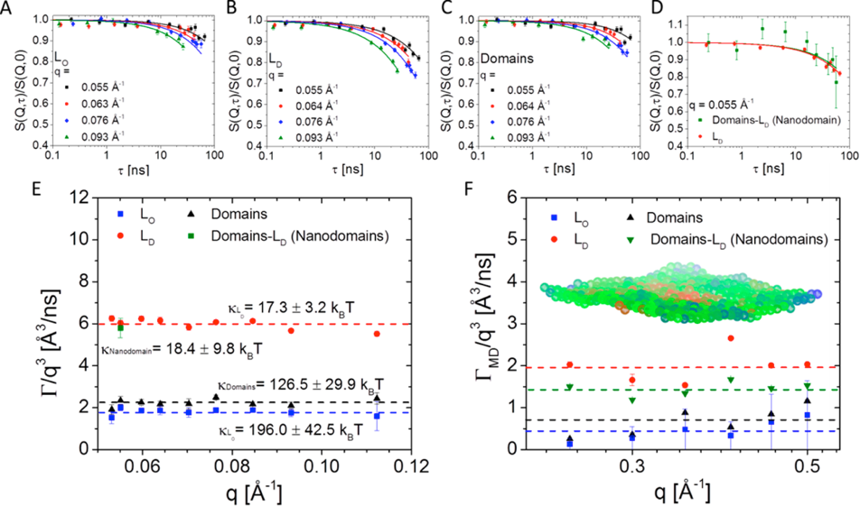


Mechanical Properties of Nanoscopic Lipid Domains
Zilman-Granek Model
$$\frac{S\left(q,τ\right)}{S(q,0)}={\exp\left(−(Γ\left(q\right)τ\right)}^{2/3})$$
$Γ\left(q\right)=0.0058 {\left(\frac{k_{B}T}{κ}\right)}^{1/2}\frac{k_{B}T}{η} q^{3}$
Zilman, A. G., and R. Granek. 1996. Undulations and dynamic structure
factor of membranes. Phys. Rev. Lett. 77:4788–4791.
Max C. Watson†* and Frank L. H. Brown†‡* Biophysical Journal Volume 98 March 2010 L09–L11
J. Nickels et al., J. Am. Chem. Soc., 2015, 137 (50)
Notes:
Lipid raft hypothesis presents insights into how the cell membrane organizes proteins and lipids to accomplish its many vital functions. Combining contrast matching approaches with inelastic neutron scattering bending moduli of lipid domains is calculated - by Jonathan Nickels

Slide 37
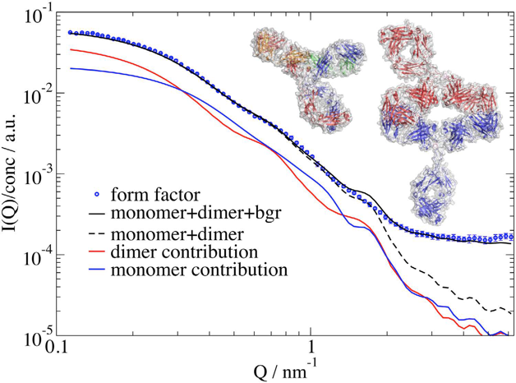

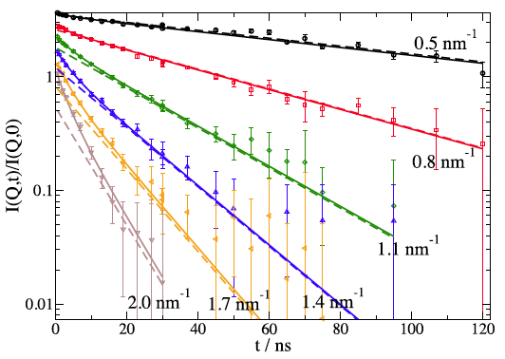
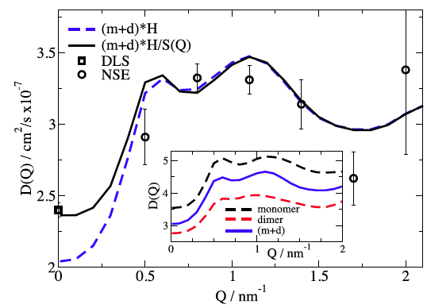

Fast antibody domain motion
L.R. Stingaciu et al. Scientific Reports 2016
Notes:
Using Neutron Spin Echo Spectroscopy we sampled Igg domain motion on a timescale of 7 ns with motional amplitudes of about 1 nm relative to each other. The mechanistic complexity of the linker region was described by a spring model with Brownian motion of the fragments in a harmonic potential. Displacements, timescale, friction and force constant of the underlying dynamics were accessed. The force constant exhibits a similar strength to an entropic spring, with friction of the fragment matching the unbound state. The observed fast motions are fluctuations in pre-existing equilibrium configurations.

Slide 38
Example of Paramagnetic NSE
Courtesy of A. Samarakoon, University of Virginia
Notes:
Spin glass

Slide 39
Summary
NSE
  a high resolution neutron spectroscopy
  measures the intermediate scattering function S(Q,𝜏)
  need large samples, scattering intensity
SNS-NSE (BL-15)
  the first NSE at a Spallation Source
  the first one with superconducting coils
  the only one with magnetic shielding
  available in user program – write a proposal!!
  see http://neutrons.ornl.gov/nse
Acknowledgements: M. Monkenbusch, D. Richter, L. Stingaciu, M. Cochran, G. Ehlers, W-R Chen, T. Kozielewski, M. Ohl, N. Arend and M.Sharp

Slide 40
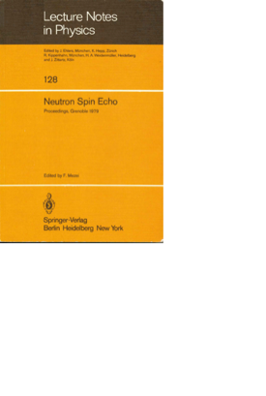

Literature
R. Pynn, Neutron Scattering, Neutron Spin Echo http://www.iub.edu/~neutron/notes/20061204_Pynn.pdf
F. Mezei, Z. Physik (1972) 255: 146.
F. Mezei (Ed.): Neutron Spin-Echo, Lecture Notes in Physics 128, Springer, 1980.
F. Mezei, C. Pappas, T. Gutberlet (Eds.): Neutron Spin-Echo Spectroscopy, Lecture Notes in Physics 601, Springer, 2003.
D. Richter, M. Monkenbusch, A. Arbe, J. Colmenero, Neutron Spin Echo in Polymer Systems, Adv. in Polymer Science 174, Springer, 2005
M. Monkenbusch, D. Richter, High Resolution Neutron Spectroscopy http://doi.org/10.1016/j.crhy.2007.10.001
C.Pappas, G. Ehlers, F. Mezei, Neutron Spin Echo and Magnetism in Neutron Scattering from Magnetic Materials, ed. T. Chatterji, Spinger 2006
B.Farago, Basics of Neutron Spin-Echo, ILL Neutron Data Booklet, https://www.ill.eu/fileadmin/users_files/documents/links/documentation/NeutronDataBooklet.pdf
G.L. Squires, Introduction to the Theory of Thermal Neutron Scattering, Cambridge Univ. Press, 3rd edition (2012)
Notes:
M. Bee: Quasielastic Neutron Scattering, Hilger, Bristol, 1988.
S. Lovesey: Theory of Neutron Scattering from Condensed Matter, Vol. 2, Clarendon Press, Oxford, 1986.

